Slide 1

ACTIVE Memory Works®: Web-based Memory Training for Healthy Cognitive Aging
George W. Rebok, PhD
Translating Healthy Aging Research Findings into Practice
2016 Symposium for State and Local Commissions on Aging
Laurel, MD
September 22, 2016

Slide 2
Why memory training is important
“To live is to remember and to remember is to live.”
- Samuel Butler
65+ population is growing
20% of population (72 million) by 2030 in the U.S.
87% of older adults do not have dementia diagnosis (Wagster, King, Resnick, & Rapp, 2012)
Cognitive decline occurs in normal aging
1 in 4 adults 70 years or older have an impairment without dementia
Normal cognitive decline results in loss of everyday function
Cognitive decline is most feared aspect of growing older
Drug trial results are disappointing

Slide 3
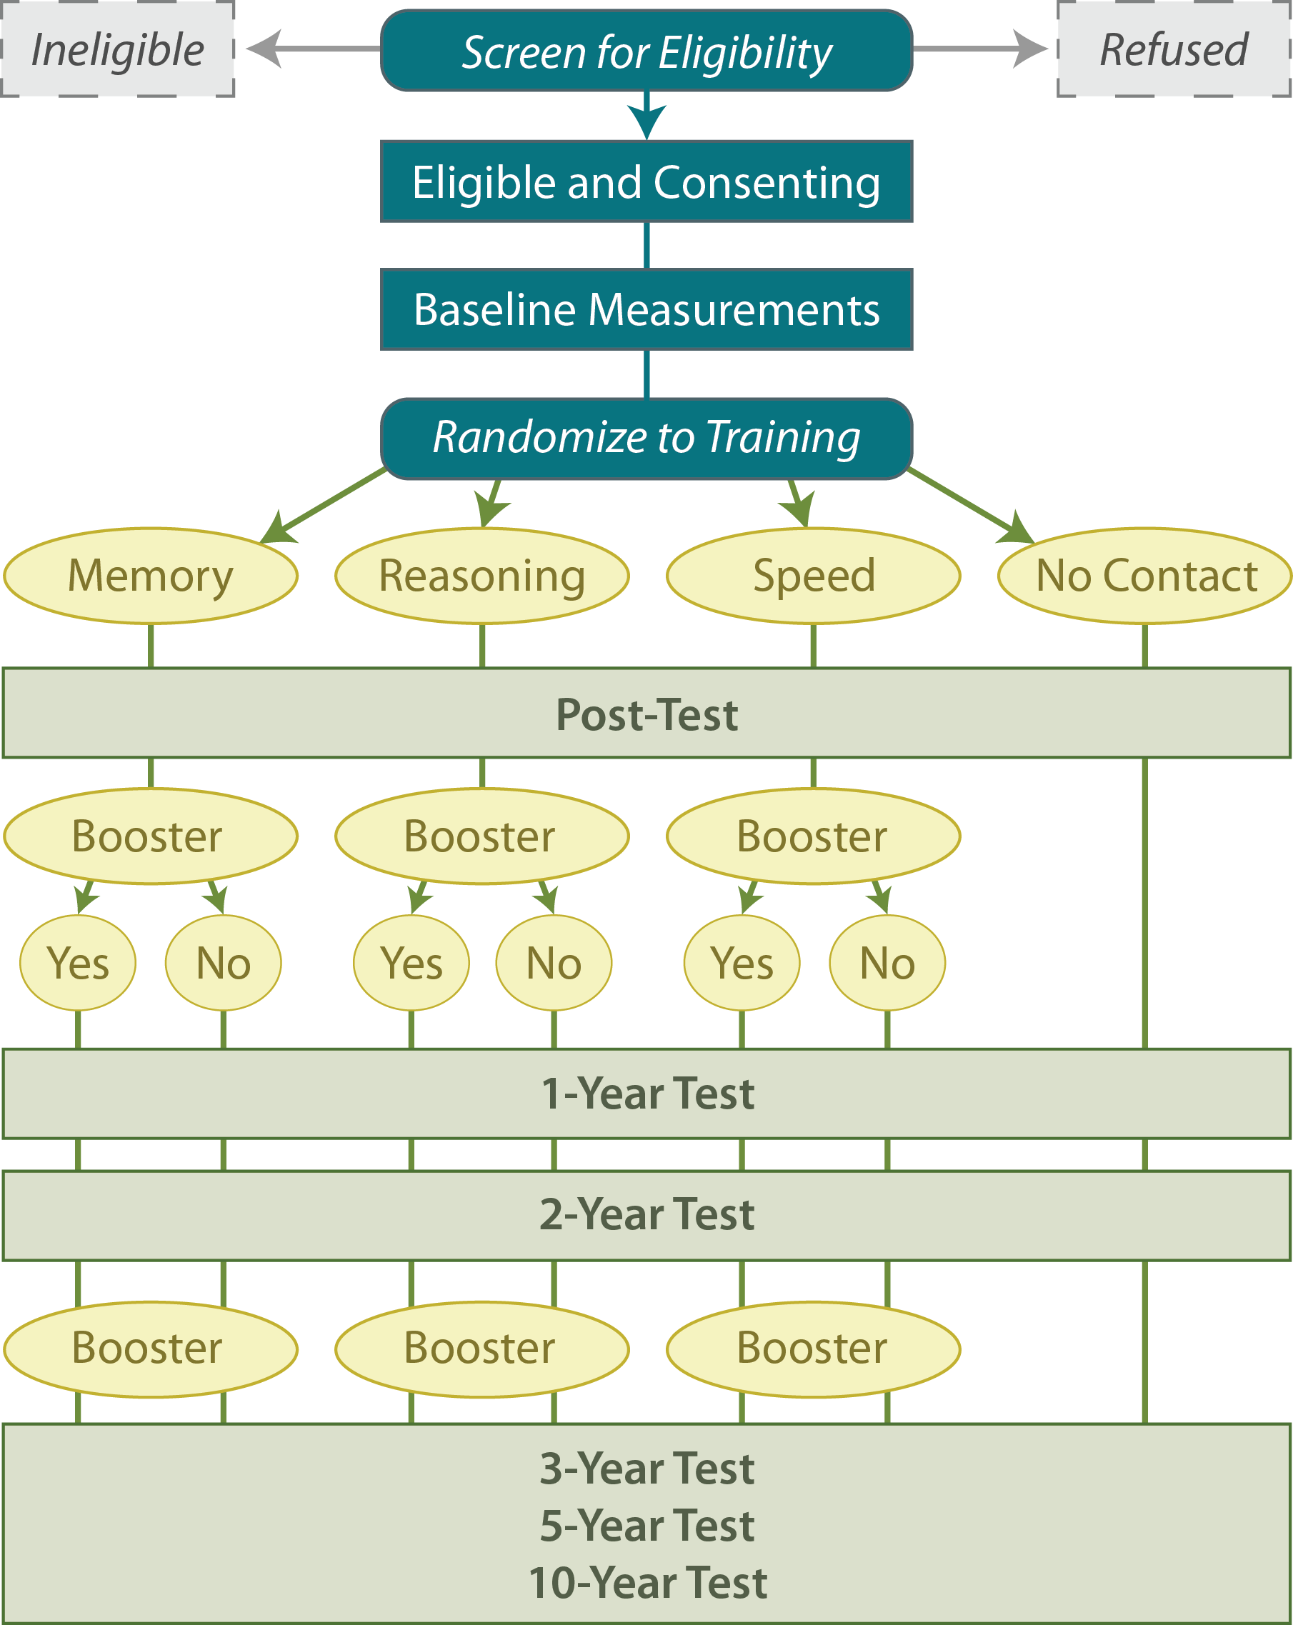
ACTIVE Trial
RFA initiated by NIA and NINR
ACTIVE - Advanced Cognitive Training for Independent and Vital Elderly
Randomized controlled clinical trial
6-site intervention protocol with proven cognitive interventions (memory, reasoning, processing speed)
N = 2802. Mean age 74 (range: 65-94); 76% female and 26% African American; median 13 yrs education
No evidence of substantial cognitive or functional decline
ACTIVE’s Primary Aim
Test the efficacy of three cognitive interventions to improve or maintain cognitively demanding activities of daily living.
Notes:
3
The present study sample consists of 1,401 OA aged 65-94 at BL, most were female and white with a HS education.
ACTIVE spurred a new generation of cognitive training that looked beyond proximal cognitive outcomes and out to functional outcomes.
GEORGE: You probably have an updated graphic showing AN10.
3

Slide 4
Training Effect Sizes at 5 Years (JAMA 2006)

Slide 5
ACTIVE Memory Works®: Unique Features
Not only give older adults practice using their memories, they teach the person new ways to remember.
Will be able to be used by care providers as a training tool and also by older adults for practice in the home.
Is based on scientific research and development; research funded by the NIA (R21AG042554-01) and Johns Hopkins School of Nursing, Center for Innovative Care in Aging grant awards

Slide 6
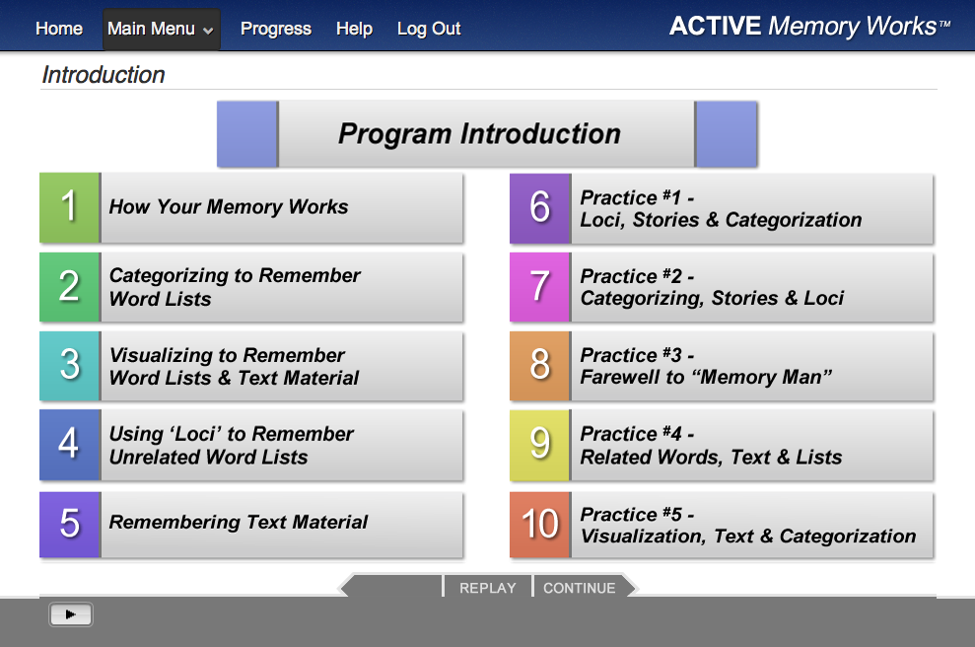
Statement of the problem/challenge
NIA R21 grant in response to PA-11-124 Translational Research to Help Older Adults Maintain Their Health and Independence in the Community
To fully develop and test the ACTIVE Memory Works (AMW) web-based memory training intervention for older adults
To compare the efficacy of the AMW to the ACTIVE paper-and-pencil memory training intervention
To longitudinally assess and compare the maintenance of training gains on memory abilities and everyday function over a 6-month period in the two training groups
CENTER Pilot Award
To conduct a small-scale, multi-stage pilot study of the AMW intervention in order to test its usability, feasibility, and acceptability in a sample of cognitively intact, community-dwelling older adults

Slide 7
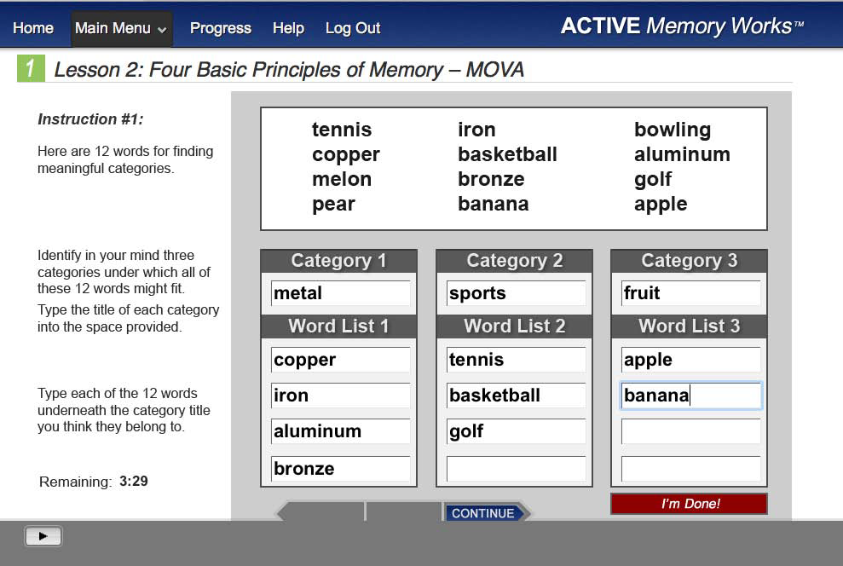

Slide 8
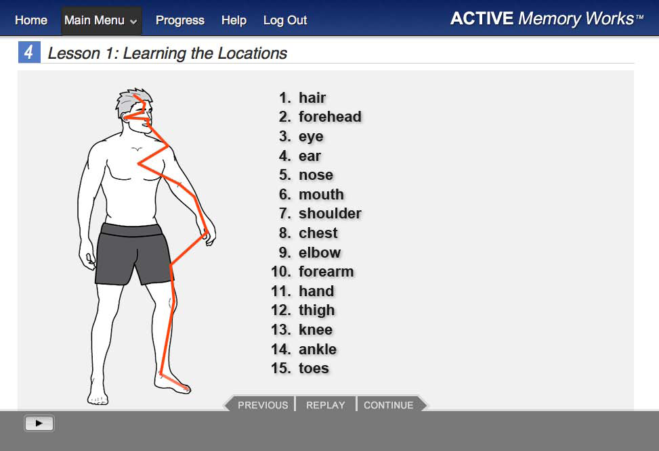

Slide 9
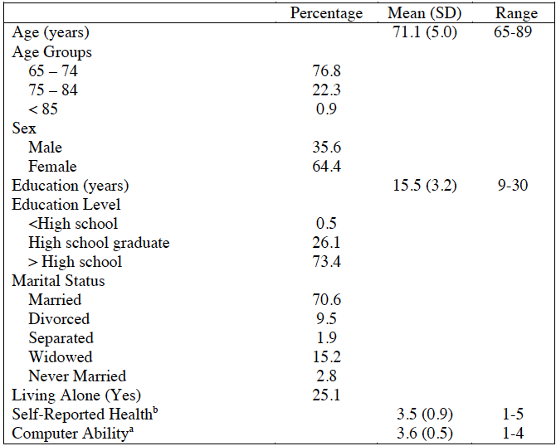
Participant Characteristics (N=211)
ªComputer ability was measured by whether the participant can do up to four computer tasks without assistance (1=Yes,
0=No). The computer tasks include sending email, surfing the internet, using word processing software, and playing games
on a computer (e.g., solitaire).
^{b}Self-reported health was measured by the first item in SF-36, “In general, would you say your health is: Poor=1, Fair=2,
Good=3, Very good=4, Excellent=5.”

Slide 10
Memory Outcome: Rivermead Test
Baseline → Post Intervention
[0 = Control, 1=Classroom, 2=Internet]

Slide 12
Satisfaction Among the Internet Group [1=Strongly disagree to 5=Strongly agree]
 | Mean (SD)
Overall satisfaction (36 items) | 4.16 (0.55)
Selected Items
I liked the overall concept of the ACTIVE Memory Works Program | 4.36 (0.94)
I look forward to going through the ACTIVE Memory Works internet program again when it becomes available | 4.17 (1.13)
I would recommend the ACTIVE Memory Works Program to my friends | 4.47 (0.92)
I now have a better understanding of how my memory works after completing the program | 4.24 (0.96)
The ACTIVE Memory Works Program kept my interest | 4.52 (0.79)

Slide 13
Thank you!
grebok1@jhu.edu

