Slide 1




Overview of the Baltimore Experience Corps® Trial
Michelle C. Carlson, PhD & George W. Rebok, PhD
Johns Hopkins Bloomberg School of Public Health
Department of Mental Health, Center on Aging
September 22, 2016
Symposium for State and Local Commissions on Aging
Maryland Commission on Aging

Slide 2
The Experience Corps (EC) Program
A model of senior service and health promotion that simultaneously creates generative roles for older adults while meeting unmet needs of public elementary schools.
Designed in 1994-1995 and evaluated in 2000-2002 (Fried et al., 2004; Rebok et al., 2004; Frick et al., 2004; Glass et al., 2004; Tan et al., 2006)
1995-8: National demonstrations, 5 cities; sponsored by Corporation for National Service (CNS)
Results of 4-7 month pilot trial & imaging study showed EC-related improvements among older adults in:
Mobility and Physical Function (Fried et al., 2004; Tan et al., 2009)
Executive Function among highest risk (Carlson et al., 2008)
Improved Brain Function (Carlson et al., 2009)

Slide 3
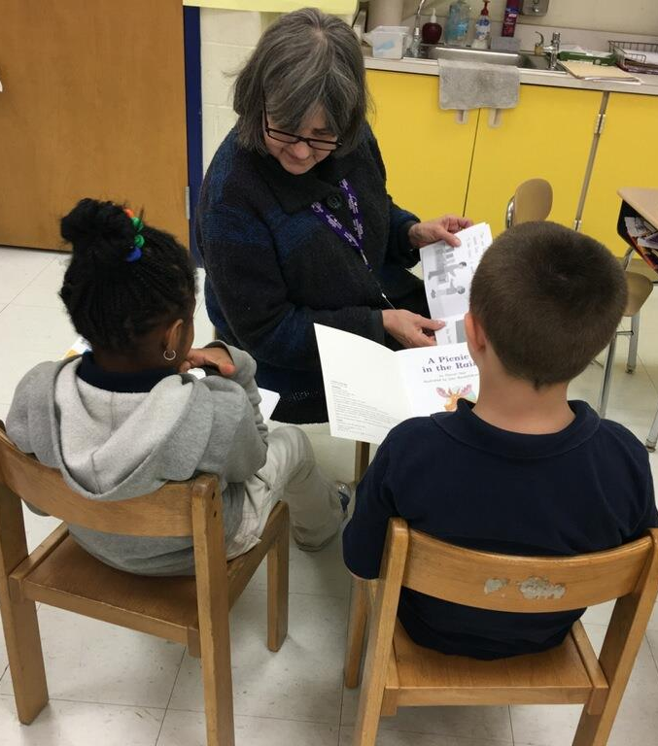
AARP Experience Corps
2011: AARP
2015: AARP Foundation
Social Innovation Grant
Evaluation of small group intervention model
2016
21 local Programs
4 “Branches”
2063 Volunteer Tutors
30,162 Students
Notes:
I will kick things off with were we are going– talking about our path—where we are going with our external evaluation efforts including how our current EC implementation evaluation informs our upcoming SIF evaluation, and then turn it over to our external evaluation partners, Abt Associates and our Project Director Cat Darrow and Principal Investigator Allan Porowski to talk about what we are learning through the current EC implementation evaluation.

Slide 4

Experience Corps Model
Volunteers 60 and older
Serve in public elementary schools: Kindergarten-3
Meaningful roles
High intensity: >15 hours per wk
Reimbursement for expenses (lunch, transit)
Sustained dose: full school year
Critical mass, teams to shift outcomes for schools
Healthy behaviors: physical, social & cognitive activity
Leadership opportunities
Infrastructure to support program
Program evaluation

Slide 5
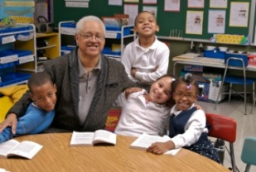
Meaningful Roles for Older Volunteers
Academic support:
Literacy support
Opening/maintaining school libraries
Math support
Behavioral support:
conflict resolution, positive attention
School attendance
Parental outreach
Public Health: Asthma club

Slide 6
Bringing Generations Together to Thrive: Intergenerational Win-Win
Win: Children and schools
Improved academic and behavioral outcomes
Improved school climate
Improved teacher retention
Win: Our aging population
Opportunity to “give back”
Decrease adverse health outcomes
Demonstrate benefits of an aging society

Slide 7
Hypothesized Causal Pathways of Benefit
Performance-based measures Secondary outcomes
Primary/ [Self Report] Outcomes
Primary Pathways
Intervention
Mechanisms
Falls
Strength, balance
Physical Activity
Walking Speed
↑ or preserved function or delayed decline in:
Experience Corps Participation-
Generative Role Performance
Frailty
Brain
plasticity;
Executive function
Mobility Function
Cognitive Activity
Memory
IADLs
Social Integration & Support
Generativity
Social Activity, Engmnt.
Psycho-Social Well-being

Slide 8
Findings I’ll summarize today
Carlson et al. (2015)
Physical activity
Brain
Health
Varma et al. (2016)
BECT intervention
Social Engagement
Cognitive outcomes
Parisi et al. (2014)
Cognitive Stimulation
Carlson et al. (under review)

Slide 9
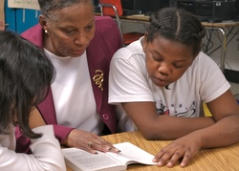
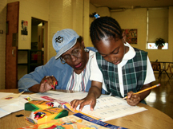
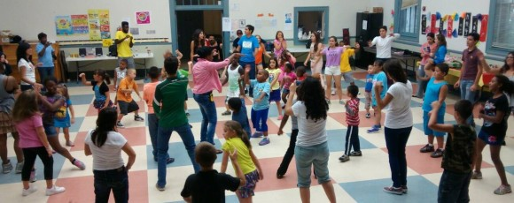
Baltimore Experience Corps Trial
Randomized: 702 older adults to EC or low-activity control over 4 years (waves)
Demographics:
x age= 67.4 yrs -- 85% female -- 95% African American – 56% > HS
33% diabetes -- 70% hypertensive
Women at greater baseline risk than men (MMSE, education, income, & BMI)
Exposure: up to 2 years of high-intensity service in 1 of 25 public elementary schools
Brain Health Substudy (N=115)
MRI: Cortical & Hippocampal volumes
Objective Physical Activity
Fried, Carlson, McGill, Seeman, Xue …Rebok, 2013

Slide 10
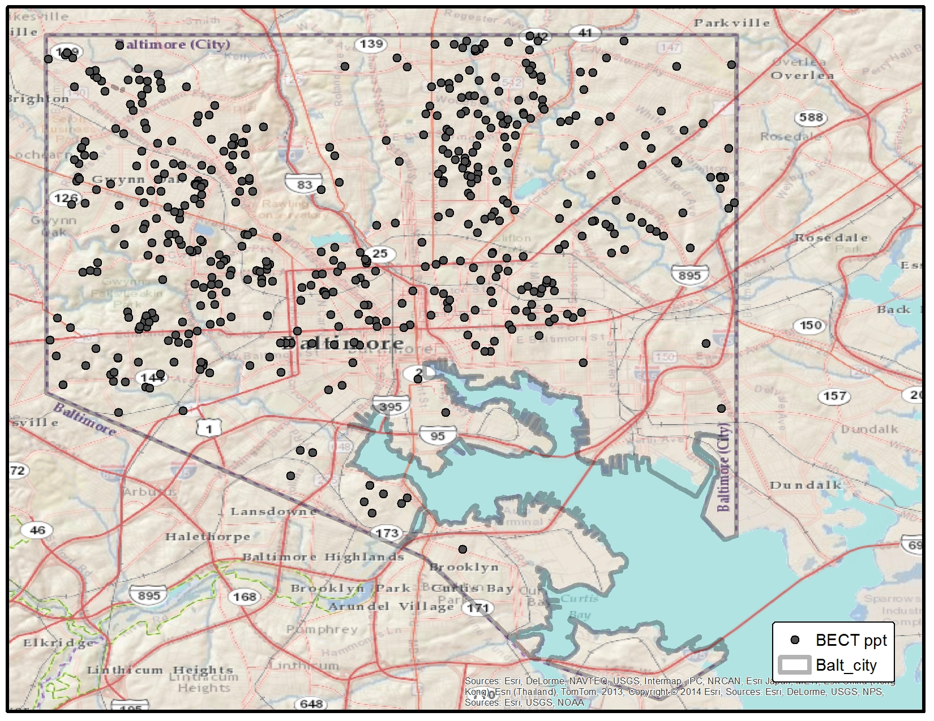
Distribution of BECT participants across Baltimore City

Slide 11
Did EC Increase Lifestyle & Cognitive Activity? Yes. EC volunteers report half a day/month increase in overall activity level, especially in intellectual (e.g., playing games) and physical activities (e.g., gardening) 12-months post-baseline. There were no significant interactions by sex.
Note. *All models adjusted for age, sex, education, major morbidities, depressive symptoms, cohort, baseline LAQ
Parisi, Kuo, Rebok, Xue, Fried, Gruenewald, Huang, Seeman, Roth, Tanner, & Carlson, 2015

Slide 12

Did EC Increase Daily Physical Activity Following Program Participation? Step Activity (BHS N=115):
Women in Experience Corps maintained average steps/day over 24 months post-Intervention while Controls declined.
Men had significantly higher baseline levels of daily physical activity than women and maintained these levels.
Women
Men
Varma, Tan, Gross, Harris, Romani, Fried, Rebok, Carlson, 2015 AJPM

Slide 13
Does Experience Corps Lead to Changes in Brain Health? Hippocampal & Cortical Volumes
Men in the Experience Corps arm showed a 0.8-1.6% increase in total cortical and hippocampal brain volumes v. declines in controls.
Women in Experience Corps also tended to exhibited modest gains of 0.3-0.54% by 24 months of exposure.
2-year improvement in memory related to 2-year increase in whole brain volume in EC (blue.
Carlson, Kuo, Chuang, Varma, et al., 2015 Alz & Dementia

Slide 14
Conclusions: A Qualified Win-Win
1st known evidence that a community-based, intergenerational volunteer program:
Increases lifestyle and objective physical activity outside of the program
simultaneously impacts in men executive function and memory
brain regions important to memory and risk for Alzheimer’s disease
Effects greater in men than in women
Baseline differences (chronic disease burden, physical activity, and physical function)
Intervention differences (different roles within the schools) (see Varma et al. Gerontologist. 2014)
Duration-dependent: trends emerged as significant by the 2nd year

Slide 15

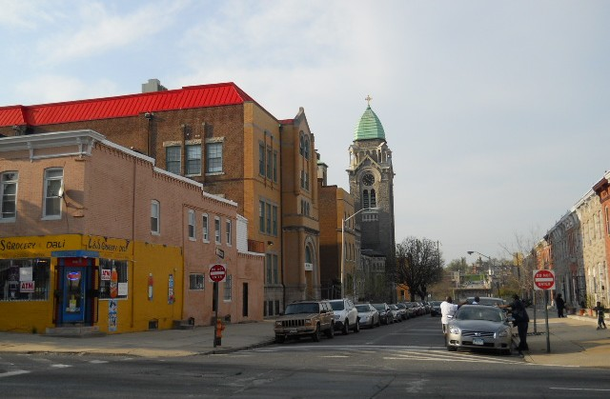
Exploring Further Why Women in EC May Show increases in Activity but not Cognition
Difficulties in reaching PA targets for older adults; particularly those of with poor health and low socioeconomic status (SES)
Here, looking beyond environment to purpose may be key to moving
Sources: HHS: Health People 2020; Tudor-Locke & Basset, 2004; PAG Report, 2008; Marshall, et al. 2007; Parra-Medina, 2010

Slide 16
It Takes a Village: Research Team and Collaborators
Jeremy Barron - JHU
Michelle Carlson - JHU
Yi-Fang Chuang - Natl Yang Ming U
Kay Dickersin - JHU
Kirk Erickson - U Pittsburgh
Constantine Frangakis - JHU
Linda Fried - Columbia U
Kevin Frick – JHU
Alden Gross - JHU
Tara Gruenewald – USC
Jin Huang - JHU
Arthur Kramer - Northeastern U
Sylvia McGill - EC Baltimore
Jeanine Parisi - JHU
Christine Ramsey – VA CT
George Rebok - JHU
William Romani – AARP
David Roth - JHU
Roberta Scherer - JHU
Teresa Seeman - UCLA
Erwin Tan – AARP
Elizabeth Tanner – JHU
Vijay Varma – NIA, LBN
Keith Whitfield – Wayne State U
Paul Willging - JHU
Qian-Li Xue - JHU
Funded by grants from the National Institute on Aging P01AG027735-03, Weinberg Foundation, Erickson Foundation, Johns Hopkins Claude D. Pepper Center, Johns Hopkins Neurobehavioral Research Unit, Alzheimer’s Drug Discovery Foundation, and AmeriCorps

