Slide 1
Building Community to Support Aging
Maryland Commission on Aging
September 10, 2014
Candace Baldwin
Director of Strategy, Aging in Community

Slide 2
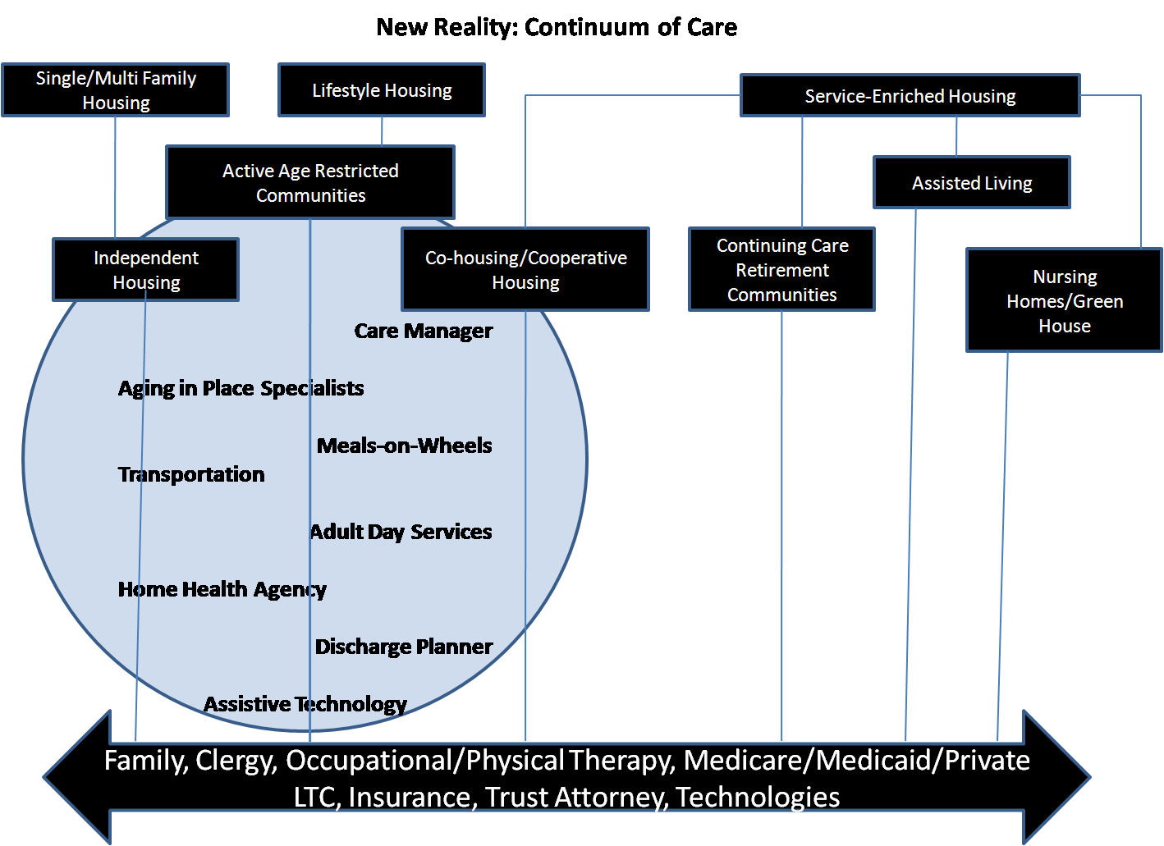
Villages

Slide 3
Cross Sector Coordination is a Foundation
Element | Features
Basic Needs -- Safe, Accessible, and Affordable | Accessible and affordable housing and community areas Provides information about services Fosters safety
Community Engagement | Fosters meaningful connections Promotes active community engagement Opportunities for paid or volunteer work
Health and Well Being | Facilitates access to medical and social services Promotes health behaviors Supports community activities that enhance well being
Independence and Autonomy | Mobilizes in-home supports and services Coordinates or offers transportation Supports family and other caregivers

Slide 4
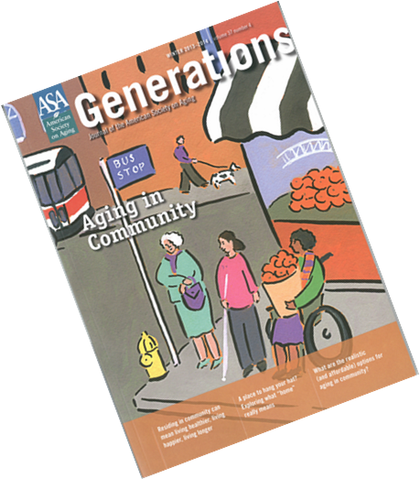
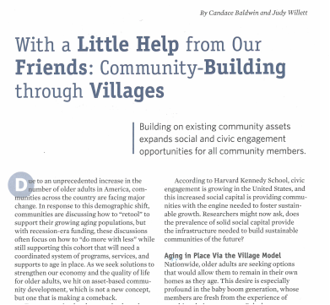

New Way to Define Social Networking
Research beginning to identify importance of social connections on health outcomes
Aging in community best chance to remain connected
Aging in Community vs. Aging in Place
ACA
focus on care and systems coordination
home and community based services

Slide 5
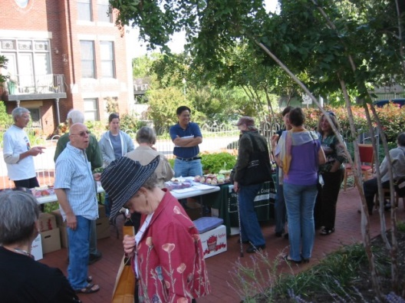
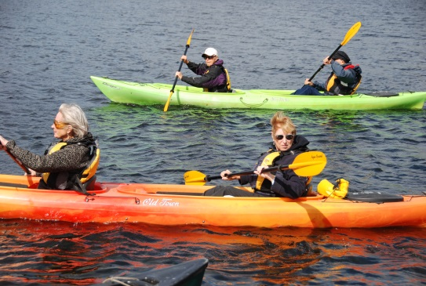

Aging In Community Principles
Experience of aging - positive interactions and collaboration in shared interests and pursuits
Relationships between community members - informal, voluntary, and reciprocal
Social capital— a sense of social connectedness and interdependence
Asset-based approach to community development creating “social architecture”
Notes:
(Thomas and Blanchard, 2009). while addressing the challenges and needs
of the community and individuals (Kretzmannand and McKnight, 1993).
therefore, sustainable over time.
Social Architecture - builds on individual and group gifts, interests, and experience,

Slide 6
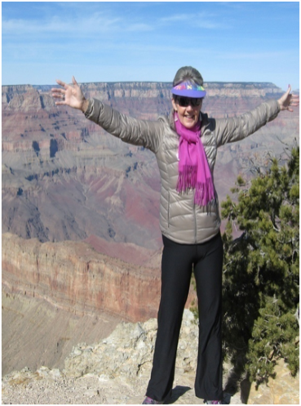
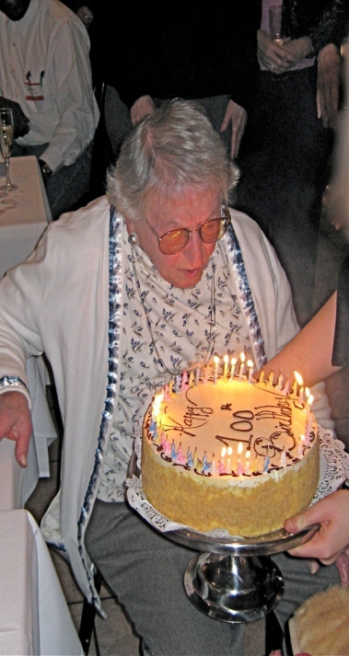
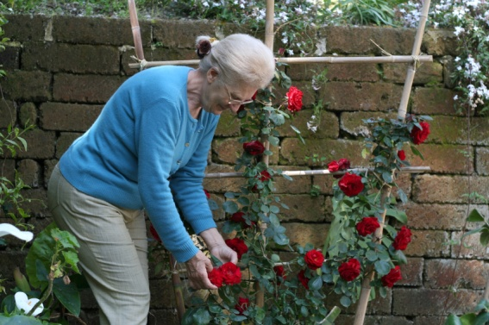
Aging in Community: Person Centered
Sense of Belonging
A place where I can be myself
Mutual Support
A place where I can give and get support
Greater Influence
High level of self efficacy and worth
Exploration
A place where I can explore new ideas/activities
Notes:
Increased focus on comprehensive care coordination at community based level
Increased community based programs will be needed at a time when funding has been cut
Villages can provide connection to a wide array of services that support aging in community
Opportunity to build community connections to promote health wellness and prevention
Villages can provide a cadre of volunteers to assist providers to address needs of residents

Slide 7
Value of Peer to Peer Supports
Critical and effective strategy for ongoing health care and sustained behavior change – chronic disease, cancer, diabetes, weight-loss
Overall, studies have found that social support:
decreases morbidity and mortality rates
increases life expectancy
increases knowledge of a disease
improves self-efficacy
improves self-reported health status and self-care skills, including medication adherence
reduces use of emergency services
Source: Peers for Progress

Slide 8
Villages Provide Mechanism to Support Aging in Community
Livable, Age Friendly Community
Support Individuals to reach highest potential
Platform for local policy/program innovation
Village Builds Strong Communities
Local Leadership Development
Health and Wellness
Resources to stimulate growth
Economic and Community Development
Model for successful aging
Notes:
Livable, age-friendly community
Infrastructure needed from local government
Members = key informers
Non-medical, social supports
Member services provide comprehensive supports
Single point of entry
Encore career and volunteer opportunities
Value add to support social engagement
Value to local economy
Supports and Services
Provide one stop, one call for community members
Facilitate connection to existing community services
Assist members to navigate medical, non-medical and social support needs
Membership Plus model provides affordable memberships
Village guiding principles provide platform for innovation
Visibility to assist older adults to “re-imagine” their older years
Foster mobilization of older adults at local level in aging issues through a consumer driven model

Slide 9
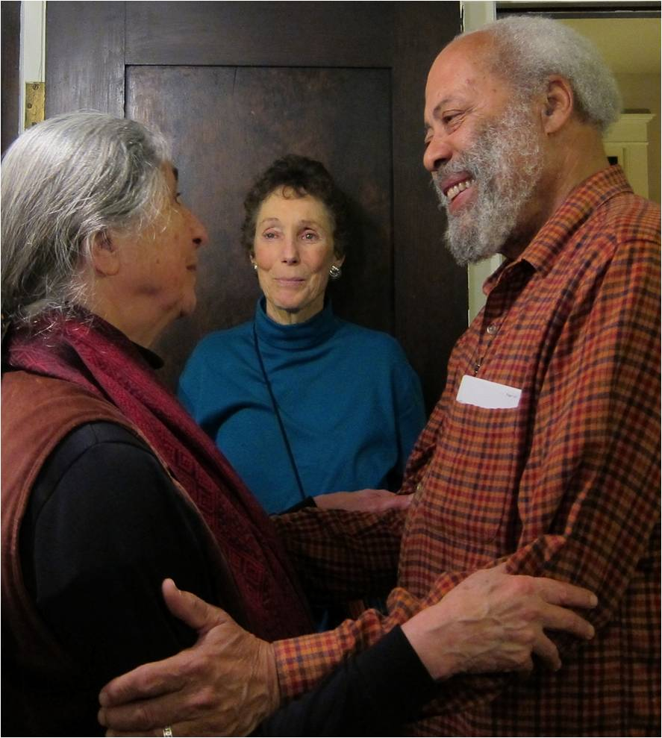
Villages Foster a Strong Sense of Community
Combination of paid staff, volunteers and community-based partnerships:
Facilitate connection to existing community services
Assist members to navigate medical, non-medical and social support needs
Create social networks and expand social capital to support aging in community
51% of Village members volunteer for their Village – truly “neighbor helping neighbor”
Notes:
Membership Plus model allows for Medicaid eligible individuals to participate
13% of members have discounted memberships = 1 in every 8 Village member is low income

Slide 10
Village Member Benefits can Complement Medicaid-Financed Services
Assistance with Medical Care Access and Coordination
Villages provide support to members with navigating medical services through case management, care coordination and/or medical advocacy
Person Centered, Consumer-Directed
Deliver services when and where people overwhelmingly want to be supported – in their own homes and communities – and not in facilities or campuses that isolate them from mainstream life
Augmentation of Medicaid
Wrap around Medicaid-financed long-term supports

Slide 11
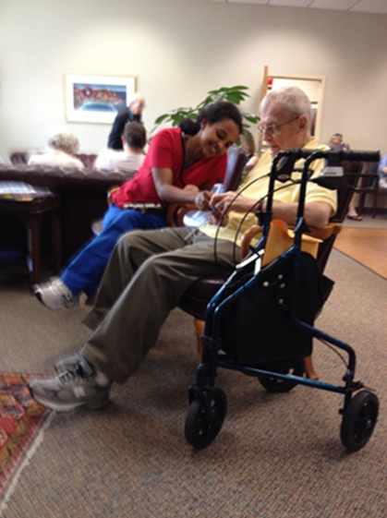
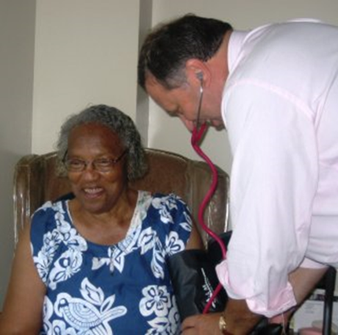
Connecting Local Innovations with National Priorities
Villages partnering to reduce hospital readmissions and increase patient engagement
Care transitions - Newton at Home – Newton, MA
Key to reducing hospital readmissions
Measuring impact of Village
Village Connections – Capitol Hill Village – Washington DC
Functional limitations, health crises impede the member’s ability to request a service or to follow through with volunteer or vendor services independently
Frequent and sustained requests to duplicate services that exist in the community

Slide 12
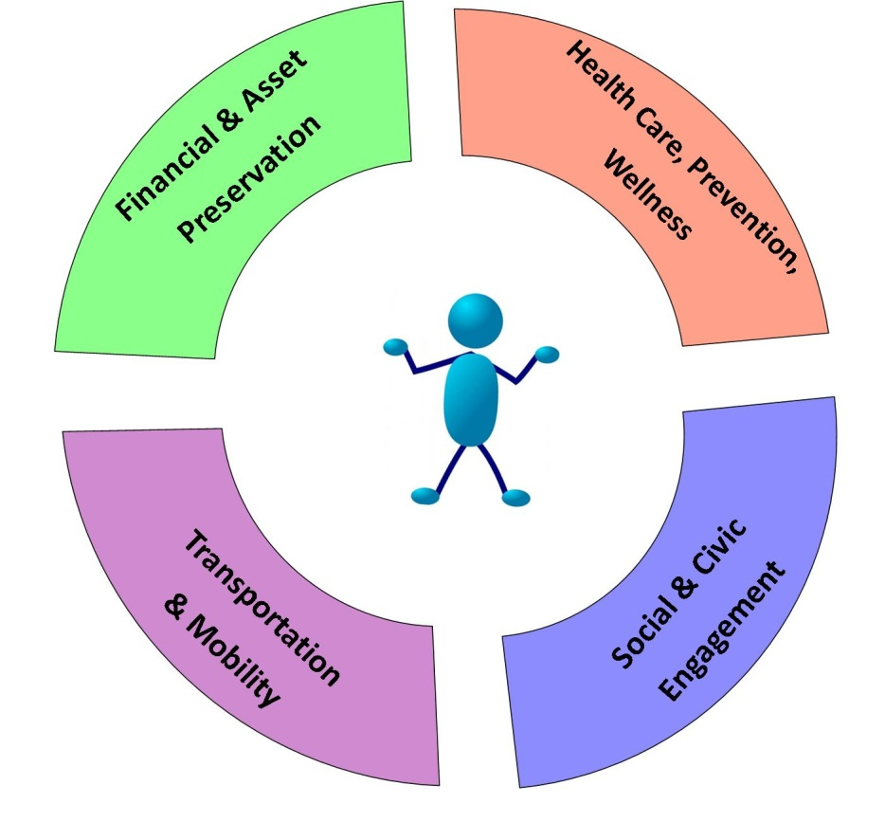
Creating a Vision of Comprehensive Aging Services
Individuals and Caregivers
Better health, prevention and wellness through social engagement outlets
Individualism + active lifestyle = not “old”
Impact on connection of health and social support
Increase awareness and ability to navigate system
Local and Community Providers
Identify and champion individual preference
Increased focus on prevention/wellness
Identify and embrace connection of social and health interventions
Notes:
What is the market??? Who benefits? Who can stand to invest in the solution?
Support for caregivers
Mitigate hospital recidivism

Slide 13
For More Information
www.capitalimpact.org
Candace Baldwin
Director of Strategy, Aging in Community
cbaldwin@capitalimpact.org

