Slide 1
Maryland Communities for a Lifetime
Lori Simon-Rusinowitz, PhD
Kathy Ruben, PhD Candidate
Raphael Gaeta, MSW
University of Maryland School of Public Health
Department of Health Services Administration and Center on Aging
College Park, MD
LASR@umd.edu
Maryland Commission on Aging
September 12, 2013
Annapolis, Maryland

Slide 2
Agenda
Introduction: Who can Benefit from Maryland Communities for a Lifetime?
The Importance of Age-Friendly Communities
What is a Community for a Lifetime?
Communities for a Lifetime in Other States
Home and Community Based Services: The Heart of Communities for a Lifetime
Initiatives on Age-Friendly Communities
University of Maryland Pilot Project in Prince George’s County
Discussion

Slide 3
Introduction:
Who can Benefit from Maryland Communities for a Lifetime?

Slide 4
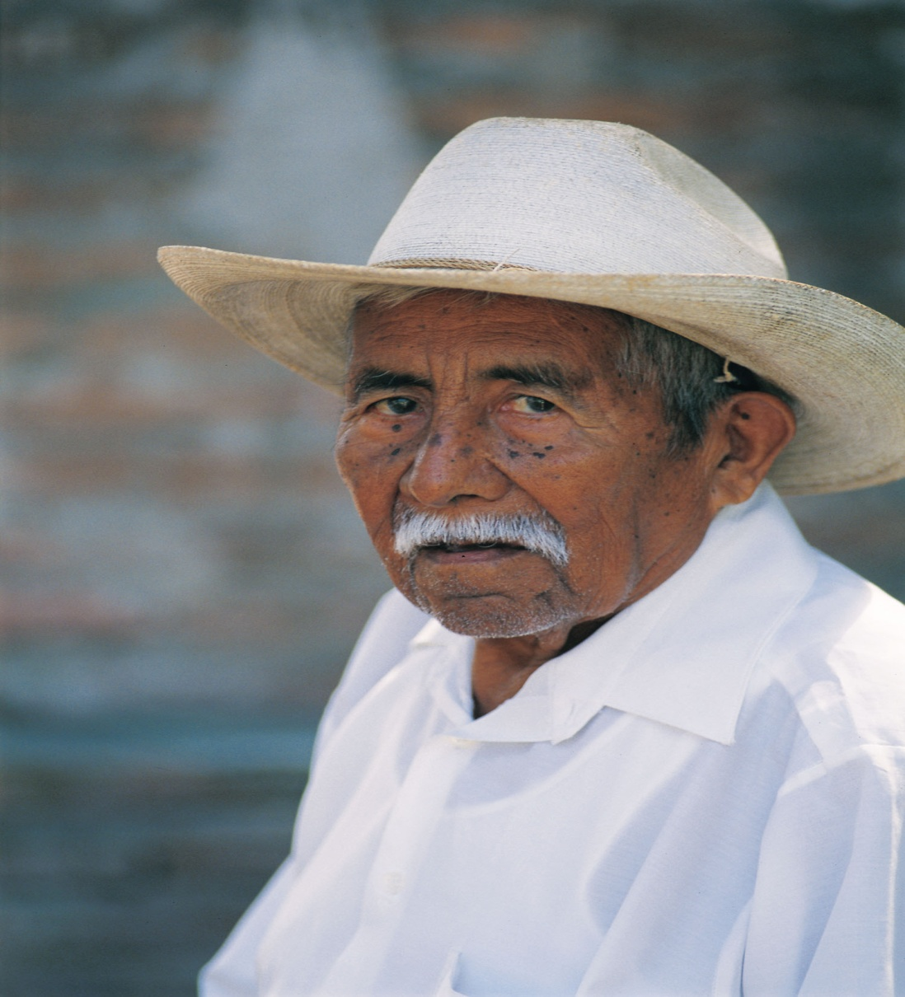

Slide 5
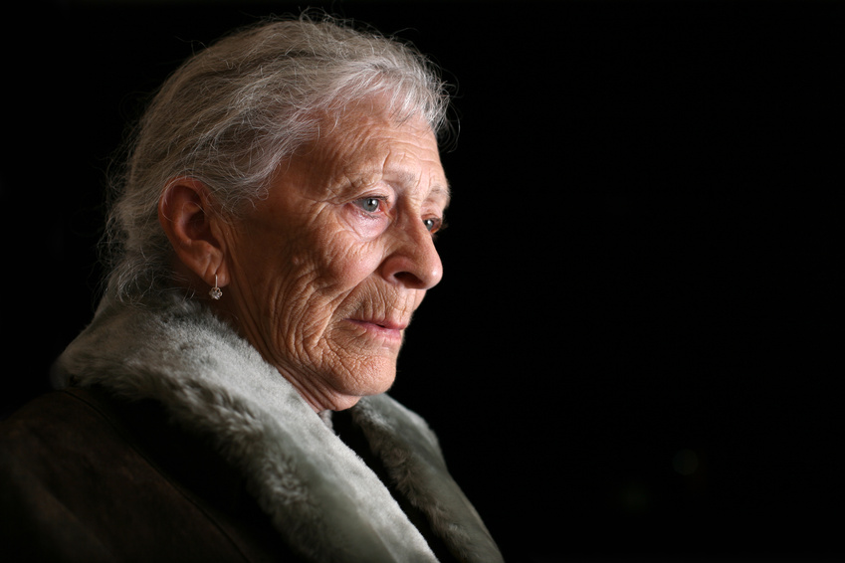

Slide 6
Family Caregivers (AARP Public Policy Institute 2011)
65 % of people needing LTSS rely exclusively on unpaid caregivers
30% of people needing LTSS supplement unpaid care with paid caregivers
59-75% of caregivers are women
Average age of caregivers: 49 years old; however 25% are between 65 - 75 years old
Caregivers provide approximately 20 hours a week of unpaid care

Slide 7
Family Caregivers
Caregivers perform diverse tasks, including: personal care, medication management, health care coordination, household tasks, bill paying, transportation, companionship, emotional support, etc.
Family care often affects caregivers’ physical and emotional health, own financial situation, retirement security, career, and social network.
The estimated economic value of unpaid caregiving contributions in U.S. was $450 billion in 2009.

Slide 8
The Importance of Age-Friendly Communities

Slide 9
Importance of Age-Friendly Communities
Address a growing elderly population and an economic imperative associated with elder care.
Honor consumer preferences to remain at home and in the community as they age.
Address challenges to aging in the community, and provide needed supports.
Improve access to existing supports for aging in the community.

Slide 10
Projected Aging in the U.S. (Number of Americans age 65 and older in millions; U.S. Census Bureau, 2005 & 2010)

Slide 11
Maryland
In 2000, 15 % (801,036) of Maryland’s 5.3 million people were 60 years or older.
By 2030, 25% of Maryland's projected population of 6.7 million will be 60 years or older.
Maryland Department of Aging
http://www.aging.maryland.gov/Statistics.html

Slide 12
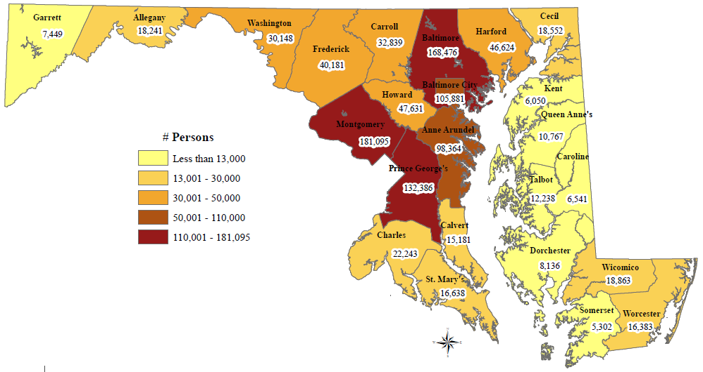
2011 Estimates of Persons 60 and Older for Maryland's Jurisdictions
Source: http://www.aging.maryland.gov/documents/2012AnnualReport.pdf

Slide 13
Maryland’s 60+ Population Percent Change Projections by Jurisdiction, 2010-2040
Source: http://www.aging.maryland.gov/documents/2012AnnualReport.pdf

Slide 14
Challenges to Aging in the Community
Health problems for many elders
Caregiver needs
Safety concerns
Housing needs
Financial needs
Limiting attitudes about elders

Slide 15
What is a Community for a Lifetime?

Slide 16
Definition: MD Chapter 295, SB 822
The Department [of Aging] shall recommend criteria that local jurisdictions may use to certify communities for a lifetime, including:
The extent to which a community has sought and plans to expand public health, prevention, and wellness programs that serve older adults;
The extent to which a community has sought and plans to expand affordable transportation options;
The extent to which a community has sought and plans to expand affordable rental housing and the ability to own affordable homes;
The extent to which a community has sought and plans to expand employment, civic engagement, recreation, and leisure options for older adults; and
The extent to which a community has sought and plans to expand other initiatives that boost the abilities of older adults to age in place.
Source: http://mgaleg.maryland.gov/2011rs/chapters_noln/Ch_295_sb0822E.pdf

Slide 17
World Health Organization Guidelines for Age-Friendly Cities
Outdoor spaces and buildings
Transportation
Housing
Social participation
Respect and social inclusion
Civic participation and employment
Communication and information
Community support and health services

Slide 18
Communities for a Lifetime in Other States

Slide 19
Maryland Communities for a Lifetime: Informed by Florida Criteria
Department of Elder Affairs, Communities for a Lifetime Bureau (1999)
Goal
To assist Florida cities, towns and counties in planning and implementing improvements that benefit their residents, youthful or elder. Communities use existing resources and state technical assistance to make improvements in housing, health care, transportation, accessibility, business partnerships, community education, employment, volunteer opportunities and recreation.
Source: http://www.communitiesforalifetime.org/docs/blueprint2007web.pdf

Slide 20
A Look at Other States
Minnesota
Laws of Minnesota, 2009, Chapter 60
Program website: www.mnlifetimecommunities.org
Maryland
Chapter 295, Acts of 2011
Maryland Department of Aging website: www.aging.maryland.gov
States with programs and proposed CFAL legislation
Indiana (program of Indiana University and partners)
Hoosiers communities for a lifetime, Senate Bill No. 277 (last considered in 2012)
Program website: www.lifetimecommunities.org
States with programs but no CFAL law/legislation
Florida (partnership of the Department of Elder Affairs and AARP)
Program website: www.elderaffairs.state.fl.us/doea/cfal.php and www.communitiesforalifetime.org
Michigan
Program website: http://www.michigan.gov/osa/1,4635,7-234-64083_64552---,00.html
Virginia
Blueprint for Livable Communities: http://www.aarp.org/content/dam/aarp/livable-communities/plan/planning/virginias-blueprint-for-livable-communities-2011-aarp.pdf

Slide 21
Home and Community Based Services: The Heart of Communities for a Lifetime

Slide 22
Participant Expectations & Preferences
Remain at home with family and within community
Participant-directed options offer:
increased choice, control, and flexibility than traditional services
ability to hire own workers, including family and friends if preferred

Slide 23
Recent Federal Initiatives to Expand Home and Community-Based Services
2007 AoA Community Living Program
2008 Veterans Directed HCBS Program
2009: Independence at Home Act
2010: Patient Protection and Affordable Care Act
Community First Choice Option
Balancing Incentives Program
Money Follows the Person (expanded)
CLASS Act (Community Living Assistance Service and Supports) . Will not be implemented.

Slide 24
Aging and Disability Resource Centers
2003 Maryland one of first 12 states to receive grant to develop
2 013 – Maryland
Maryland Access Point (MAP) program statewide
Statewide public web-based data resource
Statewide standards for Options Counseling
Expanded population served to all individuals with a disability
Central partner in Medicaid Rebalancing Programs
Umbrella for other rebalancing initiatives
MAP website: http://www.marylandaccesspoint.info/

Slide 25
National ADRC
Active in 54 States and Territories
Partner with:
Centers for Medicare and Medicaid Services
U.S. Department of Veterans Affairs
Administration for Community Living
Administration on Aging
Office of Disabilities
Administration for Developmental Disabilities
Major Player in National Rebalancing

Slide 26
What are Participant-Directed Services?
Participant-directed services: long-term services and supports to help people of all ages with all types of disabilities maintain their independence and determine what personal care services work best for them.

Slide 27

Service Models
Traditional Model
Cash and Counseling Model
professional decision-making
agency oversight
rules and restrictions regarding the timing, duration, amount, and scope of services
Participant-Directed Models
participants have more control over their services
One of the most flexible models of participant-direction
Allows participants the authority to manage a personal care budget
Counselors provide advice and program information, quality monitoring, and training in budgeting, planning, recruiting and hiring workers
Participants hire, supervise, and fire their own personal care workers (including relatives)
Participants may purchase other personal assistance goods and services.

Slide 28

Cash and Counseling Demonstration & Evaluation States and Expansion States
Demonstration
Arkansas
Florida
New Jersey
Expansion
Alabama
Illinois
Iowa
Kentucky
Michigan
Minnesota
New Mexico
Pennsylvania
Rhode Island
Vermont
Washington
West Virginia

Slide 29
National Resource Center for Participant-Directed Services
Mission: To infuse participant-directed options into all home and community-based services
Current projects
U.S. Administration on Aging Initiative to promote culture change from “professional” to “empowerment” approaches to services and supports
U.S. Administration on Aging and Veteran's Administration Initiative to create a network of “Veterans-Directed” programs in every state
Robert Wood Johnson Foundation-funded Environmental Scan of Behavioral Health and Participant-Direction

Slide 30
Initiatives on Age-Friendly Communities

Slide 31
World Health Organization Guidelines for Age-Friendly Cities
Outdoor spaces and buildings
Transportation
Housing
Social participation
Respect and social inclusion
Civic participation and employment
Communication and information
Community support and health services

Slide 32
Community Innovations for Aging in Place Grantees
Community efforts to help elders maintain their independence and age in their homes.
2009: Over 200 applications received.
14 organizations representing diverse communities nationwide received awards.
Administration on Aging
http://www.aoa.gov/AoA_programs/HCLTC/CIAIP/index.aspx#Purpose

Slide 33
Administration on Aging Grantee Projects (examples)
Atlanta Regional Commission, Atlanta, GA
A community capacity-building project for aging in the community
Boston Medical Center, Boston, MA
Services to Help At-Risk Elders Age in the community (SHARE)
Catholic Charities, Kansas City, MO
Caring Communities Resource Centers
The Coordinating Center, Millersville, MD
Opting for Independence

Slide 34
Administration for Community Living
New agency announced April 16th, 2012: Administration for Community Living (ACL), in the Department of Health and Human Services.
Merges the Administration on Aging, Administration on Developmental Disabilities, and Office of Disability.
Goal : increase access to community supports and full community participation; focus attention and resources on the needs of elders and people with disabilities.

Slide 35
AARP and WHO: A Shared Vision
The AARP Network of Age-Friendly Communities helps participating U.S. communities adopt features like safe, walkable streets, better housing and transportation options, access to key services, and opportunities for residents to participate in community activities.
Benefits include access to:
global network of participating communities
aging experts
peer to peer opportunities
information and best practices
Source: http://www.aarp.org/livable-communities/network-age-friendly-communities.html

Slide 36
AARP and WHO: A Shared Vision (Cont’d)
Ten cities have joined the AARP Network
New York City, NY; Washington, DC; Philadelphia, PA; Portland, OR; Austin, TX; Des Moines, IA; Honolulu, HI; Auburn Hills, MI; Wichita, KS; Westchester County, Brookhaven, and Chemung County, NY; and Macon-Bibb County, GA
Affiliated with the World Health Organization’s (WHO) Age-Friendly Cities and Communities Program
137 communities in 21 countries
Source: http://www.aarp.org/livable-communities/network-age-friendly-communities.html

Slide 37
Naturally Occurring Retirement Community (NORC)
A NORC is a community with a concentrated population of older individuals (e.g., a residential building, housing complex, a neighborhood composed of age-integrated housing).
U.S. Department of Health and Human Services
Maryland has two NORCs operated by:
Jewish Federation of Greater Washington, Rockville
Jewish Federation in Baltimore

Slide 38
Housing Plus Services (HPS): LeadingAGE Center for Applied Research
HPS is an umbrella term coined by the National Low Income Housing Coalition to capture the phenomenon of combined housing and supportive services to help low-income people achieve housing stability.
For older adults, this means combined housing and supportive services (e.g. healthcare, support services, case management, life skills, crisis management, social and community engagement) to prevent institutionalization and facilitate aging in place.
Source: http://nlihc.org/issues/other/hps
Source: http://www.leadingage.org/Center_for_Housing_Plus_Services.aspx

Slide 39
Housing Plus Services (HPS): LeadingAGE Center for Applied Research (Cont’d)
HPS Learning Collaborative
12 community teams that develop and pilot HPS programs to:
Identify the essential elements and practices of HPS strategies.
Develop indicators and mechanisms to measure whether HPS models can improve health outcomes for seniors while creating cost savings for the health care system.
Explore how regulatory and financing models could help HPS to scale
1 Maryland community team
Associated Catholic Charities in Baltimore, MD, working with Greater Baltimore Medical Center as its service provider partner.
Source: http://nlihc.org/issues/other/hps
Source: http://www.leadingage.org/Center_for_Housing_Plus_Services.aspx

Slide 40
The Village Movement
The Village Movement: helps elders remain in their homes and communities by organizing programs and services that help older people lead a safe, healthy and productive life.
http://www.cbsnews.com/8301-505146_162-39942521/assisted-living-creative-villages-concept-can-help/

Slide 41
The Village Movement
Pioneered by the Beacon Hill Village in Boston, founded in 2001
97 operating “villages” in the U.S. with another 78 locations in the planning stage
Source: http://www.vtvnetwork.org/content.aspx?page_id=1905&club_id=691012#search_results

Slide 42
The Village Movement
Villages can complement other community approaches to aging such as NORCs and Area Agencies on Aging programs.

Slide 43
Villages Features
Member/consumer-driven, grass-roots organizations (self-governing)
Run by volunteers and paid staff
Coordinate access to affordable services (transportation, health and wellness programs, home repairs, social and educational activities and trips
Vetted- discounted providers

Slide 44
Village Features
Strategic partnerships vs. duplicating services
• “Whole person” focus (community building, member services, healthy aging)
• Reduced-fee memberships
• Volunteerism, peer assistance
• Intergenerational connections

Slide 45
Maryland
At Home Chesapeake
Aging in Place – Hyattsville
Bannockburn Neighbors Assisting Neighbors
Burning Tree Village
Chevy Chase at Home
Downtown Silver Spring Senior Village

Slide 46
Village Networks (select Village Networks nationwide)
Beacon Hill Village (Boston, MA)
Community Without Walls (Princeton, NJ)
60-Plus Club (Noblesville, IN)
At Home In Greenwich (CT)
Avenidas Village (Palo Alto, CA)
Capitol Hill Village (Washington, DC)
Front Desk Florence (OR)
Gramatan Village (Bronxville, NY)
Lincoln Park Village (Chicago, IL)
Penn's Village (Philadelphia, PA)
SAIL Support for Independent Lives (Madison, WI)
Tierrasanta Project (San Diego, CA)
Washington Park Cares (Denver, CO

Slide 47
Policy Brief Recommendations
Develop a “Maryland Communities for a Lifetime” website so existing resources are accessible in one location.
Establish a statewide or regional coalition to support communities in their efforts to develop/expand age-friendly communities (e.g., Westchester County Center for Aging in Place, Metropolitan Atlanta Lifelong Communities)
Sponsor a statewide or regional symposium focused on Communities for a Lifetime

Slide 48
University of Maryland Pilot Project in Prince George’s County

Slide 49
Creating Age-Friendly Communities: Investigating Needs and Preferences of Senior Building Residents in Prince George’s County
Project Goal: To conduct a needs assessment of low income and racially/ethnically diverse communities in Prince George’s County to inform the development of “Communities for a Lifetime” tailored for this population. The project supports the 2011 Maryland Communities for a Lifetime Act.
Project Approach: The two-part project comprises: 1) key stakeholder focus groups with Prince George’s County leaders; elderly residents of two low-income senior buildings; and family members of building residents and 2) review and synthesis of existing County data to describe the needs of County elders.

Slide 50
Creating Age-Friendly Communities: Investigating Needs and Preferences of Senior Building Residents in Prince George’s County (Cont’d)
Timeline:
Focus group development and recruitment (Fall 2013)
Focus groups conducted (Winter 2013/2014)
Project report (Spring 2014)
Overall Goal: Explore the development of a university/state/county partnership to implement Maryland Communities for a Lifetime.

Slide 51
Creating Age-Friendly Communities: Investigating Needs and Preferences of Senior Building Residents in Prince George’s County (Cont’d)
Focus Group Moderator Guide: Senior Building Residents
Do you need help in your home? If so, what help do you get? What do you like about the help you get? What could be better?
Do you need any more/other help in your home? If so, what help would you want? For what reasons? Please describe. What would this help look like?
Do you need help with things that you need and want to do in your community? If so, what help do you get? What do you like about the help you get? What could be better?

Slide 52
Creating Age-Friendly Communities: Investigating Needs and Preferences of Senior Building Residents in Prince George’s County (Cont’d)
Focus Group Moderator Guide: Senior Building Residents (Cont’d)
4. Do you need any more/other help with things that you need and want to do in your community? If so, what help would you want? For what reasons? Please describe. What would this help look like?
5. Thinking about the future, do you think you might need help/additional help in your home? If so, what help would you want? Please describe. What would this help look like?
6. Thinking about the future, do you think you might need help/additional help with things that you need and want to do in your community? If so, what help would you want? Please describe. What would this help look like?

Slide 53
Discussion

Slide 54
Thank you!
Lori Simon-Rusinowitz, PhD
University of Maryland School of Public Health
Department of Health Services Administration and Center on Aging
College Park, MD
LASR@umd.edu

