Slide 1
Maryland Commission on Aging Training
Hagerstown Community College
September 10, 2014
Michael Marcus
mmarcus@hjweinberg.org
410-654-8500 ext 244

Slide 2
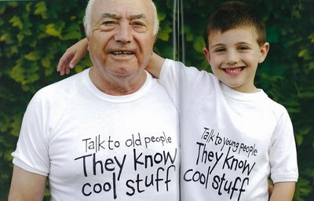
“A test of a people is how it behaves toward the old.”
Abraham Joshua Heschel
Notes:
Cheryl, slide 2, 1 min.
So as someone who has been blessed with the ability to serve my community through philanthropy, I am a proud member of the Jewish Funders’ Network, and I am also a Trustee of Jewish Home Lifecare in New York. Jewish Home serves over 10,000 elders each year, most in their own homes, and the rest through short-term on-site rehabilitation following a hospital stay, or long-term residential care for those who are so medically fragile or cognitively impaired that they cannot remain safely at home. Through my work with Jewish Home, I have seen first-hand the incredible impact that philanthropy can have on an older person’s quality-of-life. Eldercare today embraces innovative technology for its ability to help elders stay connected wherever they’re living. Eldercare today is demanding that long-term care center around individual choice, through both residential architecture and the caregiving that takes place within these new buildings. Eldercare today means opportunities for philanthropy to research, develop, implement, and spread exciting new opportunities and resources that will benefit not only our elders, but also our future selves. It is a very exciting time for those of us in a position to support these initiatives!

Slide 3
The Harry and Jeanette
Weinberg Foundation
Mission:
To help low-income and vulnerable individuals and families by providing grants to nonprofits that provide direct services.
“While others are finding the cures for all the ills of the world, someone will be hungry, someone will be cold. That’s our job.”

Slide 4
Older Adults
No other American foundation of similar size has emphasized care for poor older adults to the extent demonstrated by The Weinberg Foundation. The Foundation is the #1 funder in the field of Aging at $38-40 million a year.
Seven foci:
Community based services - Supportive Communities and Elder Abuse*
Caregiver supports and services – Making Maryland the Best Place to Grow Old*
Workforce Development for paid caregivers to older adults
Elder Economic Security
Affordable Housing with Services*
Culture change long-term care residences
Community Based Centers formerly known as Senior Centers

Slide 5
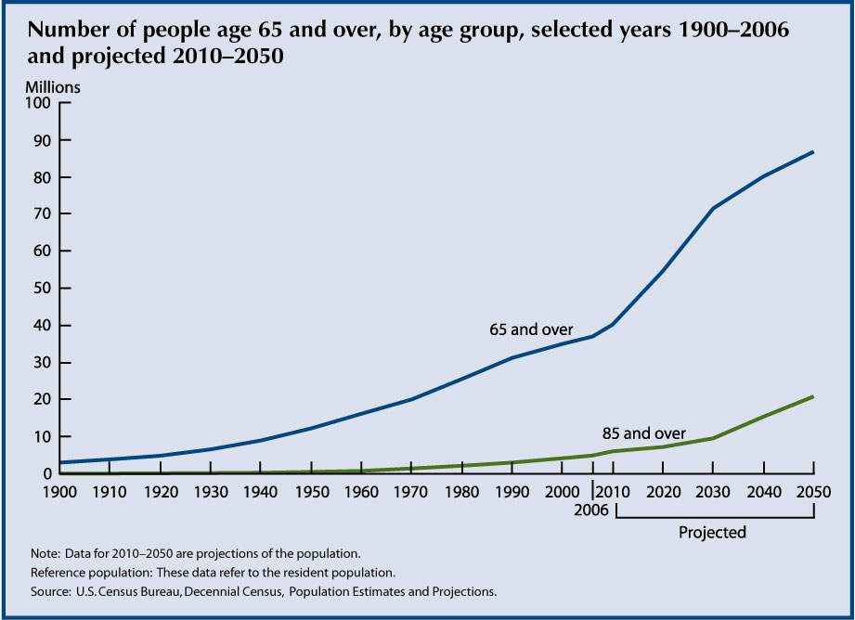

Slide 6
Census Year | Number Males 65 and older | Percent Males 65 and older | Number Females 65 and older | Percent Females 65 and older | Number 65 and older - both sexes | Percent 65 and older - both sexes | Total, both sexes, all ages
2000 | 14,409,625 | 41.2% | 20,582,128 | 58.8% | 34,991,753 | 12.4% | 281,421,906
2010 | 17,291,694 | 43.0% | 22,937,018 | 57.0% | 40,228,712 | 13.0% | 310,232,863
2020 | 24,323,182 | 44.4% | 30,481,288 | 55.6% | 54,804,470 | 16.1% | 341,386,665
2030 | 32,293,978 | 44.8% | 39,797,937 | 55.2% | 72,091,915 | 19.3% | 373,503,674
2040 | 36,396,362 | 44.8% | 44,842,029 | 55.2% | 81,238,391 | 20.0% | 405,655,295
2050 | 39,916,666 | 45.1% | 48,630,307 | 54.9% | 88,546,973 | 20.2% | 439,010,253

Slide 7
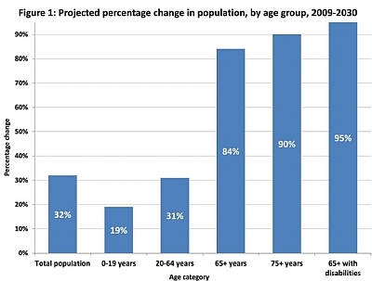

Slide 8
In Maryland
In 2010 Maryland Residents 60+ represented 17.9% of the State's Population, 16.7% of the residents of Baltimore City.
By the year 2020 Maryland Baby Boomers, 55 to 74 years of age will represent 29% of the State’s population
Those 75+ will represent another roughly 5% of the population, and growing
Nearly half of Maryland’s older residents would be living in poverty if it were not for Social Security. Each year Marylanders receive over $9 Billion from Social Security alone. Older adults make a significant contribution to the State of Maryland.

Slide 9
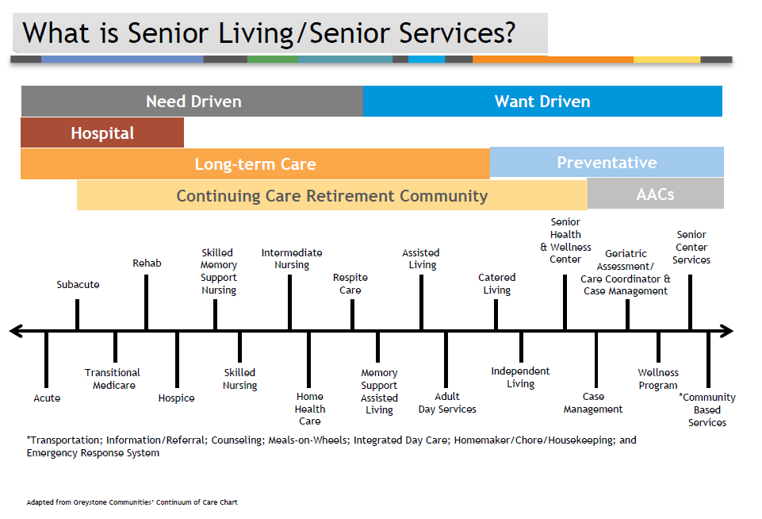
The Spectrum of Care
Notes:
Comments:
Complexities
Fluid Nature
One program does not fix all
Most of what we do at JHL is carefully measured and documented which is a combination of government requirements and our commitment to share research with the filed. to study the results of new ideas implemented on a small scale and then replicate those ideas across our system and through peer-reviewed journals. . As funders, you should appreciate this discipline.
It is fast paced – with new technologies and new models of care being developed to allow elders to stay at home longer and live more comfortably in facilities.
Through the balance of this presentation, I’ll share a few examples of recent innovations and what funders have found interesting in our work.

Slide 10
Making Maryland the Best Place to Grow Old
Built on the Foundation’s 3 year, $8.4 m (plus $8 m matching) national Family and Informal Caregiver Initiative, 14 sites in 9 states. Every one continues to operation. Over 400,000 caregivers received services. 2400 participants in the project assessment. Services to these participants saved over $38 m in public expenditures.
4 part, 5 to 7 year initiative, beginning in Baltimore and reaching out.
- Replicating 12 core services and supports for caregivers.
- Developing 3 additional services: Urgent alert; wheelchair transportation; durable medical equipment lending.
- Enhanced paid caregiver training, support and supervision.
- No wrong door access.

Slide 11
Five Grants Made Thus Far
Civic Works -- Cities for All Ages
Benefits Data Trust – Maryland Outreach Project
Johns Hopkins Bayview – Strengthening Caregiver Partnerships
SAGE – SAGECAP (Caregiver Action Program)
National Council on Aging – Elder Security Initiative/Economic CheckUp

Slide 12
Leading Issues
A shortage of professional Caregivers: Currently 2.5 million, the US will need 4 million by 2020. We need more older adult caregivers than K-12 teachers.
Caregiving Industry: poor pay, high turnover, little oversight, and almost no consistency in training standards.
Volunteer (Informal) Caregivers: Currently, an estimated 30-70 million Americans provide support to roughly 13 million people over 65 at a value estimated at over $400 billion a year.

Slide 13
Leading Issues
Available data from state Adult Protective Services (APS) agencies show an increasing trend in the reporting of elder abuse
The most recent major studies on incidence reported that 7.6%–10% of older adults report having experienced abuse in the prior year.
This does not include financial abuse. Most experts believe 60% of elder abuse is financial abuse
Many believe 20% to 25% of older adults have suffered abuse. One study estimated that only 1 in 14 cases of elder abuse ever comes to the attention of authorities. The New York State Elder Abuse Prevalence Study found that for every case known to programs and agencies, 24 were unknown.

Slide 14
Leading Issue
There is a national shortage of affordable housing between 7 - 9 million rentals.
Older adults are more likely than their younger adults to spend more than 30% on their home.
Almost half those earning under 50% of area median income spend over 50% of their income for housing. There are 10 older adults waiting for every unit of Section 202 housing that becomes available.
There is a lack of housing with services. Senior housing was built expecting people to stay 6 years, today 12 is more typical. Today the average age is 84.

Slide 15
Leading Issues
An increasingly complex services and benefits sector (aka intimidating forms and processes.
Less than 50% of eligible seniors receive SNAP (Food Stamps); SSI requires three separate doctor’s determinations to qualify; Medicare requires people to choose which plan to purchase.
The elder sufficiency line is estimated at $25,000, yet nearly 40% of those 65+ live on Social Security alone
Average SS income is $1,250 or $15,000 (2011); poverty for 65+ is $11,011 (2012) lower than general poverty line $11,945 (2012); over 70% make under 300% of poverty

Slide 16
Leading Issues
The growing need for care is great: 55% of all cancers are diagnosed in individuals 65+. The number of seniors with diabetes is expected to double by 2030 (to 10.6 million). The number of older adults with Alzheimer’s disease is expected to grow by 50% by 2030 to 7.7 million.
Half of people with Medicare spend at least 15% of their incomes on hospital care and other health services.
The average Medicare beneficiary requires more than $1,200 in prescriptions each year. For the 50% of seniors whose income falls below $22,000/year, this represents a significant outlay.
As of 2010, only around 40% of seniors who qualify for the Part D Low-Income Subsidy were receiving the benefit.

Slide 17
So What About Villages?
They are a great idea
Asset based approaches are the core of successful strategies for change
Two concerns
- Access to ADL deficit services
- Access for those who do not have the fundes

Slide 18
Leading Issues
Is there a role for Senior Centers?
Senior Centers act as the focal point for more than 60% of senior services.
There are at least three types: Multi-purpose, Intergenerational, Single-program focus.
Average client is female, 70-79, white, low- to middle-income, desires social interaction, lower education level.
Boomers are not interested in traditional senior centers. (BoomerANG Study North Penn Community Health Foundation)

Slide 19
Some Responses
Community Services
Retooling community based programming to accommodate frailer individuals including supportive communities, villages, and no wrong door.
No wrong door is a guiding Weinberg Principle, it means the older adult or her/his caregiver can walk through any door and be connected to the entire network of services they need.
Rethinking transportation including peer support, new voucher programs, volunteer reimbursement and insurance programs Partners In Care, ITN

Slide 20
Some Responses
New Approaches to Caregiving
Caregiver Support: Caregiver support programs offering training, rethinking respite, rethinking the use of technology, collaborative efforts outside the “aging network.”
Caregiver Support Programs: Develop focused training and recruiting other volunteers using an asset-based approach.
Chronic Self-care: Peer health educators, chronic self-care, nutrition and falls prevention programs, great use of paraprofessionals.

Slide 21
Some Responses
Workforce Development
Caregiver Recruitment: Creation of caregiver recruitment efforts.
Caregiver Pay: Incentives, master caregivers, new approaches to managed HCBS care.
Training: State by state consistency, more hands-on, more practicum, accredited curriculums and methodology.
Peer services: The average age of a professional caregiver is now around 50. There is a movement to train older people to carry out some of the lighter duties. Some states are very focused on recruiting family members to become paid caregivers.

Slide 22
Some Responses
Housing
Housing Options:
Housing with services
Enhanced home modification programs,
Intergenerational housing,
Co-housing,
Scattered site housing,
Renewed attention to the “In-law apartment”,
Renegotiating 202s, new 811 program.

Slide 23
Possible Responses
Facilities Providing Long-Term Services
Culture Change the movement to transform the institutional approach into one that is person-directed. In culture change, quality of care and quality of life are inseparable and equally important.
Nearly 1/3 of the 16,500 nursing homes in the US describe themselves as implementing culture change, but most is just window dressing…pets and plants.
Wide range of approaches some emphasizing facility design, individual autonomy, smaller numbers in groups.

Slide 24
Some Responses
Elder Abuse
Fund the Elder Justice Act, passed in 2010 as part of the ACA, the WH had proposed $25 million which includes some special initiative funding.
Develop model Multi Disciplinary Teams (MDTs), an on-going collaboration between prosecutors, APS, social service providers, health providers. In some states, notably Illinois, they are required by law and funded by the state legislature.
Create more Elder Abuse Shelters, providing elder abuse victims a safe place to go while they heal and services which help make them whole, legal assistance, forensic accounting, housing services, etc. Now 10 in the U.S., including 2 in Maryland, 6 more in development.

Slide 25
Thanks For All You Do!
Michael Marcus
mmarcus@hjweinberg.org
420-654-8500 ext 244

