Slide 1

Health Benefits of Caregiving?
David L. Roth, Ph.D.
Johns Hopkins University
William E. Haley, Ph.D.
University of South Florida

Slide 2
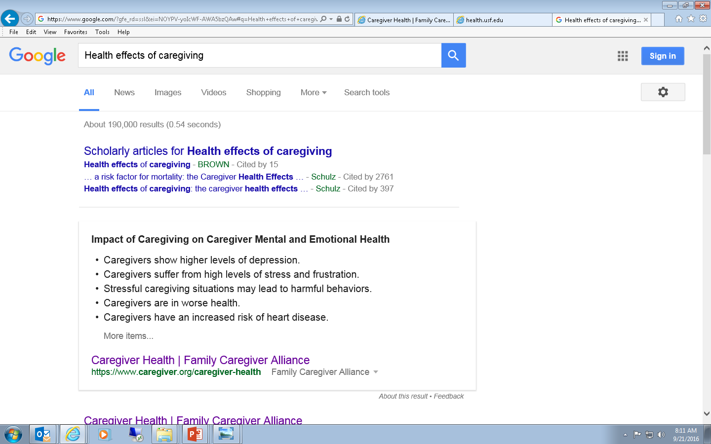

Slide 3
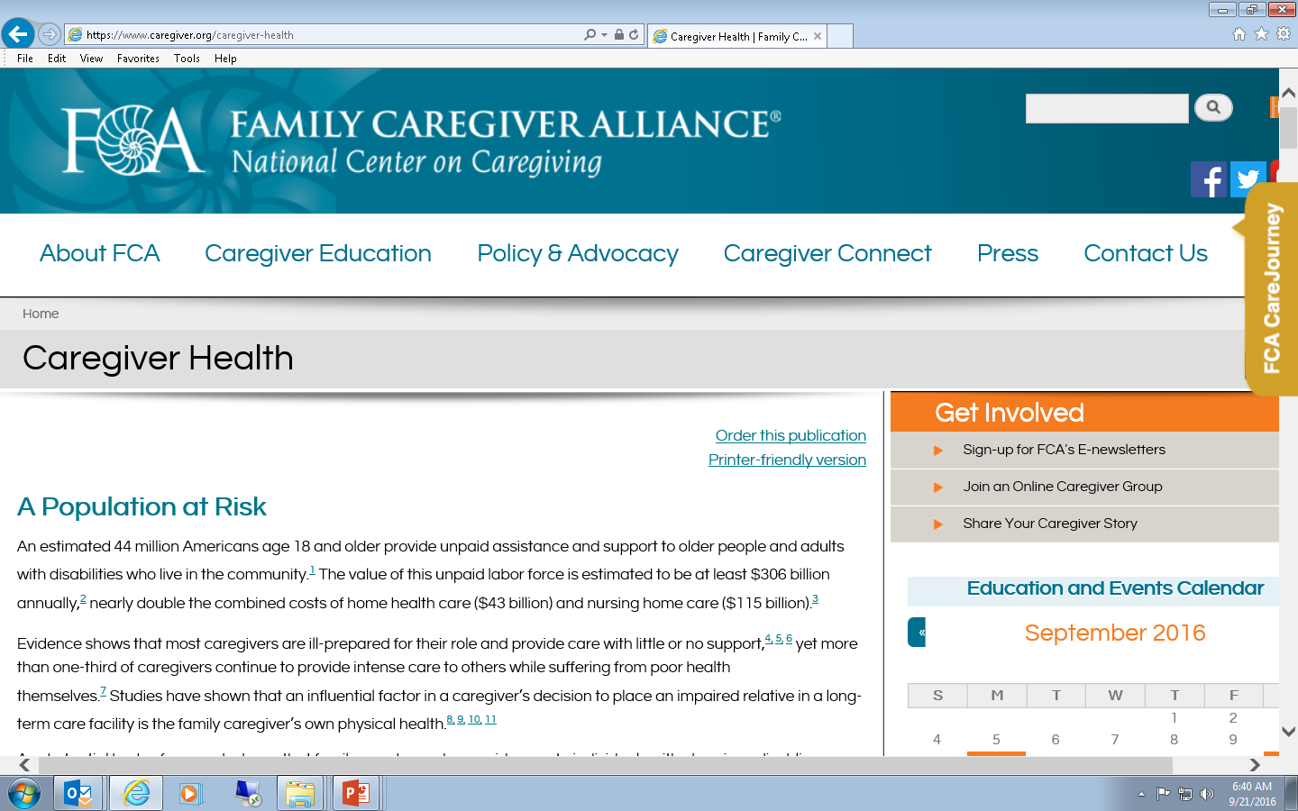
Evidence shows that most caregivers are ill-prepared for their role and provide care with little or no support, yet more than one-third of caregivers continue to provide intense care to others while suffering from poor health.

Slide 4
Internet Reports on Informal Caregiving and Mortality
“Caregivers suffer a mortality rate that is 63% higher than non-caregivers.”
- US Administration on Aging
(based on Schulz & Beach, 1999)
“Family caregivers experiencing extreme stress have been shown to age prematurely. This level of stress can take as much as 10 years off of a family caregiver’s life.”
- Caregiver Action Network
(based on Epel et al., 2004)

Slide 5

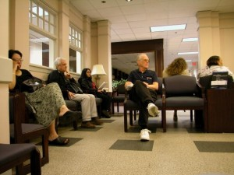
Caution: Cigarette Smoking May Be
Hazardous to Your Health.
Caution: Informal Caregiving May Be
Hazardous to Your Health.

Slide 6
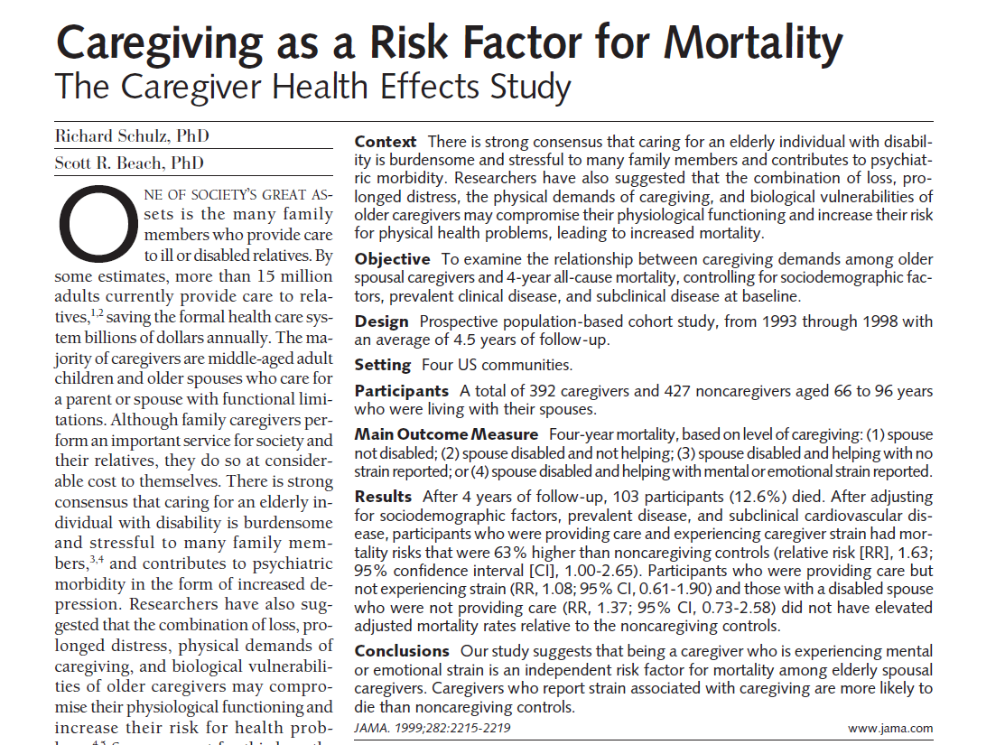

Slide 7
The REasons for Geographic and Racial Differences in Stroke (REGARDS) Project (N = 30,239)
Enrolled 2003-2007
45+ years of age at enrollment
Oversampling in the South (55%)
47% African American
57% Women, 43% Men
Sample includes 3,710 caregivers
18% report high caregiving “strain”
White
African American

Slide 8
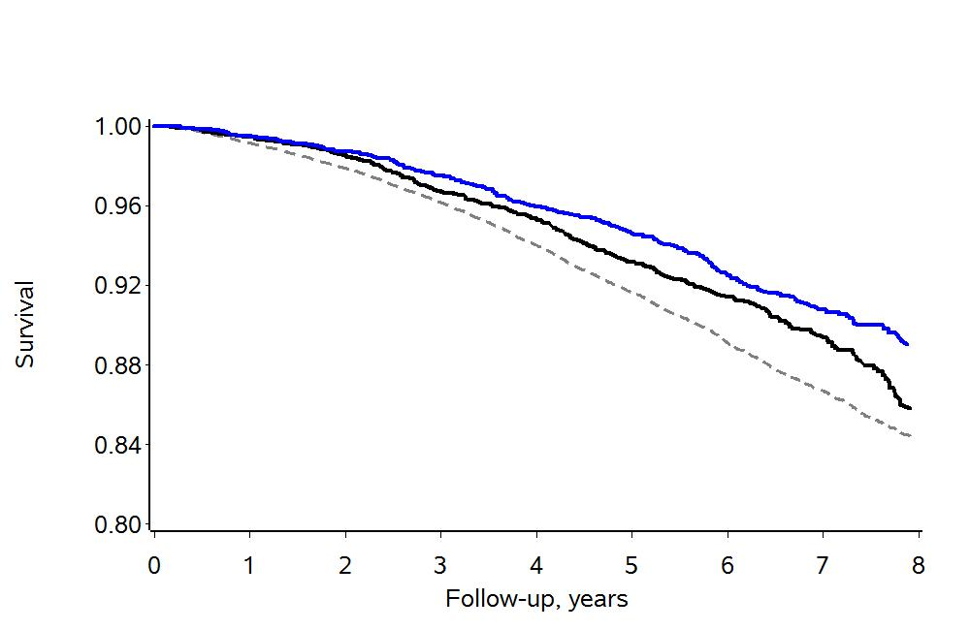
Caregiving and All-Cause Mortality in the REGARDS Project
Caregivers (N = 3,503)
PM Noncaregivers (N = 3,503)
All Noncaregivers (N = 24,883)
Source: Roth et al. (2013). American Journal of Epidemiology, 178, 1571-1578.

Slide 9
Effects of Informal Caregiving on Caregiver Mortality
Schulz & Beach (1999)
Brown et al. (2009)
O’Reilly et al. (2008)
Ramsey et al. (2013)
Fredman et al. (2010)
Roth et al. (2013)
Effect: Hazard ratio or relative risk for mortality, Caregivers vs. Noncaregivers
Source: Roth, Fredman, & Haley (2015). The Gerontologist, 55, 309-319.

Slide 10
Important Update on Caregiving and Mortality
Common claim: “Caregivers suffer a mortality rate that is 63% higher than non-caregivers.”
- US Administration on Aging (2013),
based on Schulz & Beach (1999)
Update: In fact, no study has ever found that all caregivers (as a general group), have significantly higher mortality rates than comparable non-caregivers. If anything, caregivers experience a longevity benefit (18% to 26% lower mortality rate) compared to non-caregivers.
- Roth et al. (2015), based on 5 population-
based studies since Schulz & Beach (1999)

Slide 11

Probably true
Research indicates that caregivers suffer from higher rates of depression than non-caregivers and caregivers suffer a mortality rate that is 63 percent higher than non-caregivers.
Definitely not true

Slide 12

Caregivers
(N = 300)
Non-caregivers
(N = 26,446)
Non-caregivers
(N = 300)
2003 2005 2007 2009 2011 2013 2015 2017

Slide 13
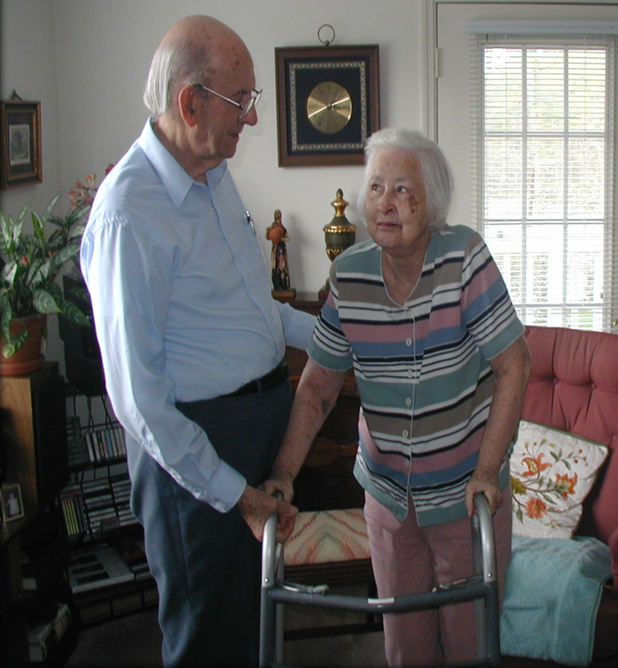
Facts about Informal (Family) Caregivers
There are an estimated 18 million to 44 million Americans who provide some regular, unpaid assistance to an older family member or friend with a chronic illness or disability.
The AARP has estimated that economic value of these services provided by caregivers to older adults in the United States is around $500 billion per year.
The increasing size of the older adult population, smaller and more dispersed families, and increasing emphasis on home-based care are converging into a supply-and-demand crisis for informal care resources.

Slide 14
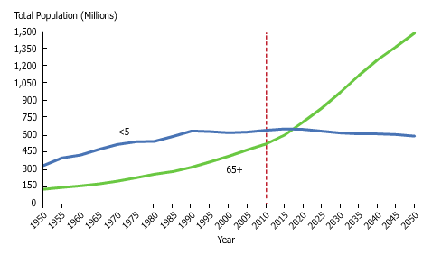
World Population, Age 65+ and Age <5
Source: Population Reference Bureau

Slide 15

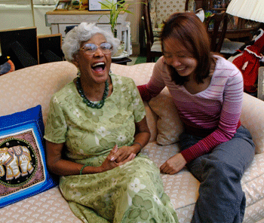


Center on Aging
and Health
Promoting the health and well-being of older adults
Please contact us for more information: phone: 410-955-0491
email: droth@jhu.edu
website: http://coah.jhu.edu
Thank you!

