Slide 1
Understanding Health Disparities in Late Life
Roland J. Thorpe, Jr., PhD
rthorpe@jhu.edu
Associate Professor, Health, Behavior, and Society
Director, Program for Research on Men’s Health
Deputy Director, Hopkins Center for Health Disparities Solutions
Johns Hopkins Bloomberg School of Public Health
September 22, 2016

Slide 2
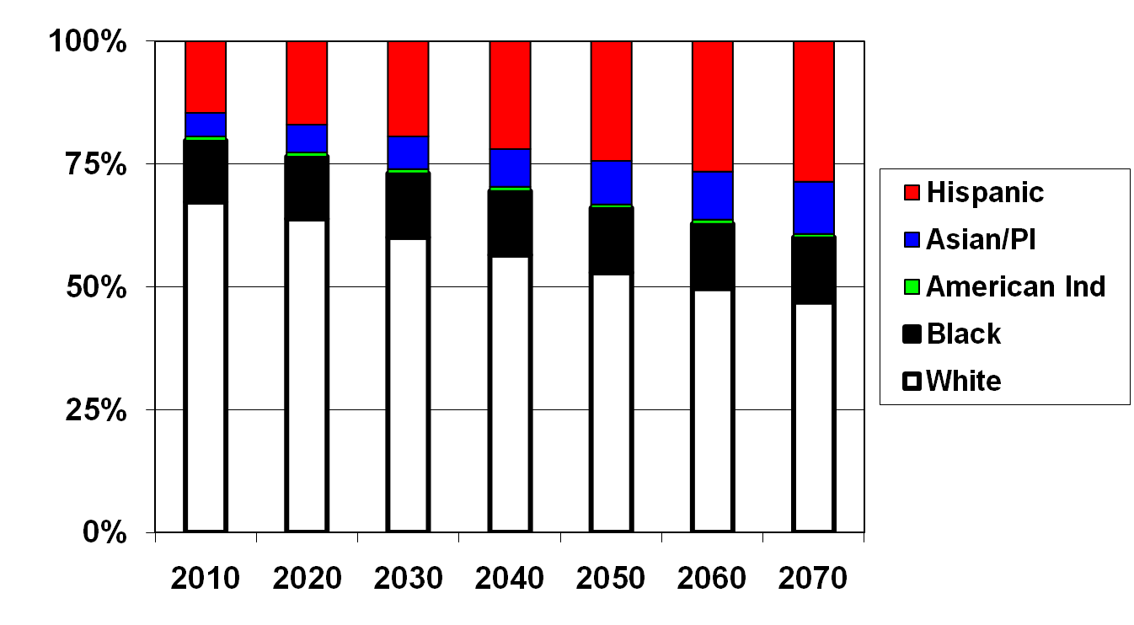
Projected Percentage Resident Population by race/ethnicity, U.S. 2010-2070
Source: U.S. Bureau of the Census:(NP-T5) Projections of the Resident
Population by Race, Hispanic Origin, and Nativity: Middle Series, 1999 to 2100
Notes:
For these reasons the US Census bureau projects by the middle of the 21st Century that we will be a majority-minority country. As the US undergoes this demographic transitions, health statistics of the nation will become a reflection of the health status of racial minorities.
What we know now as health disparities and minority health will become the nation’s health. As you will see later in the presentation mionirities typically have a worst health profile than whites.

Slide 3
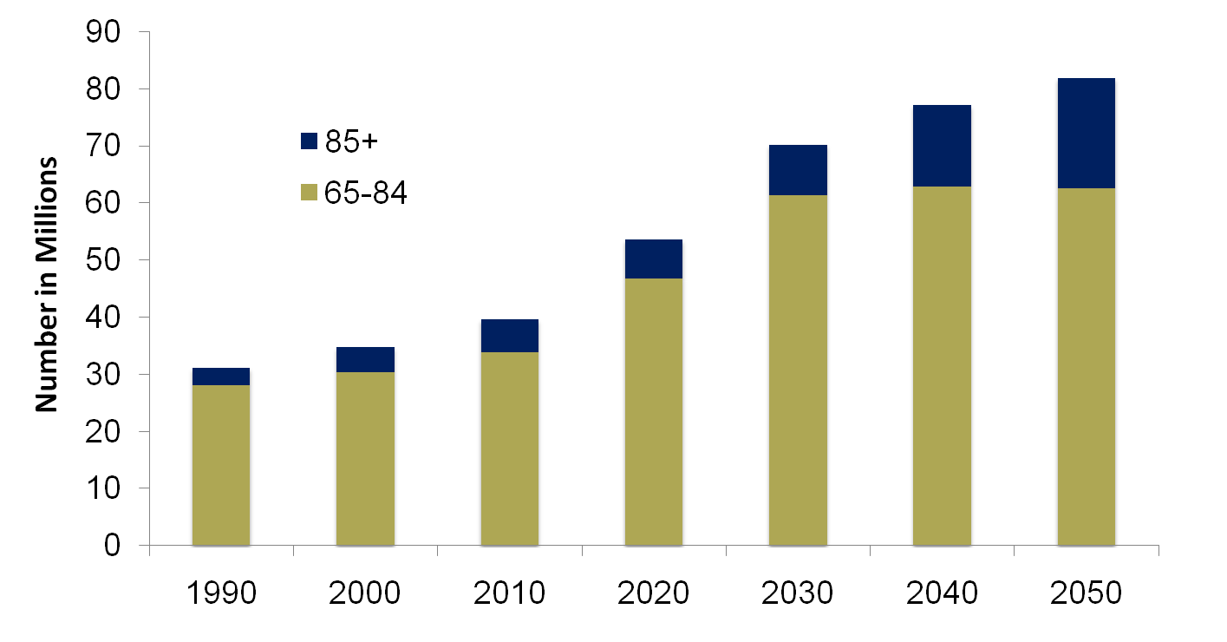
Expected Increase in U.S. Older Population 1990 – 2050
U.S. Bureau of Census middle series projections, Jan. 2000

Slide 4
Percent age 65+ by race and Hispanic origin, 2008 and 2050
Reference population: These data refer to the resident population.
SOURCE: U.S. Census Bureau, Population Estimates and Projections. 2008.

Slide 5
Percent of Males 65 and Over (age-adjusted) with Disability or Mobility Difficulty, 2008
Percent
Data Source: National Health Interview Survey
Notes:
Now moving to some selected chronic conditions. These were chosen because they are among the most common and costly health conditions.
With the exception of CHD, NH Black males report higher percentages of the selected chronic conditions compared with NH whites and Hispanics
Note: There was not enough data to generate a reliable estimate.

Slide 6
Percent of Females 65 and Over (age-adjusted) with Disability or Mobility Difficulty, 2008
Percent
Data Source: National Health Interview Survey
Notes:
When looking at the same select chronic conditions among older women, we see
NH Black females report higher percentages of the CHD, HTN, Stroke, and Diabetes relative to NH whites and Hispanics
Note that NH Whites report a higher percentage of any cancer than minorities

Slide 7
WHY?

Slide 8
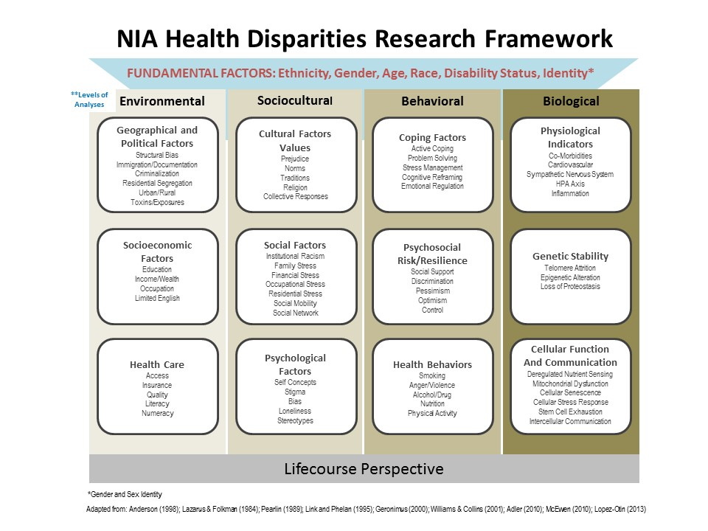
Health Disparities Research Related to
Aging
Source: Hill CV, Perez-Stable E, Anderson N, Bernard M. 2015. The National Institute on Aging Health Disparities Research Framework. Ethnicity & Disease, 25(3):245-254.

Slide 9
We Need Community-Based Solutions
Family
Schools
Housing
Crime
Employment
Supermarket
Parks and recreation
Pollutions and Environmental Toxins
Neighborhood
We need to think about factors outside the box. There are other factors that influence health and healthcare outcomes besides medical care.

Slide 10
Understanding Health Disparities in Late Life
Roland J. Thorpe, Jr., PhD
rthorpe@jhu.edu
Associate Professor, Health, Behavior, and Society
Director, Program for Research on Men’s Health
Deputy Director, Hopkins Center for Health Disparities Solutions
Johns Hopkins Bloomberg School of Public Health
September 22, 2016

Slide 11
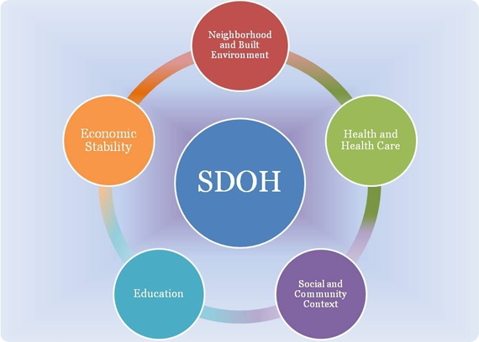
Social Determinants of Health

