Slide 1


Hearing Loss &
Healthy Aging
Frank R. Lin, M.D. Ph.D.
Associate Professor of Otolaryngology, Geriatric Medicine,
Mental Health, & Epidemiology
Johns Hopkins University
Baltimore, Maryland
Notes:
1021

Slide 2
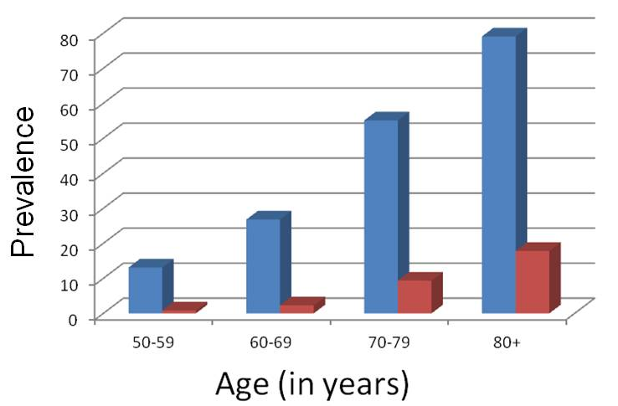
Hearing Loss & Hearing Aid Use Prevalence in the U.S. , 1999-2006
Chien W et al, Arch Int Med, 2012

Slide 3
Age-Related Hearing Loss (ARHL)
Basic Questions
What are the consequences of ARHL for older adults?
What is the impact of treating ARHL on older adults?
How can ARHL be effectively addressed in the community?

Slide 4
Hearing Loss & Cognition
Common Cause or Modifiable Risk Factor
Intervention
Cognitive
Load
Changes in
brain
structure
Reduced Social
Engagement
Hearing Loss
Impaired
Cognition
Hearing loss intervention could:
Reduce the cognitive load of processing degraded sound
Provide increased brain stimulation
Improve social engagement
Common pathological process
Role of HL as a potentially modifiable, late-life risk factor for cognitive decline & dementia

Slide 5
Aging, Cognition, and Hearing Evaluation in Elders (ACHIEVE) RCT
In collaboration with J. Coresh, M. Albert, N. Glynn, T. Chisolm, ARIC Study Team (T. Mosley, K. Bangdiwala, K. Hayden, J. Pankow)
Proximal/Mediating
Outcomes
Proximal/Mediating
Outcomes
Primary
Outcome
Primary
Outcome
Secondary
Outcomes
Intervention
Secondary
Outcomes
Intervention
HRQL
Social/Leisure Activities
Daily
Functioning
Mobility
Brain structure (MRI)
Best-Practices Hearing Rehabilitative Treatment
Vs.
Successful Aging Control
Audibility of speech & environmental sounds
Cognitive
Functioning
Enhanced Verbal Communication & Social Engagement
NIA R34AG064548
Notes:
Non-pharmacologic cognitive training intervention

Slide 6
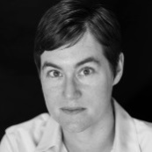
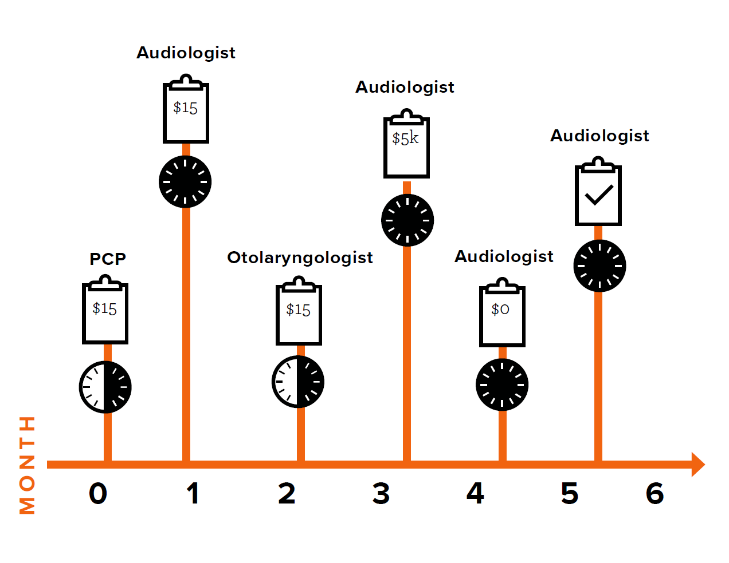
Carrie Nieman

Slide 7
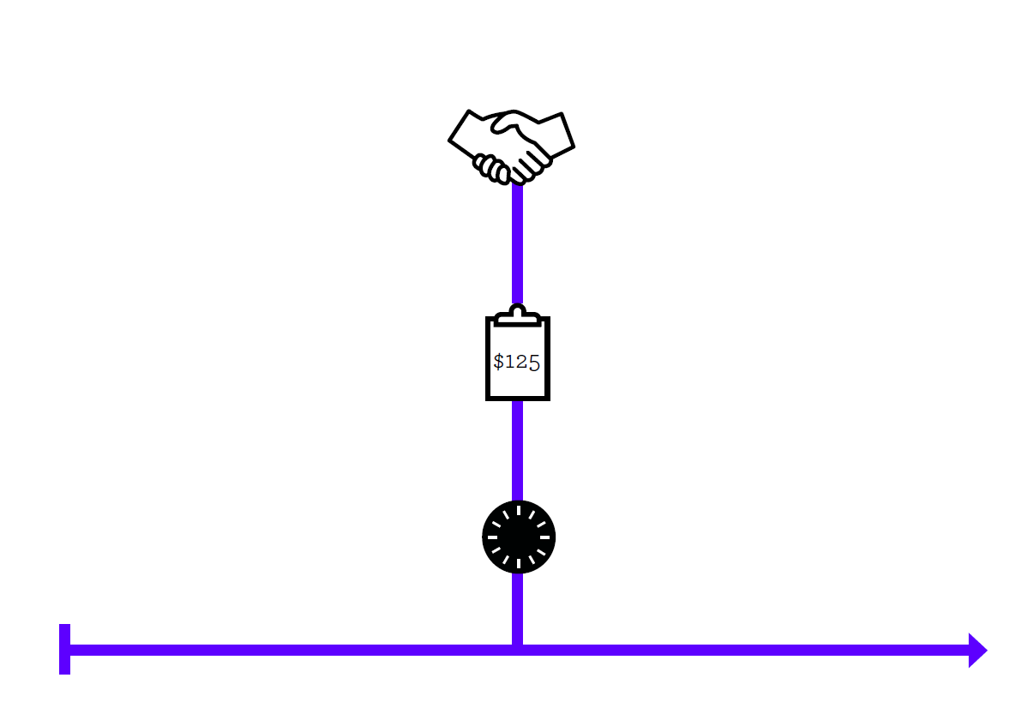
Carrie Nieman
$200

Slide 8

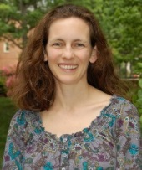
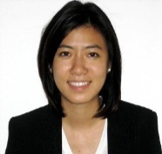
Access HEARS: Hearing care Equality through Accessible Research & Solutions
HEARS Intervention
1) Hearing Loss Screening
2) Device Orientation:
- Self-fit amplification device
- Individual programming
3) Counseling:
- Expectation management
- Communication Strategies
BaltimoreHEARS
Low-income minority older adults inner city Baltimore
Pilot Studies in Multiple Populations
Carrie Nieman
Older Adults with Cognitive Impairment or Dementia
Sara Mamo
Korean-American Older Adults – Korean Martyrs Catholic Church
Carrie Nieman
Janet Choi
Definitive Trials
Licensing & Dissemination
Non-profits
Local government
Pilot Studies
Multiple Communities
Outcomes in participant & communication partner
Social Engagement
Communication
Activities
HRQL
Intervention
Development
2016-2019
2014-2016
2013
Notes:
Insert graphic

Slide 9
Thank you! flin1@jhmi.edu www.accesshears.com www.linresearch.org

Slide 10
Acknowledgments
Johns Hopkins
  Nick Reed
  Jennifer Deal
  Joe Coresh
  Richey Sharrett
  Marilyn Albert
  Alden Gross
  George Rebok
  Josh Betz
NIA
  Luigi Ferrucci
  Susan Resnick
  Yang An
  Eleanor Simonsick
ARIC Study Team
K23DC011279
R34AG046548
R01HL096812
R21DC015062
P30AG048773
Triological Society & American College of Surgeons Clinician Scientist Award
Eleanor Schwartz Charitable Foundation
NIA Intramural Research Program

