Slide 1
Notes:
No change in content, just added color.

Slide 2

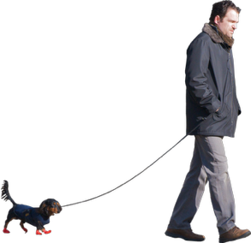
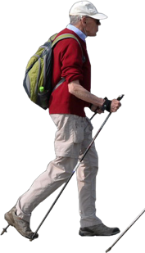
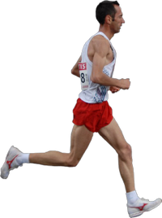




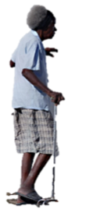

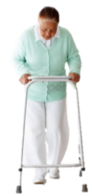

Aging and Trajectory of Function
Notes:
No change.

Slide 3
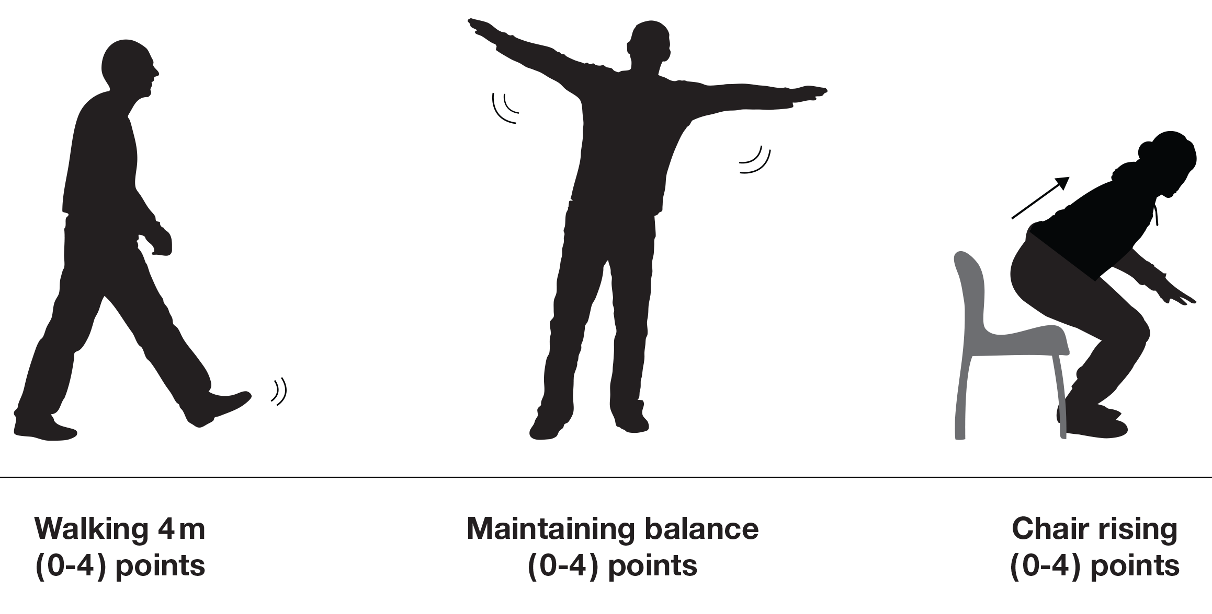
Development of a Short Physical Battery to Predict Disability
Notes:
We divided your slide into two. This one illustrates the development of the short physical battery.

Slide 4
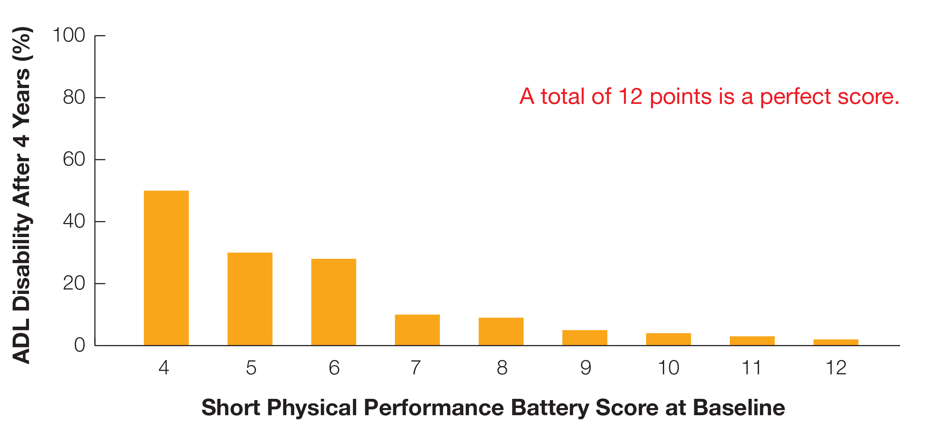
Lower-Extremity Function in Persons over the Age of 70 Years as a Predictor of Subsequent Disability
^{Jack M. Guralnik, MD, PhD}
^{Luigi Ferrucci, MD, PhD}
^{Eleanor M. Simonsick, PhD}
^{Marcel E. Salive, MD, MPH}
^{Robert B. Wallace, MD}
Notes:
This is the second half of your slide. We used the data points which were embedded in the slide.

Slide 5
Walking Speed
A Powerful Predictor of Mortality
100%
Faster 80%
Percent Survivors
75%
Cancer
The slowest 20% had a lower survival rate
after 6 years than participants with cancer.
Slowest 20%
50%
0
2
4
6
Years
Notes:
Retitled. The graph is based on the original data from your slide.

Slide 6
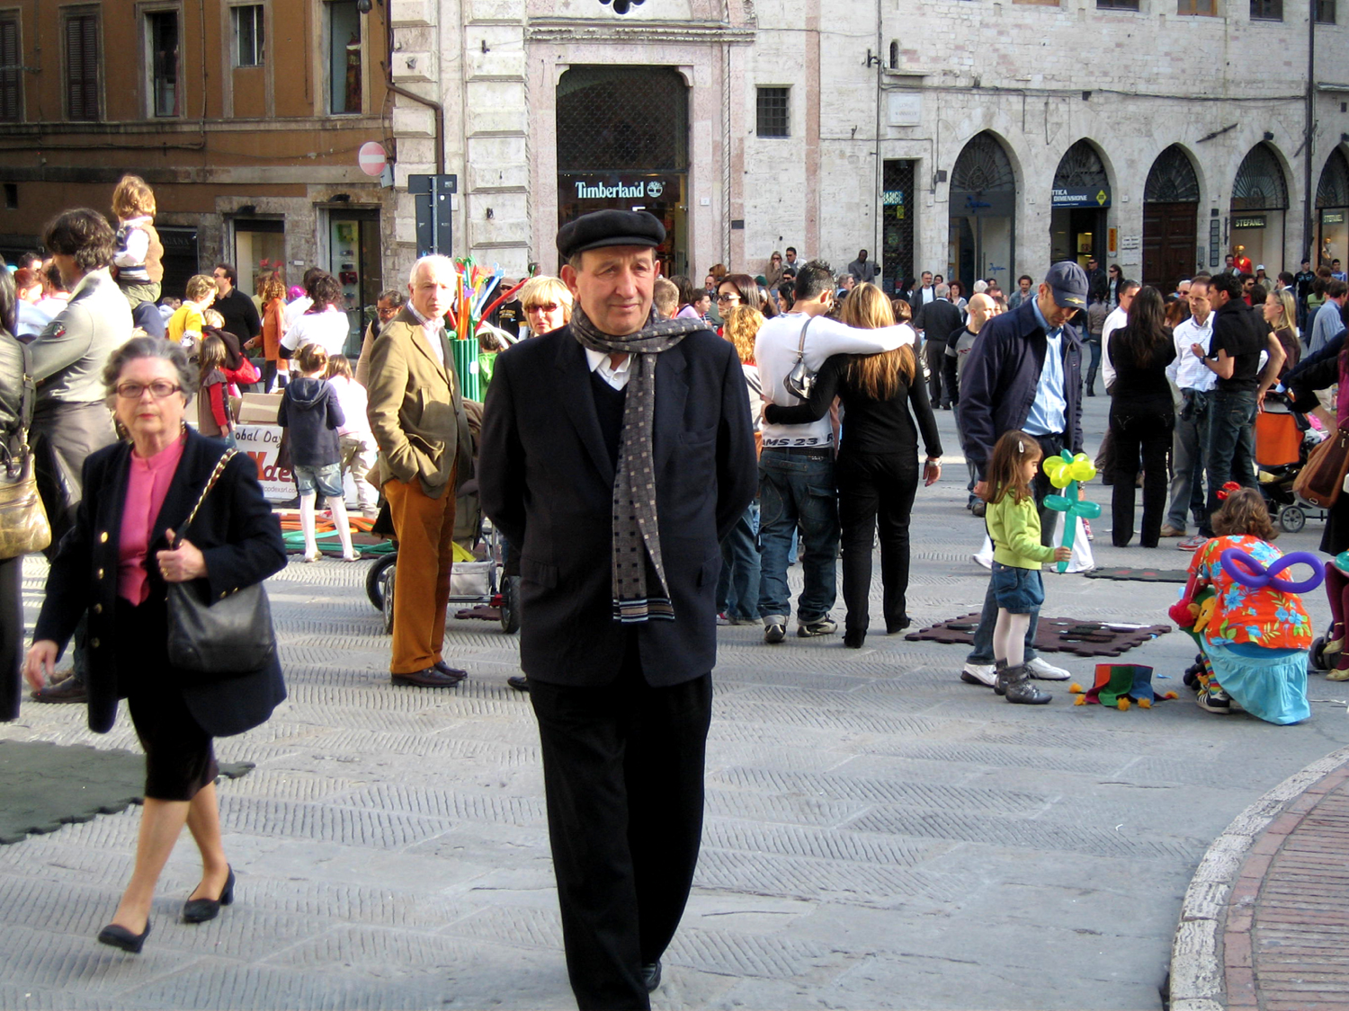
How old is she?
Notes:
No change

Slide 7
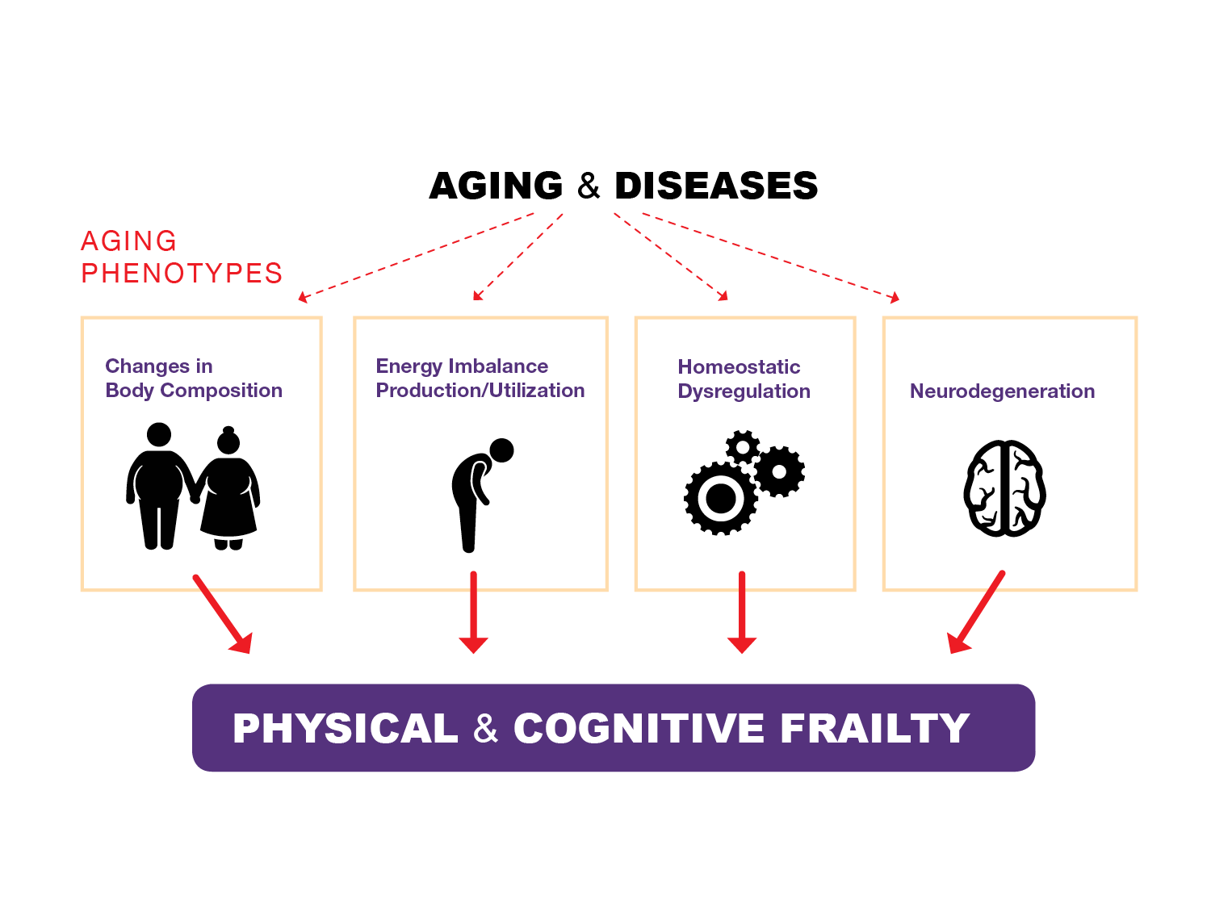
The Process of Aging and Diseases
Notes:
We tried to make it easier to read from the seats.

Slide 8

Changes in
Body Composition
Notes:
Based on your slide.

Slide 9
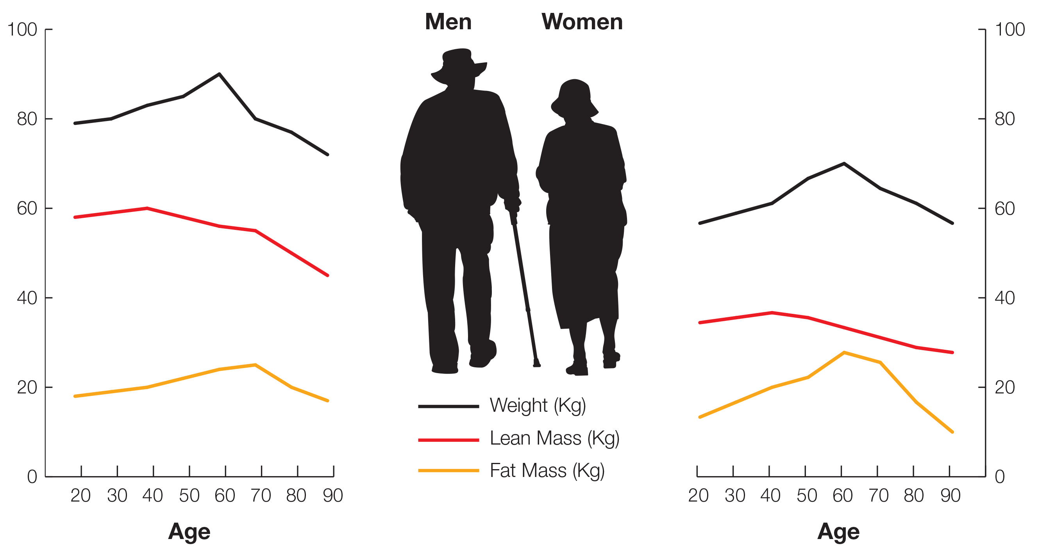
Weight, Muscle and Fat
Longitudinal Changes in Body Composition with Age
Notes:
This is one you saw before.

Slide 10
Fat and Where it is Located is Related to Glucose Intolerance in Older Adults
Early Liver Uptake
Late Muscle Uptake
REFERENCE
Glucose AUC (mg*h/dl; median)
Lean
Belly Fat
Fat All Over
Fall All Over but No Extra Belly Fat
Notes:
Is this too simplified?

Slide 11
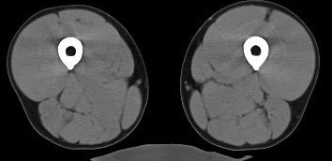
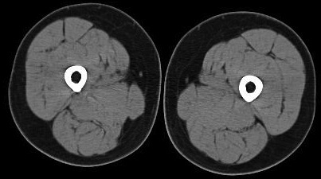
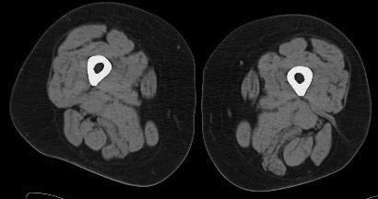
Muscle
Mid-Thigh CT Images for Women (BMI 30-32)
33 Years
55 Years
80 Years
Notes:
No change

Slide 12
Differences in Muscle Mass by Age
20000
Men
Women
15000
Mid-Thigh Muscle Cross-Sect Area (mm²)
10000
5000
20
40
60
80
100
Age (years)

Slide 13
Decrease in Muscle Strength by Age
200
Men
Women
150
Quadriceps Isokinetic Peak Torque (180'/sec) (N.m)
100
50
0
20
40
60
80
100
Age (years)
Notes:
Simplified

Slide 14
Both Muscle Mass and Muscle Strength
Decrease with Age
25-34
versus
<25
35-44
versus
25-34
45-54
versus
35-44
55-64
versus
45-54
65-74
versus
55-64
75-84
versus
65-74
85+
versus
75-84
Strength
Mass

Slide 15

Energy Imbalance Production Utilization

Slide 16
Energy Budget
Reserve energy for sustained or intense activity
Energy for
casual walking
Sources of Energy Waste
Instability, infirmity &
inefficiency
Excess cost of Movement
due to Energetic Inefficiency
Repair, recovery
& regulation
Homeostatic Effort due to Diseases and/or Aging
Minimum energy
to sustain life
in “good health”
Basal Energy
60-70% of 24 h
consumption

Slide 17
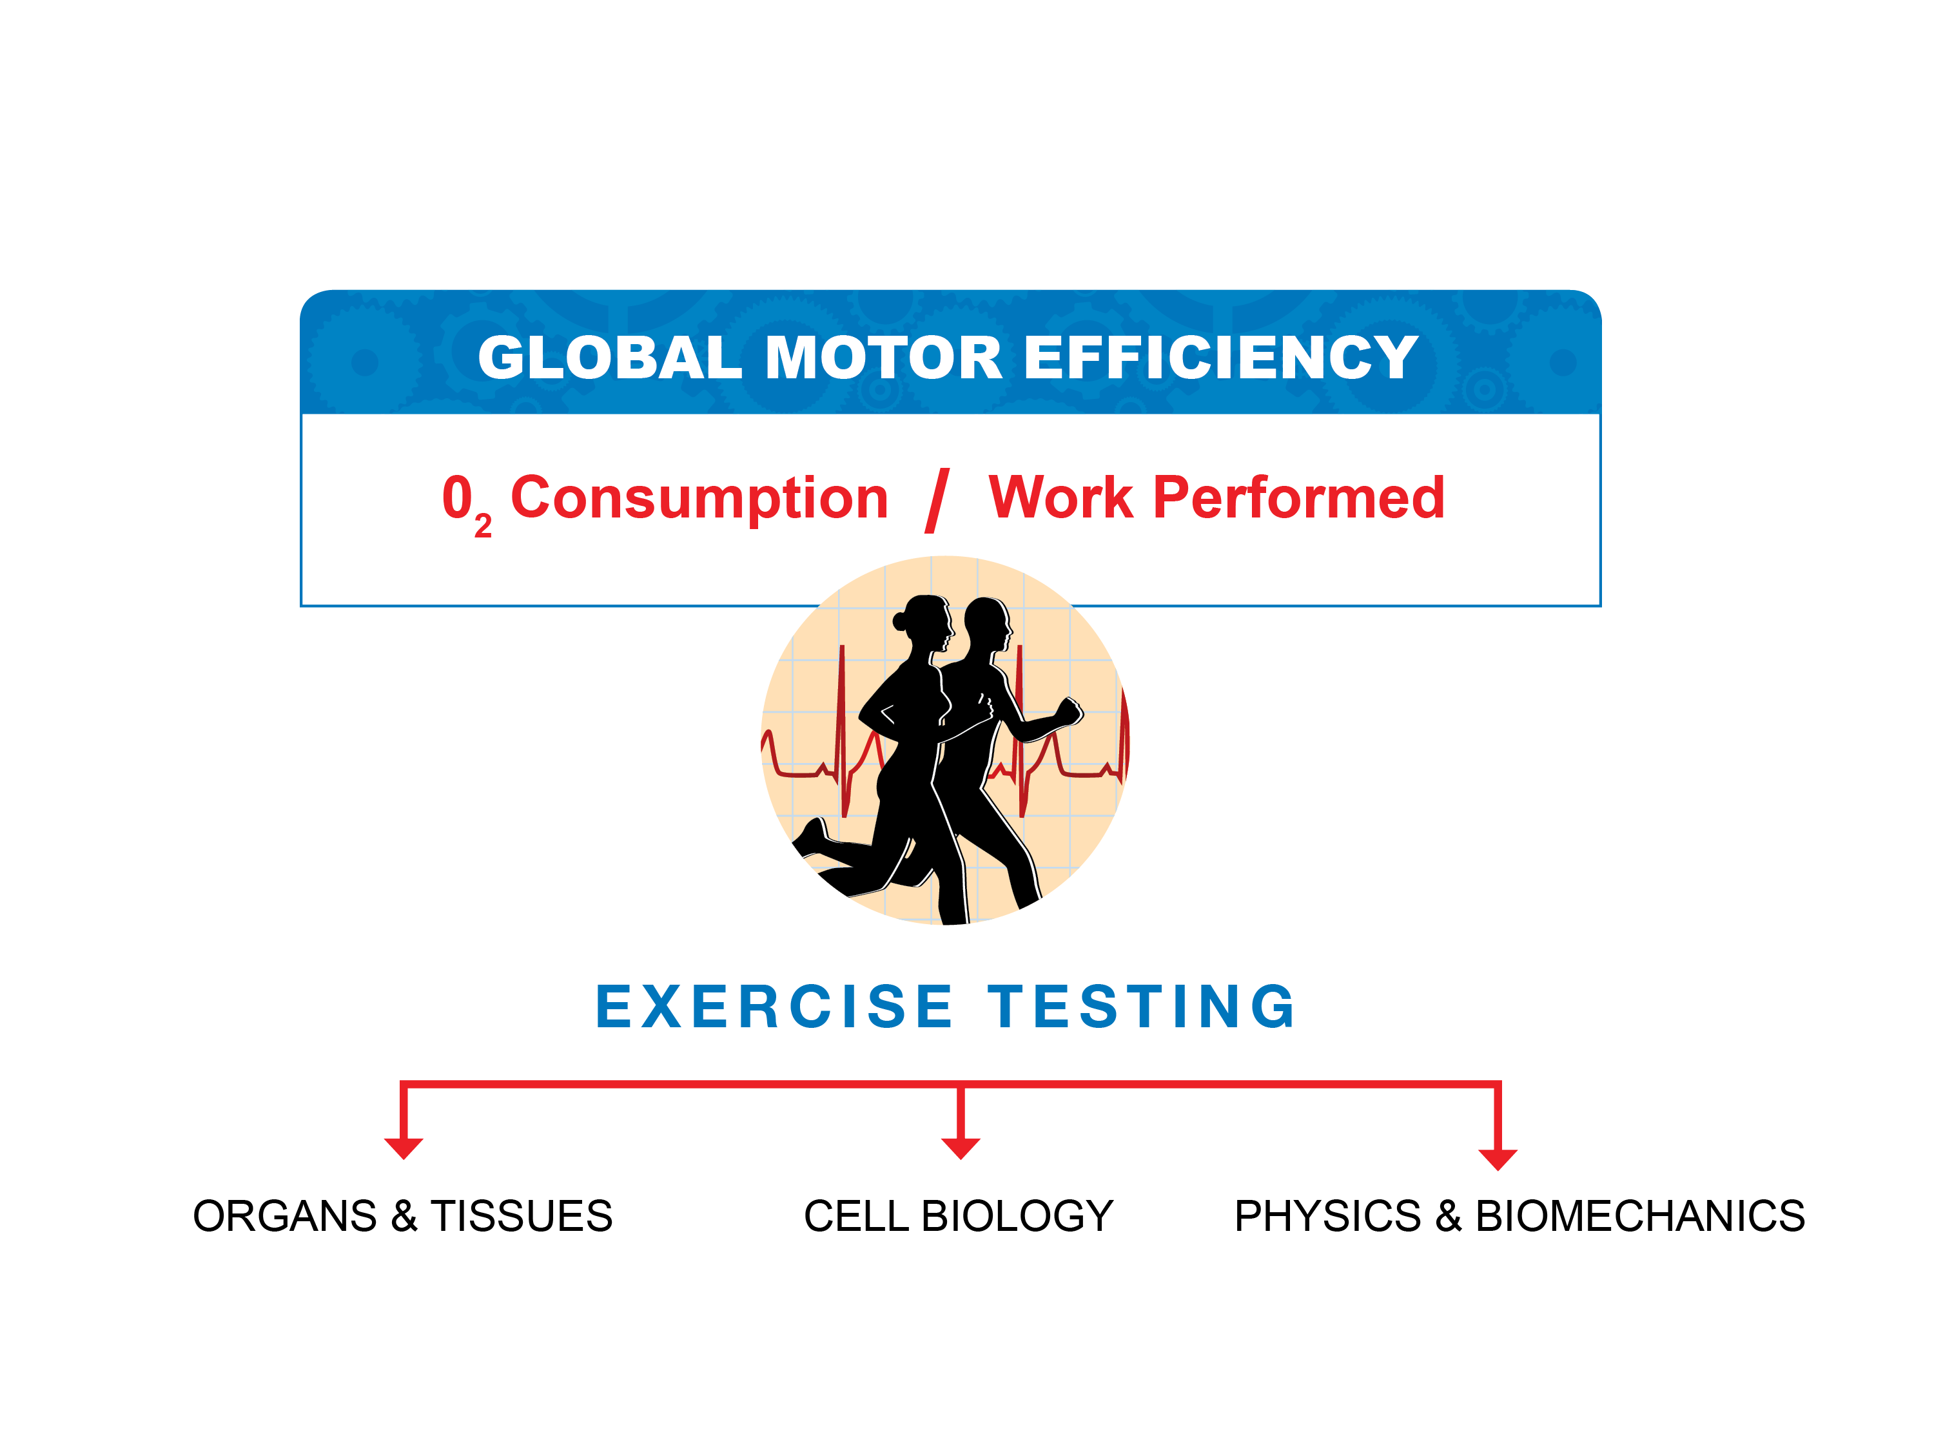
How We Measure Energy Efficiency

Slide 18
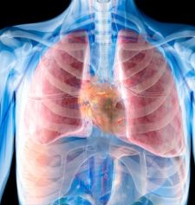
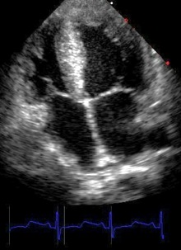
Organs and Tissues
Respiratory Testing
Oxygen uptake efficiency slope
Spirometer (FEV1)
CV Testing
Cardiac function (Echo)
Vascular stiffness (PWV)
Capillary density (biopsy)

Slide 19
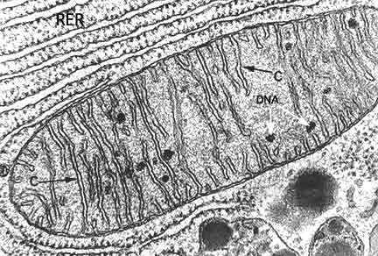
Cell Biology
Cell Biology and MRS
Mito volume
(microscopy + EM)
Mito content (cardiolipin)
ADP-ATP phosphorylation (ATPmax) (31P MRS)
Phase III mitochondrial respiration (oxygraph)
ECT enzyme activity
(NADH oxidase)

Slide 20
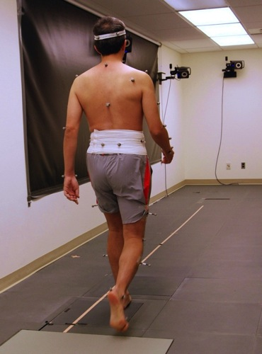
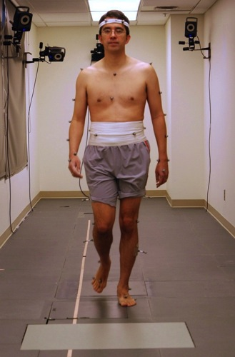
Physics and Biomechanics
Gait Testing
Muscle
strength/mass
Balance
Joint pathology
Sensory impairment

Slide 21

Homeostatic Dysregulation

Slide 22
The Mild Pro-Inflammatory State of Aging
IL-6 in Men
IL-6 in Women
1.5
1.5
1
1
0.5
0.5
n of SD from the sex-specific mean
0
0
-0.5
-0.5
-1
-1
1
20-39
40-49
50-64
65-74
75-84
85+
20-39
40-49
50-64
65-74
75-84
85+
Age Groups
Age Groups

Slide 23
Interleukin-6 Serum Levels in Older Adults
Predict Incident Disability 4 years later
95% CI
1.0
0.8
Adjusted
probability
2.5 pg/ml
0.6
Probability of Mobility Disability
0.4
95% CI
0.2
0
-0.5
0
0.5
1
1.5
2
2.5
3
Ln (IL-6)

Slide 24

Neurodegeneration

Slide 25
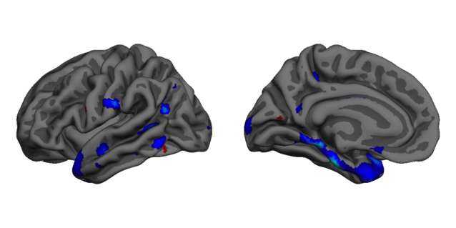
Annual Rates of Cortical Thinning over 8 Years in Normal Aging & Cognitive Impairment
Cognitively Normal (n=96)
Cognitively Impaired (n=25)
-0.04
-0.01
0.01
0.04
-0.04
-0.01
0.01
0.04
CI > CN
-4
-2
2
4

Slide 26




Amyloid Plaques Precede
Memory Problems
Memory Problems
4 years later
Stable Memory

Slide 27
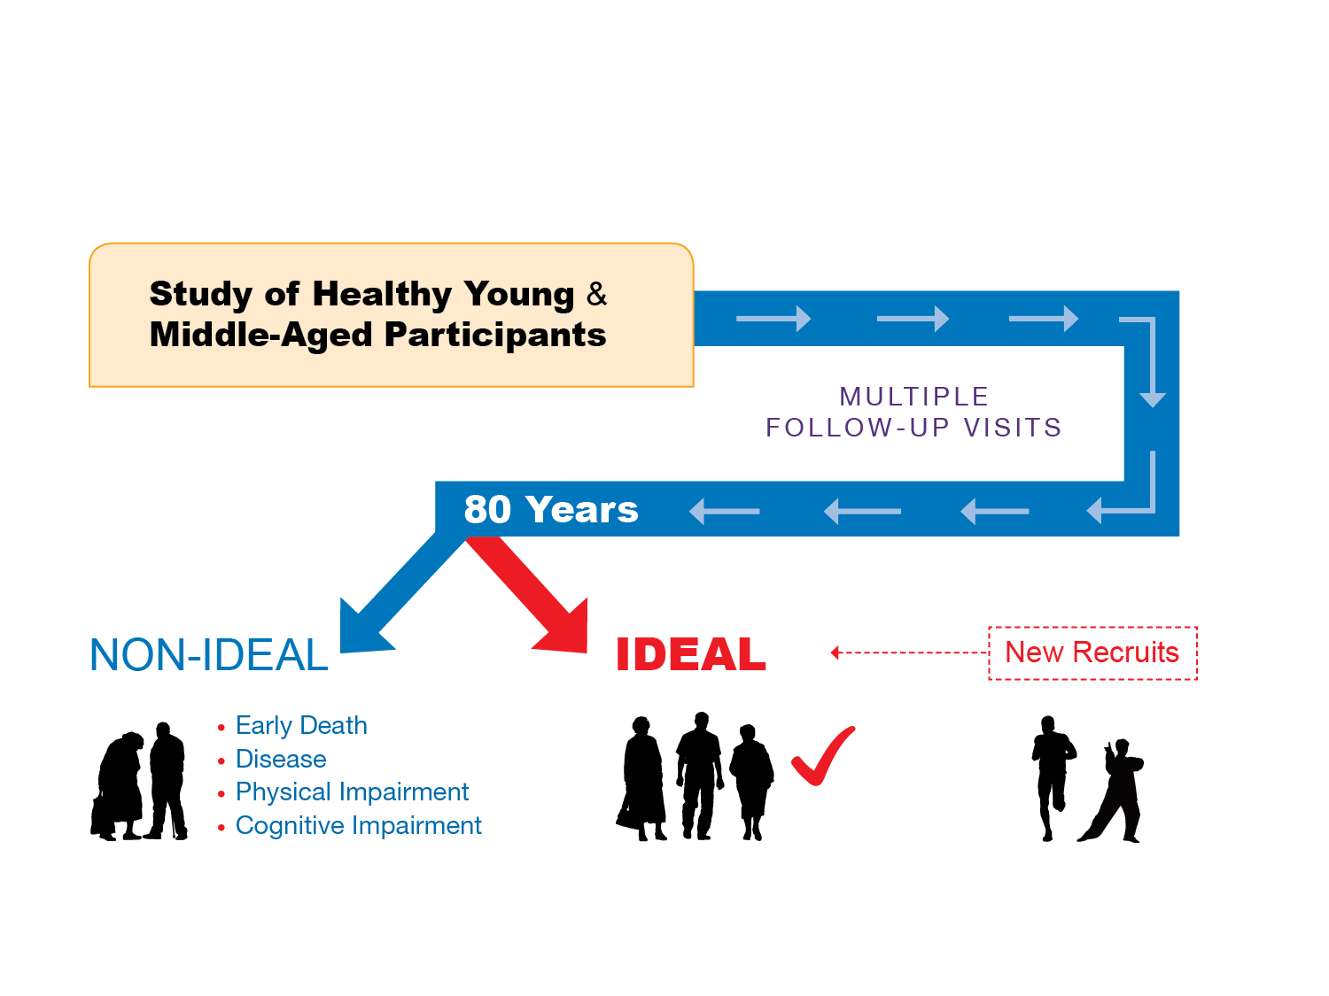
The BLSA
Baltimore Longitudinal Study of Aging

Slide 28
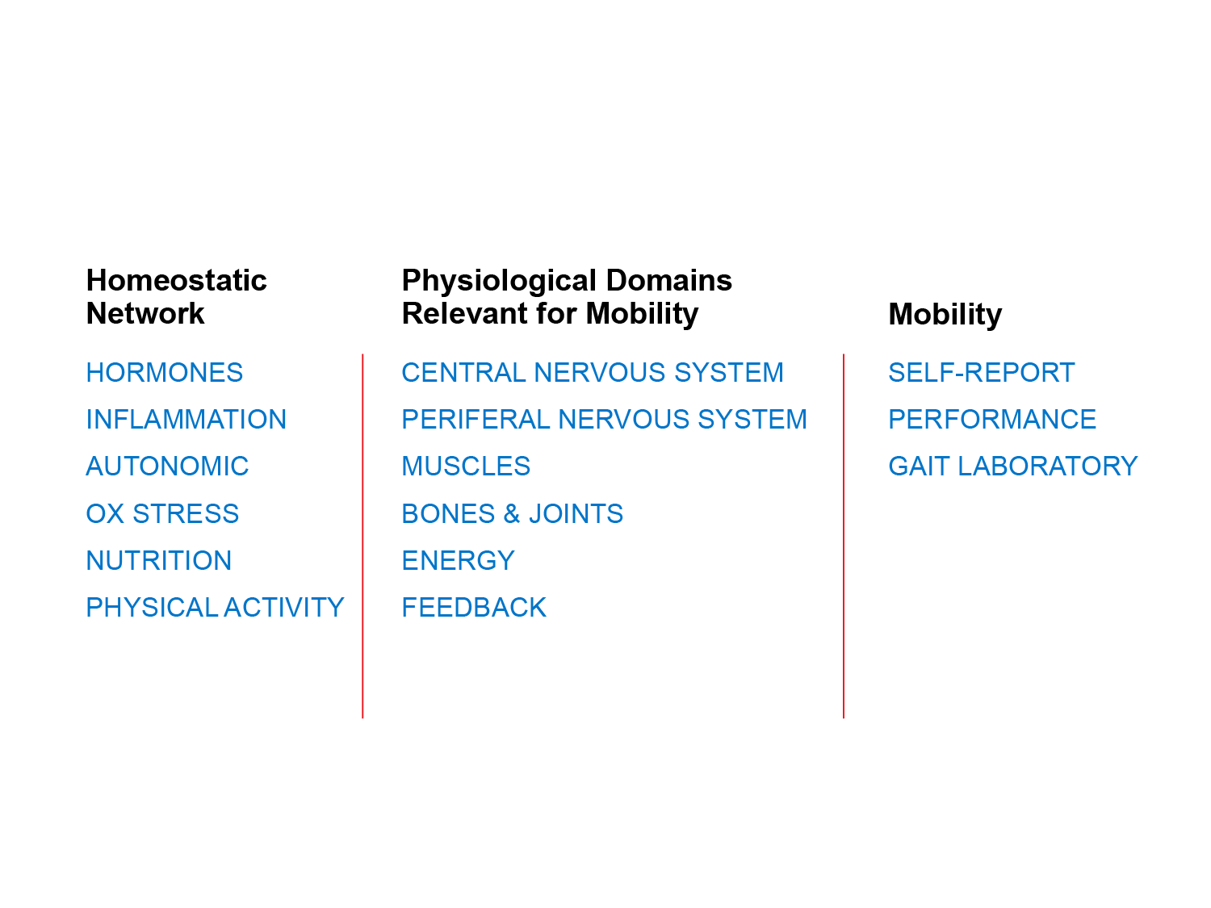
Measures in the BLSA
Paradigm – A Hierarchical Network of Measures
t
Notes:
So we need this? If yes where do suggest it should go?

Slide 29
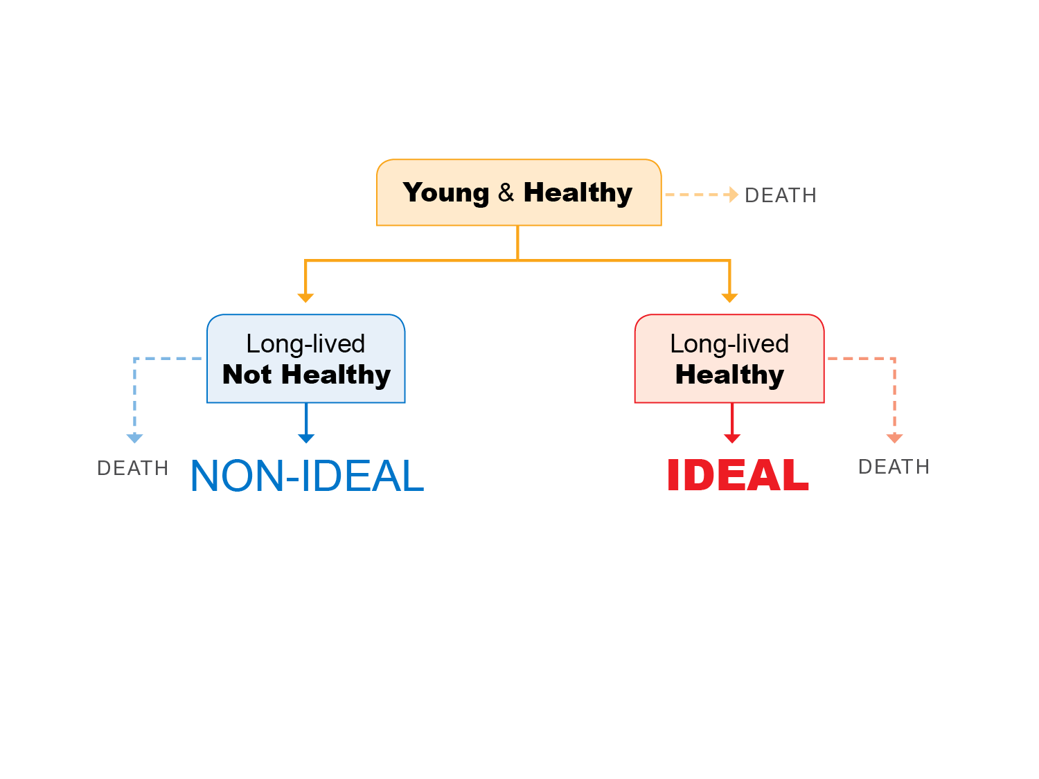
What Can We Learn From IDEAL?
Notes:
Will provide title and minor redesign.

Slide 30
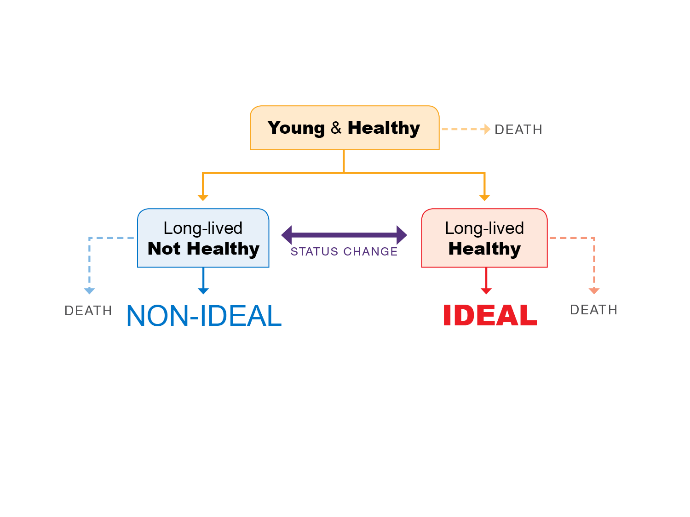
What Can We Learn From IDEAL?
What differentiates people who survive to old age maintaining an IDEAL condition compared to those who also survive to old age but develop diseases and functional impairments?
Notes:
Will provide title and minor redesign.

Slide 31
What Can We Learn From IDEAL?
What are the risk factors for mortality or losing IDEAL status
in IDEAL persons
Notes:
Will provide title and minor redesign.

Slide 32

Lessons from the BLSA

Slide 33
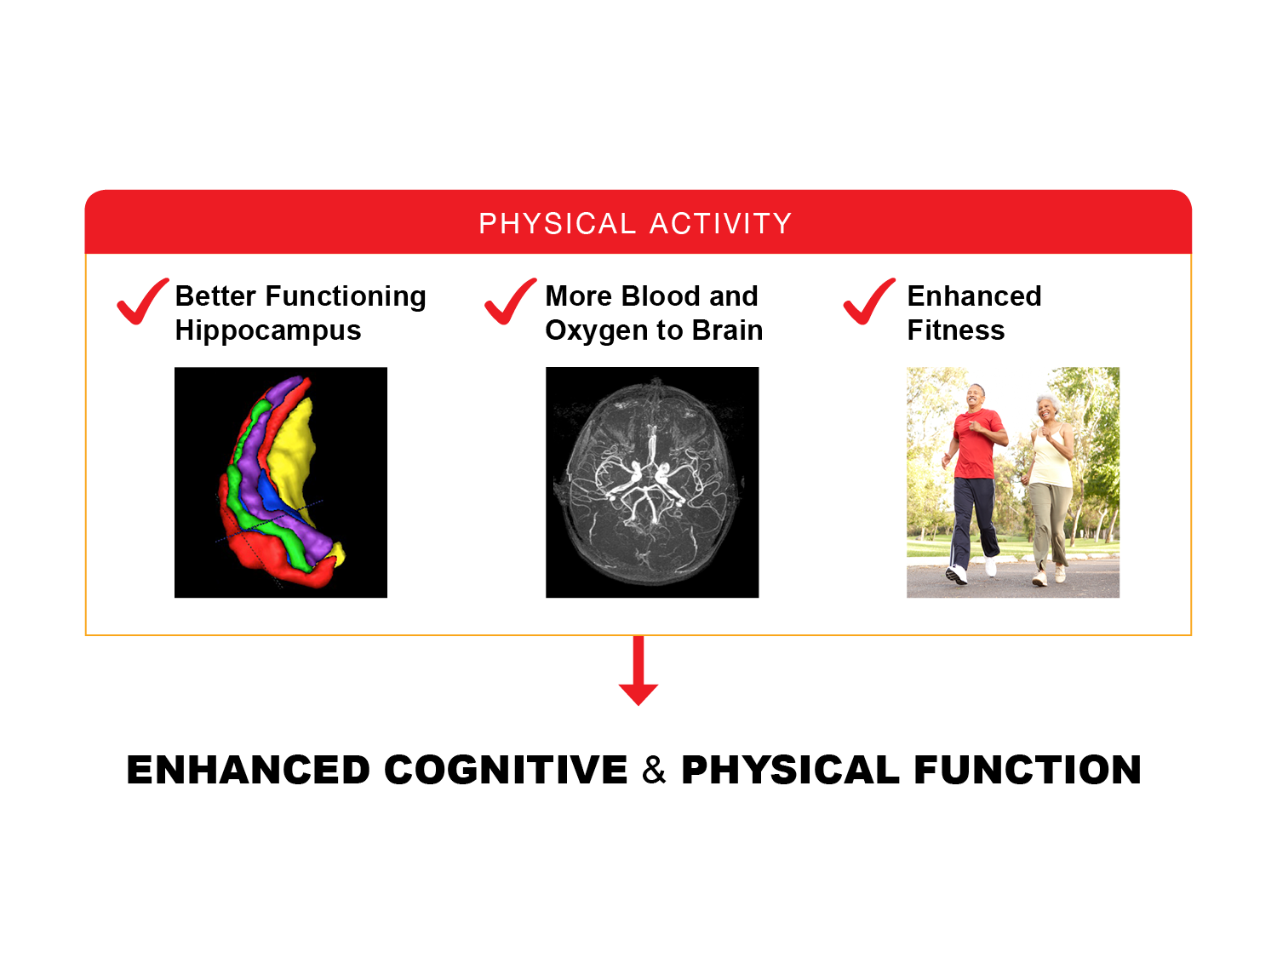
Get Moving
senior citizens running

Slide 34
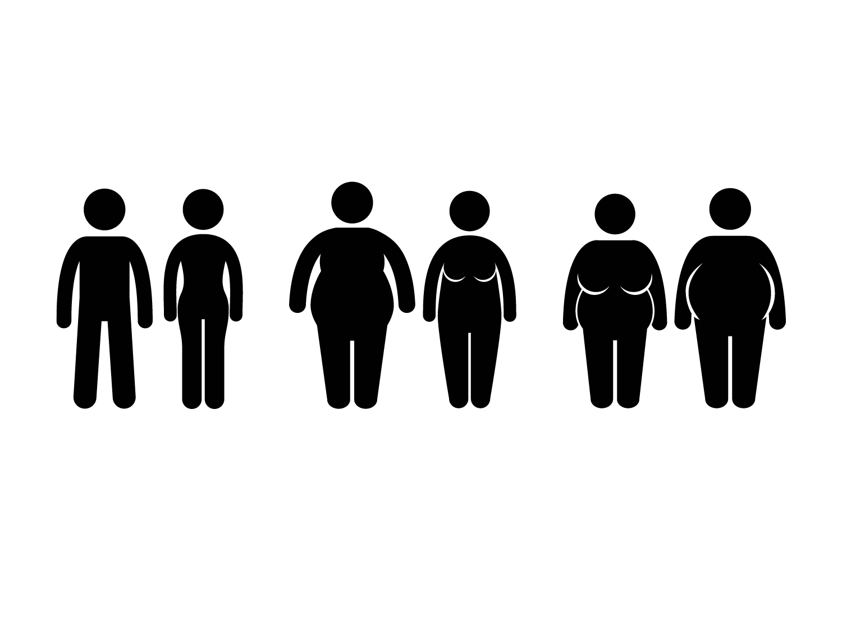
Pay Attention to Weight and Shape
LEAN
PEAR
APPLE

Slide 35

Think About What you Eat

Slide 36

Participate in Activities you Enjoy

Slide 38
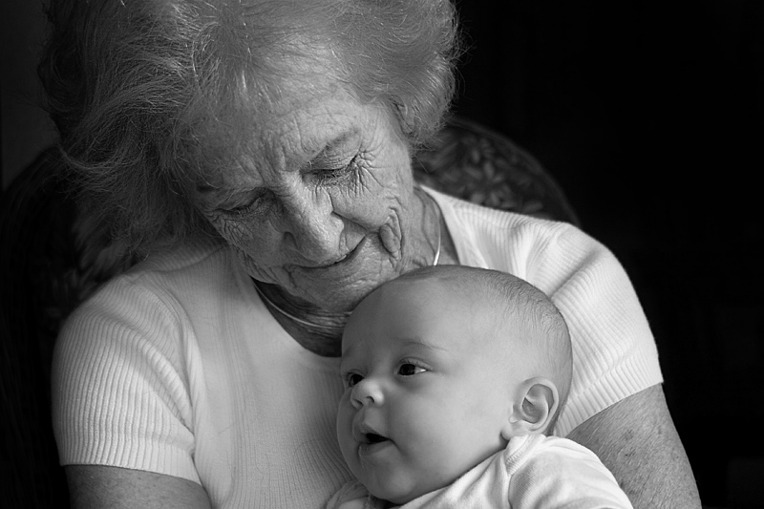
A Study for our Children and the Children of our Children

Slide 39

QUESTIONS?

