Slide 1


Investing in Research that Promotes Healthy Aging and Independent Living
Maryland Commission on Aging
Marie A. Bernard, M.D.
Deputy Director
National Institute on Aging
September 22, 2016

Slide 2

Objectives
What is the role of the NIA at NIH?
What things can enhance overall aging?
What can be done about Alzheimer’s type dementia?

Slide 3


National Institutes of Health
NIH Building 1

Slide 4
NIA Mission
Established in 1974 to support and conduct research on:
    aging processes
    age-related diseases
    special problems and needs of the aged
Train and develop research scientists
Provide research resources
Disseminate information on health and research advances

Slide 5
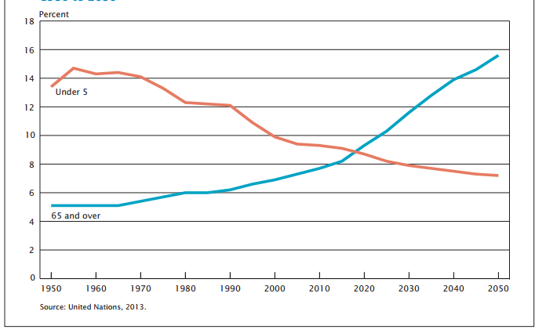

World’s Older Population is Growing
He et al. U.S. Census Bureau, International Population Reports, P95/16-1, An Aging World: 2015

Slide 6
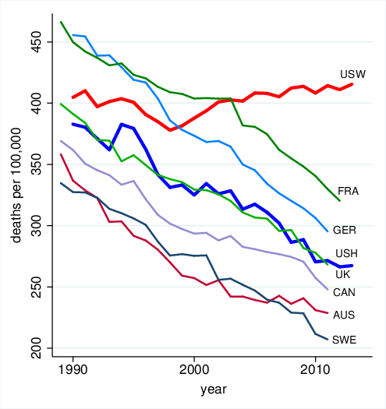
Rising Morbidity and Mortality Among White Americans in the 21st Century
Case A and Deaton A. PNAS. 2015

Slide 7


Slide 8
True or False?
Behavioral modification does not play much of a role in aging
Medications can be as effective as lifestyle modification in avoiding diabetes in older age
Exercising 70 to 80 year old individuals with functional problems can limit disability
Lowering the blood pressure to 120/80 is risky for older adults

Slide 9
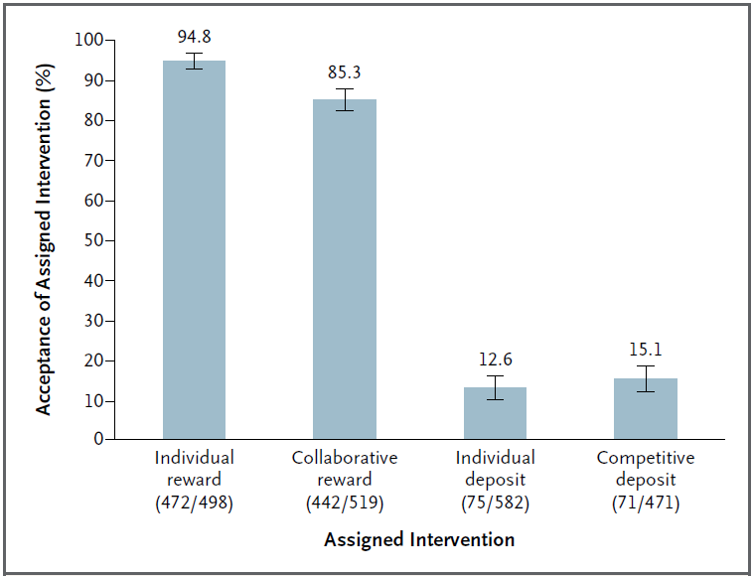
Smoking Cessation - “Reward” over “Commitment” conditions
Halpern et al. N Engl J Med. 2015

Slide 10
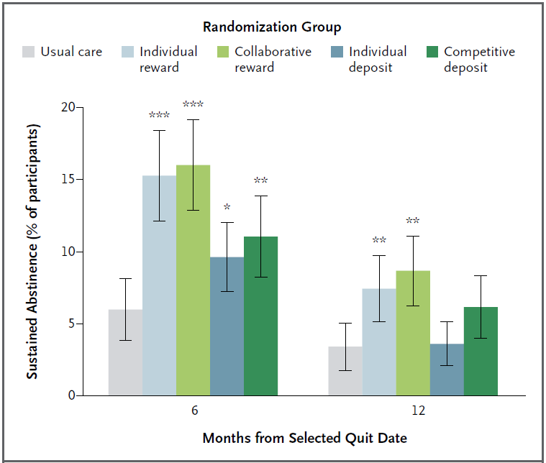
Outcomes
Halpern SD, et al. N Engl J Med. 2015.

Slide 11
Diabetes Prevention Program
15
Lifestyle
Metformin
Placebo
12
9
Cases/100 person-yr
6
3
0
25-44
45-59
> 60 (n=648)
(n=1000)
(n=1586)
Diabetes Prevention Program Research Group. (2002) N Engl J Med 346:393-403.

Slide 12
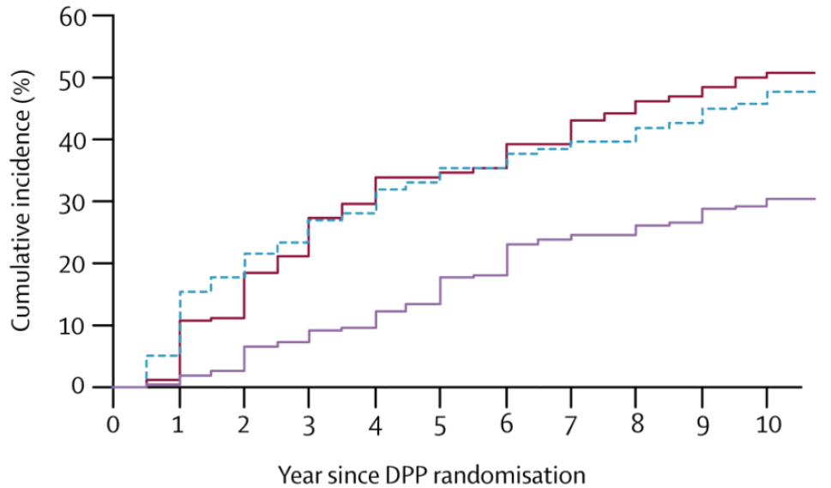

DPP: 10 Year Follow-Up
Diabetes Prevention Program Research Group. Lancet. 2009

Slide 13


Slide 14

Lifestyle Interventions and Independence For Elders
A Randomized Clinical Trial of Exercise to Prevent Mobility Disability in Non-disabled Older Persons with Functional Limitations

Slide 15

The LIFE Study
Objective: Can exercise prevent major mobility disability?
Design:
  multicenter RCT
  1,600 non-disabled, community-dwellers
  70-89 y.o.

Slide 16

LIFE Interventions and Outcomes
Walking
Resistance
Balance
Stretching
Decreased disability by 18%
If disabled, reduced length of time with disability
Pahor M,et al. JAMA. 2014

Slide 17


Be Active Every Day!
go4life.nia.nih.gov/month

Slide 18
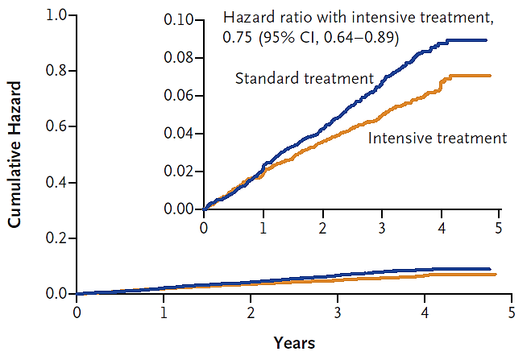
SPRINT Study
The SPRINT Research Group (2015) NEJM 373(22):2103-16.

Slide 19
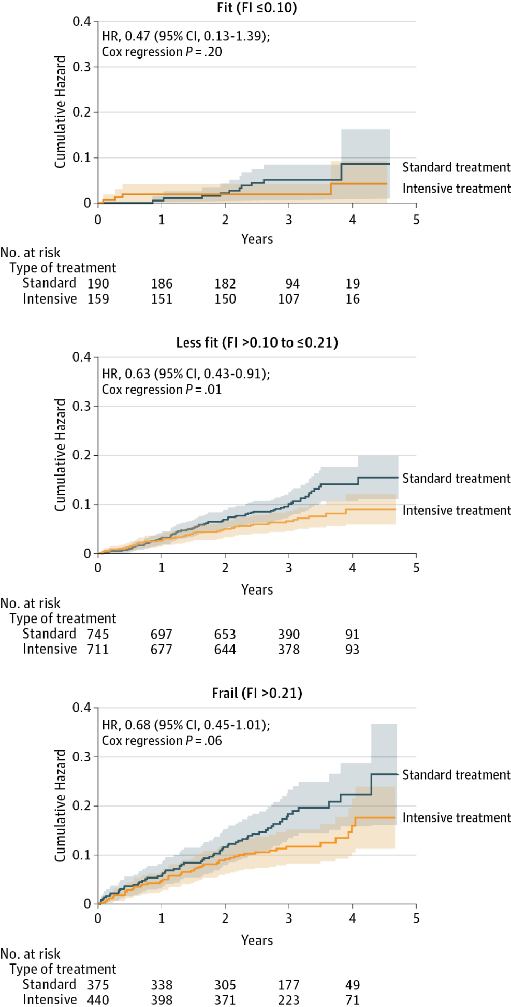
SPRINT Follow-up in Adults 75 years or Older
Williamson, J, et al. JAMA. 2016 Jun 28;315(24):2673-82. doi: 10.1001/jama.2016.7050

Slide 20

SPRINT Follow-up in Adults 75 years or Older

Slide 21
SPRINT Follow-up in Adults 75 years or Older

Slide 22
True or False?
Behavioral modification does not play much of a role in aging
Medications can be as effective as lifestyle modification in avoiding diabetes in older age
Exercising 70 to 80 year old individuals with functional problems can limit disability
Lowering the blood pressure to 120/80 is risky for older adults

Slide 23
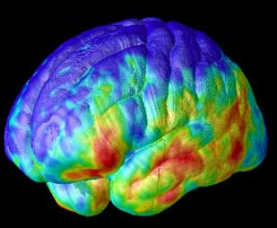
Slowing and/or Preventing Alzheimer’s Disease

Slide 24
True or False?
Dementia care is one of the most costly to the U.S.
There is a national plan for Alzheimer’s disease (AD)
An AD diagnosis is best made by neuroimaging techniques
Exercise and/or cognitive stimulation can stave off AD type dementia

Slide 25
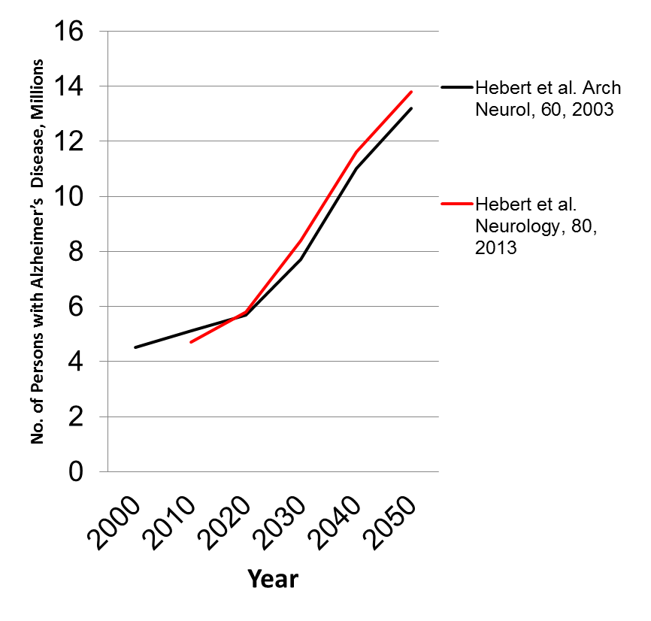
Prevalence of Dementia in the U.S.
2003 data
2013 data
Hebert, LE et al. (2013) Neurology 80(19):1778-83.
Hebert, LE et al. (2003) Arch Neurol 60(8):1119-22.

Slide 26
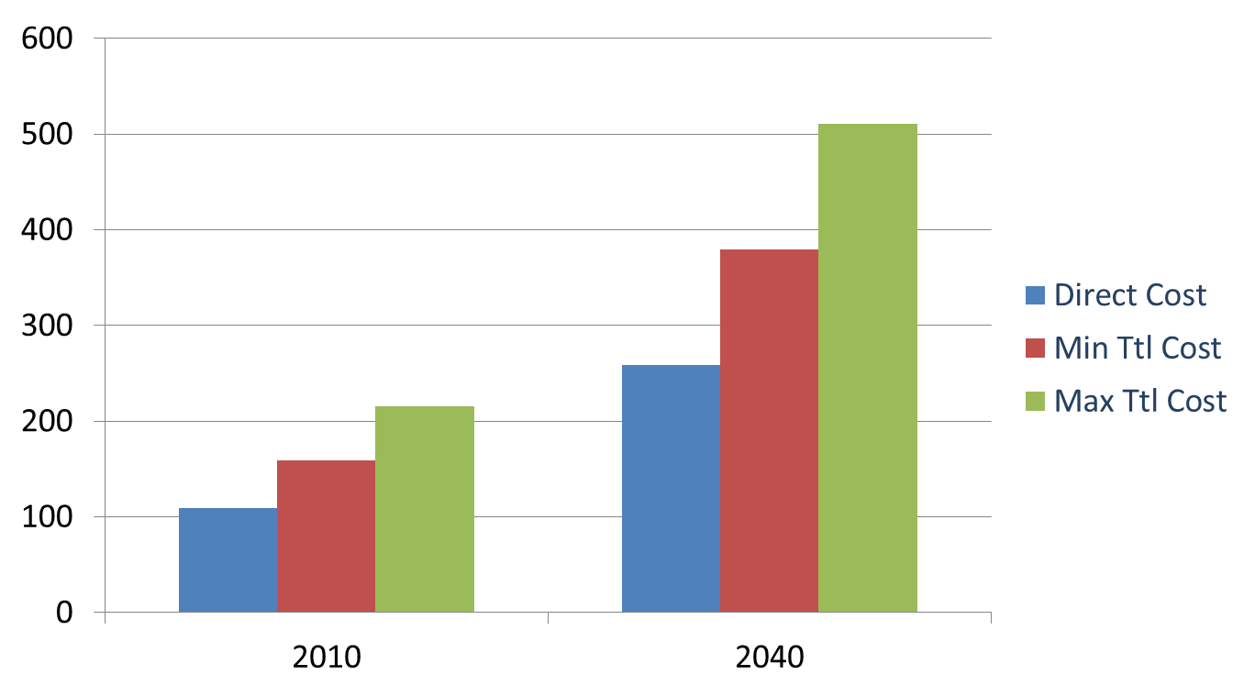
Costs of Dementia in the U.S.
$s in Billions
- projections in 2010 dollars
Hurd MD, et al. N Engl J Med. 2013

Slide 27

http://aspe.hhs.gov/daltcp/napa/NatlPlan.pdf

Slide 28
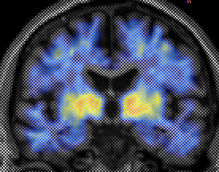
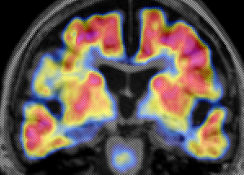
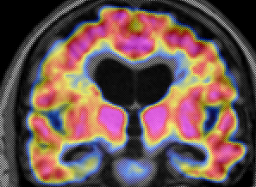
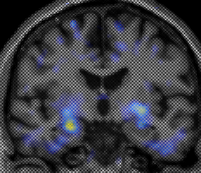
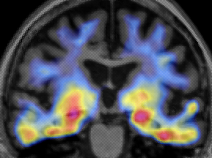
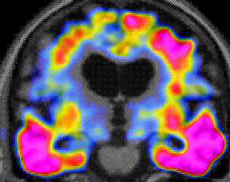
New technologies point the way
Aβ
(PiB)
Tau
(T807)
Cognitively Normal
Cognitively Normal
AD
Dementia
Sperling R,et al. Neuron. 2014.

Slide 29
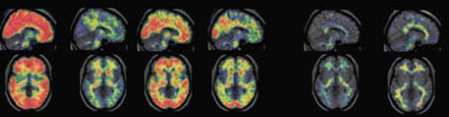
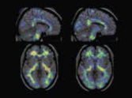
Early Identification is a Key Goal
For example, a family in Colombia that develops AD early is generously working with researchers
Non-Carriers, late 30’s
Gene Carriers, late 30’s
Beta-amyloid, late 20’s
Dementia onset is in late 40’s
Fleisher, AS et al. (2012) Lancet Neurology 11(12):1057-65.

Slide 30
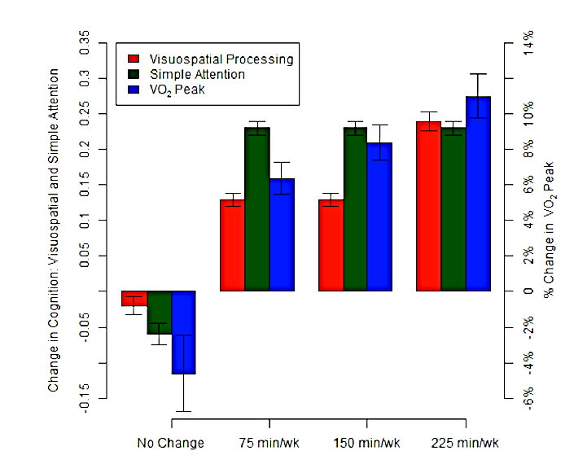
Vidoni, ED et al. (2015) PLoS One 10(7):e0131647.

Slide 31



AHRQ-HMD Study
Two-part assessment of the science of prevention strategies for AD-type dementia, amnestic MCI, and age-related cognitive decline

Slide 32
True or False?
Dementia care is one of the most costly to the U.S.
There is a national plan for Alzheimer’s disease (AD)
An AD diagnosis is best made by neuroimaging techniques
Exercise and/or cognitive stimulation can stave off AD type dementia

Slide 33



Slide 34
Summary
NIA leads federal research in aging and Alzheimer’s disease
There are a number of interventions that can enhance aging
There are developing interventions for Alzheimer’s type dementia

Slide 35

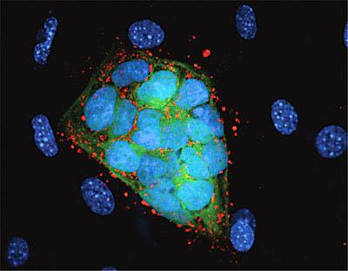

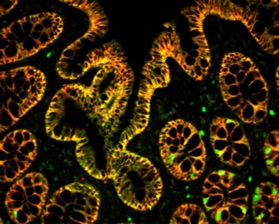




NIH…
Turning Discovery Into Health

