Slide 1
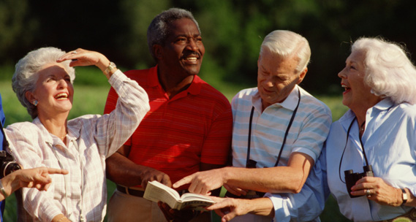
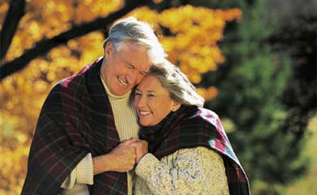


Creating Livable Communities for All Ages
Sandy Markwood
National Association of Area Agencies on Aging
Maryland Commission on Aging Training
September 10, 2014

Slide 2
What is Our Vision?
“To Build a Society That Values and Supports People as They Age”

Slide 3
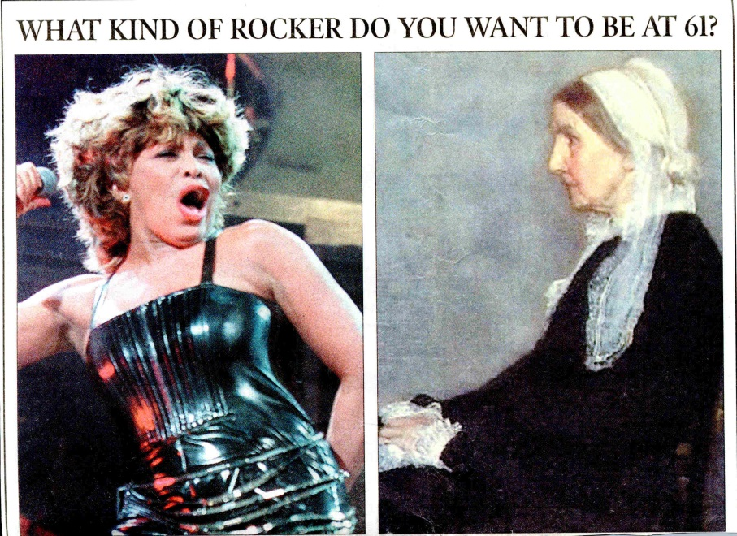
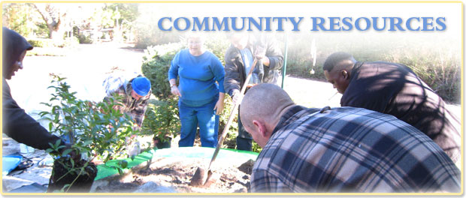
Redefining Age Redefining Aging in the Community
Notes:
I hope my aging 101 has given you some sense of the growth and diversity of the aging population and some insights into current and future health needs.
Here’s four points to help shape your strategies.
Third bullet - NC proposed legislation for 150 minutes of physical activity per week for K-8 and NC proposed legislation for pilot study in 8 schools where more nutritious foods are served for lunch and are made available in vending machines.

Slide 4
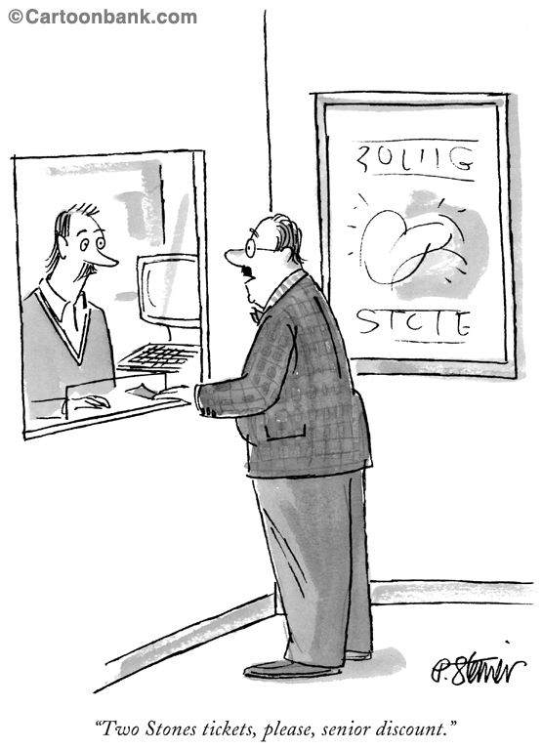
“Two Stones tickets, please, senior discount”
©2001 The New Yorker Collection from cartoonbank.com. All Rights Reserved.

Slide 5
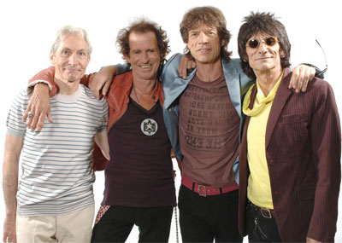
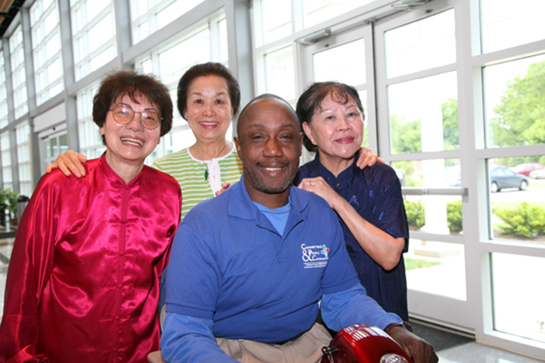
Meeting the Needs & Capitalizing on the Assets of Multiple Older Generations

Slide 6
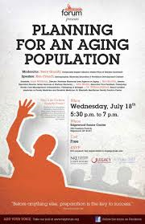
The Aging of the Population Is Something to be Celebrated!
But To Ensure that Individuals Can Age Successfully will Require:
Individuals Need to Plan
Their Families Need to Plan
And Our Communities Need to Plan

Slide 7
Impact of the Aging of the Population on Your Community
Housing
Health
Transportation
Land Use Planning
Public Safety
Parks and Recreation
Workforce Development/Education
Volunteerism/Civic Engagement
Arts and Cultural Activities
Economic Development/Fiscal Impact

Slide 8
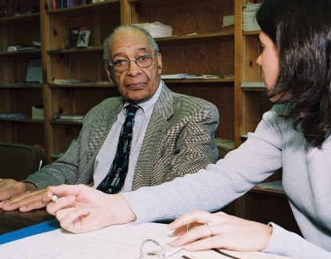
Land Use Planning
Review of Master Plan
Review of Capital Improvements Plan
Review of Transportation Plan
Review of Zoning and Subdivision Requirements
Review of Building Codes

Slide 9
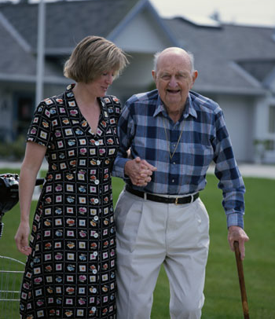
Housing
Modification of Existing Homes
Zoning Changes to Allow Different Types of Housing Units within Existing Neighborhoods
Regeneration of Housing in Downtown Areas
Development of Active Communities
Development of Affordable Assisted Living Facilities, Continuing Care Retirement Communities, Group Homes, Co-Housing
Use of In-Home Technology

Slide 10
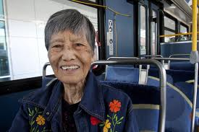
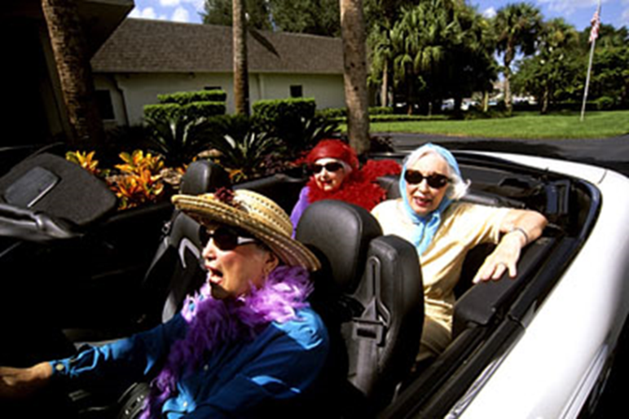

Transportation
Making the Roads Safer
for Older Drivers
Making Sidewalks and Street Crossings More Accessible for Older Pedestrians
Providing Mobility Options- Transit, Paratransit, Volunteer Drivers
Offering Mobility Management Assistance

Slide 11
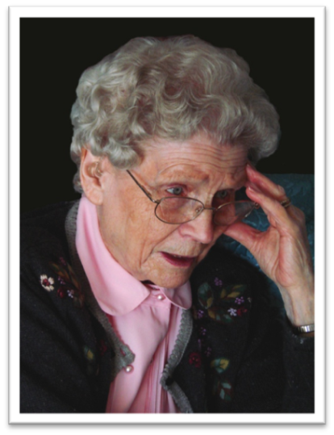
Public Safety
Promoting “Safe Communities”
Considering Older Adults in Emergency Evacuations/Homeland Security/Disaster Preparedness
Increased Need for EMS

Slide 12
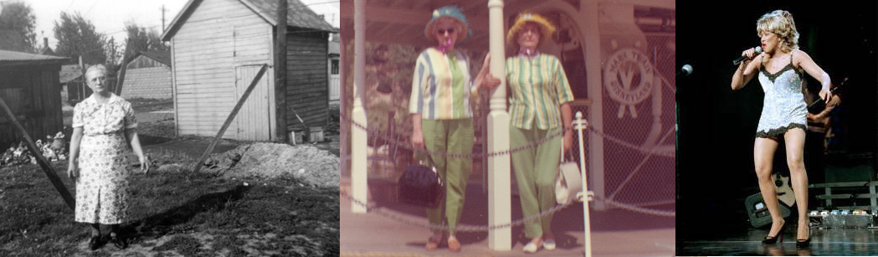
Are America’s Communities Ready for the Aging Baby Boomers?

Slide 13
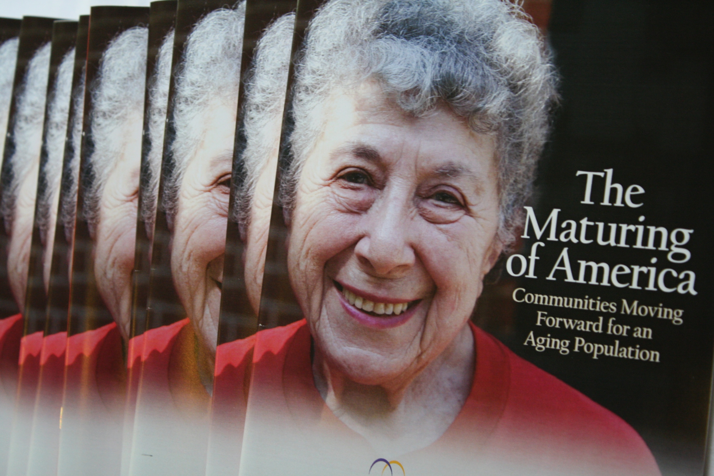

Slide 14
Maturing of America National Survey Found
Less than half of U.S. communities have begun significant planning efforts to prepare for their aging population

Slide 15
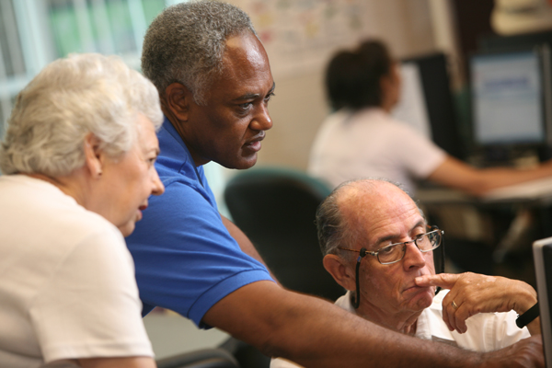
But the Survey Also Found that…
A Number of America’s Communities Are Starting to Change Their Services/Design to Become Lifelong Communities

Slide 16
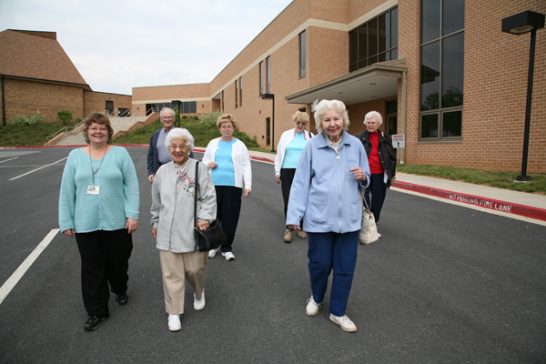
Is Your Community Ready to Meet the Needs and Capitalize on the Assets of Your Current Aging Population?

Slide 17
And Will Your Community Be Ready to Meet the Needs of the Boomers?

Slide 18
For a Copy of/Information on: Maturing of America Survey A Blueprint for Action: Developing a Livable Community for All Ages Holding a Livable Communities Forum in Your City Contact:
Sandy Markwood
National Association of Area Agencies on Aging
1730 Rhode Island Avenue, NW, Suite 1200
Washington, DC 20036
202/872-0888
smarkwood@n4a.org

