Slide 1

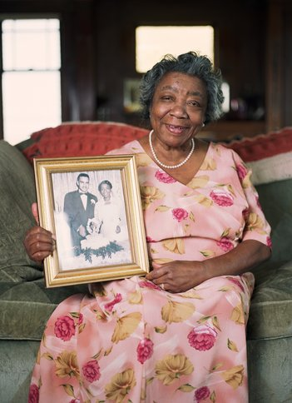


“Maximizing Independence at Home” (MIND at Home):
A Memory Care Coordination Program
Quincy M. Samus, PhD, MS

Slide 2
Current Financial Support
National Institute on Aging
Centers for Medicare and Medicaid
BrightFocus Foundation
Broadmead Retirement Community (JHU consultant contract)
Welltower (JHU consultant contract)

Slide 3


Program origin and vision
Photo: Paula Tillman-Hoffberger
    Origin
    Conceived by Roy Hoffberger & Kostas Lyketsos
    Grassroots, philanthropic collaboration
    Recognition great unmet needs in the community but effective care strategies available
    Vision
    Home-based, care coordination
    Family-centered, individualized (not one-size fits all), evidence-based
    Goals of care patient-centered (age-in-place, quality of life, reduce caregiver burden)
    Proactive and pragmatic
    Platform to “connect the dots” for medical, social and supportive care and services, technology

Slide 4

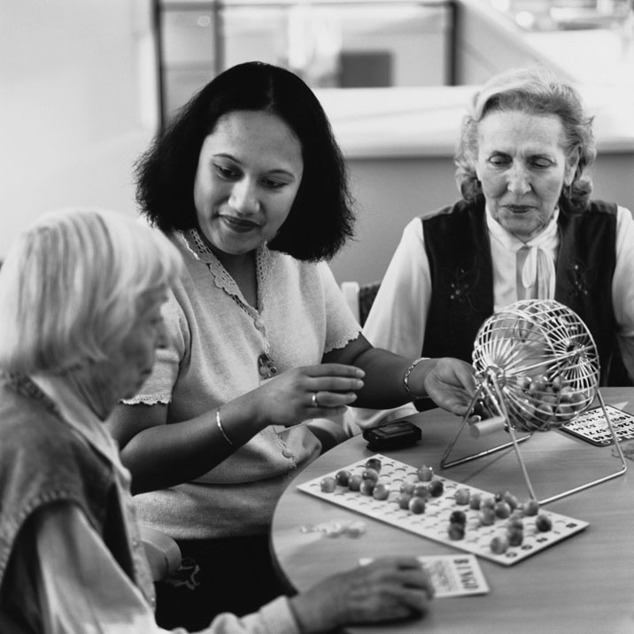
Pilot studies
Phase 1
Tested a dementia case finding method
Developed needs assessment tool
Initial prevalence unmet needs
Developed protocol
Phase 2
Pilot RCT of MIND on aging in place among community-living persons with memory disorders (18m, n=303)
PTs: Delayed transition from home, improved quality of PT life, reduced unmet needs
CGs: time savings (i.e. fewer hrs per wk with PT), reduced burden
Samus et al., American Journal of Geriatric Psychiatry, 2014
Notes:
Hybrid all stages of design

Slide 5
MIND at Home Model
(Streamlined, PLUS)
Home
Setting
Person with Dementia/
Family Caregiver
Primary Care and Specialty Care Provider
Social and supportive care services
Community Resources
Educate/Navigate/Support
Memory Care Coordinator
Direct Consultation on Complex Issues/ Full Needs Assessments
Facilitate/Coordinate
Aging Services
Regular clinical expert support
Geriatric Psychiatrist
Registered Nurse
Occupational Therapist
Other community resources

Slide 6
MIND at Home minimum core (Streamlined)
Initial JHDCNA needs assessment (PT & CG)
Individualized need-based care planning and standardized MIND service delivery
    Written care plan (family and Primary care provider)
    Implement core care strategies per standardized protocol
      Disorder education
      Referrals and Linking
      Specific skills/strategies/problem solving-DICE
      Emotional support
      Symptom screening/ Needs Assessment
    Caregiver resource binder
Monitoring and revision of care plan
  MCC direct encounter every 30 days
  Quality reviews, every participant, every 60 days by clinical supervisor
  Weekly care team rounds (challenging/complex cases)
  Tracking encounters in Dementia Care Management System
Full JHDCNA In-Home Reassessment (every 9 months)
Critical Events protocols
  PRN telehealth visits within 1 week of discharge
  Transitions/discharges

Slide 7
How MIND works
Care Needs
Proximal outcomes
Cognitive
Behavioral
Home Safety
Medical care
Activity/Daily Living
Legal/Adv. Care
Care Financing
CG education
CG Skills Training
Medical care
Mental health care
Informal supports
Legal
Reduce unmet needs
Maximize QOL
Reduce behavior problems
Appropriate use of health services
Reduce CG burden
Delay transition from home
Reduce NH expenditures/ total health care cost
Assess
Implement
Monitor
Reassess revise
Plan
Primary outcomes

Slide 8
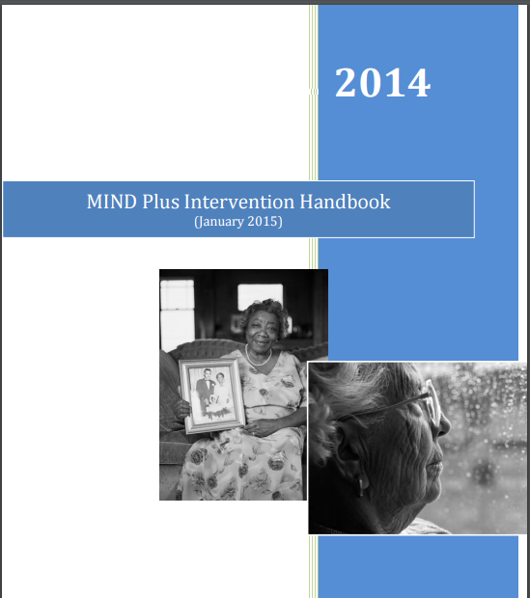

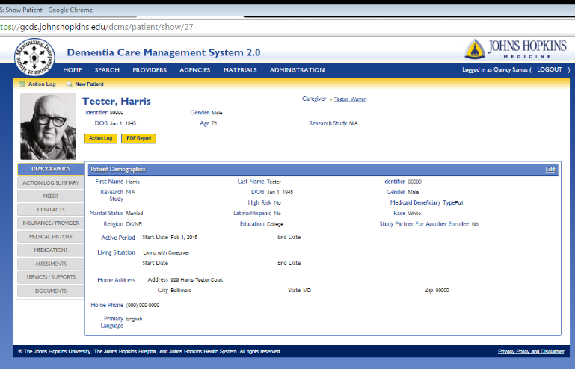
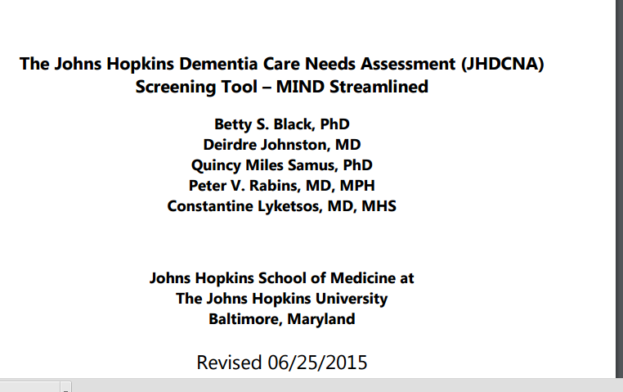
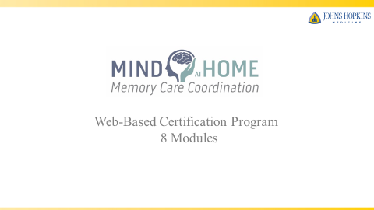
Program Tools

Slide 9
Stories from the field
Working with a Physician Assistant to discuss a MOLST with a critically ill participant, who later died peacefully in own how, according to his wishes.
Helping a family caregiver recognize symptoms of a urinary tract infection, who promptly called the PCP and obtained outpatient labs and treated—potentially avoiding a ED or worse, a hospitalization.
Providing emotional support and empowerment to a family caregiver, who at the initial home visit, was so overwhelmed that she was tearful through most of the interview, and 9 months later is now a Caregiver Advocate for the Alzheimer’s Association.
Assisting with overseas travel preparation for a person with mild dementia (recommended contacting PCP for advice on flying and blood clot prevention, creation of an ID pouch in case of getting lost)
Assisting with calling Maryland Health Connection, after patient lost health insurance coverage, and was initially declined to have it re-instated. Assistance led to re-instating health insurance coverage so that the participant could obtain her medications.
Assisting with ordering a bedside commode to prevent entering a nursing home. Now PT can make it to the toilet in the middle of the night instead of inappropriately urinating and ruining the hardwood floors.
Helping to secure an Alzheimer’s Association Caregiver Grant for a weekend get-a-way for a caregiver who had gone 8 years of daily caregiving without a full night respite.

Slide 10
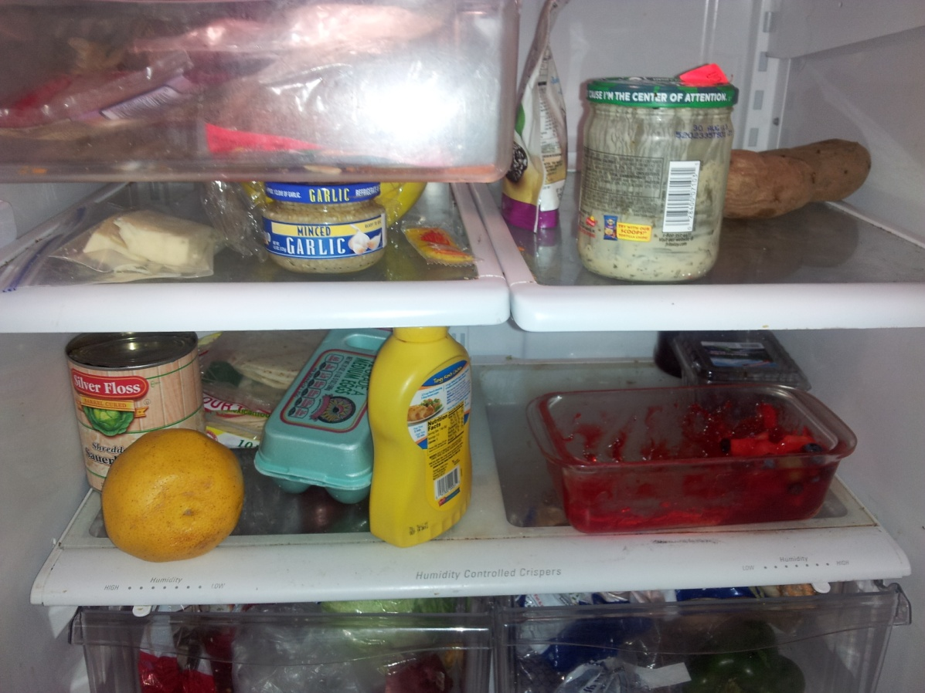
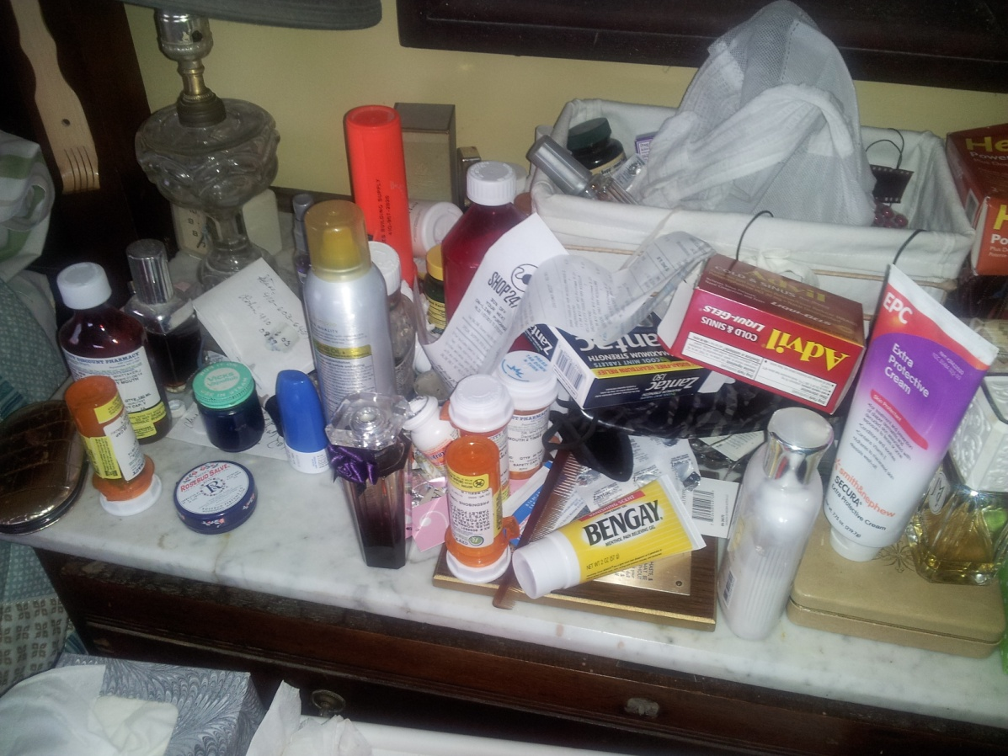
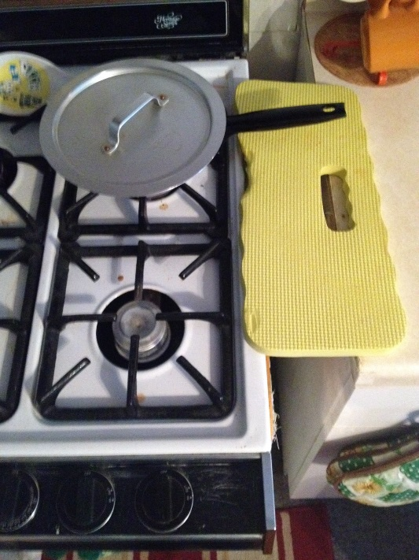
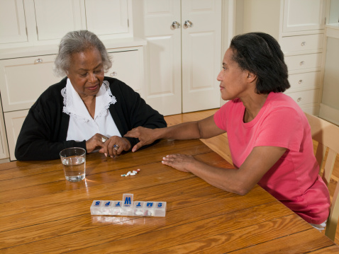
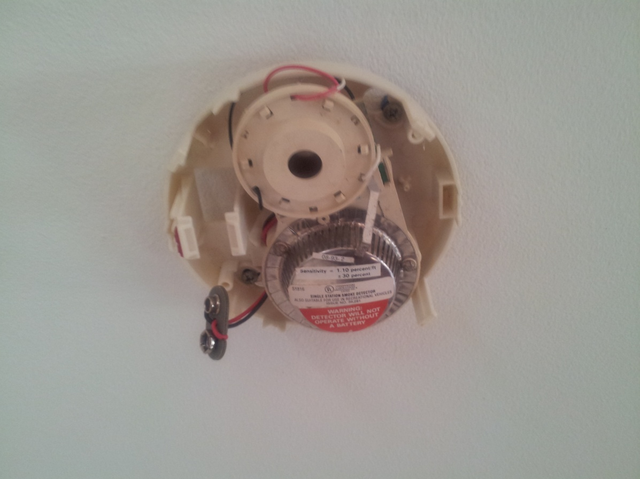
Importance of working in the Home
Over 90% of MIND PTs had safety
unmet needs at baseline

Slide 11
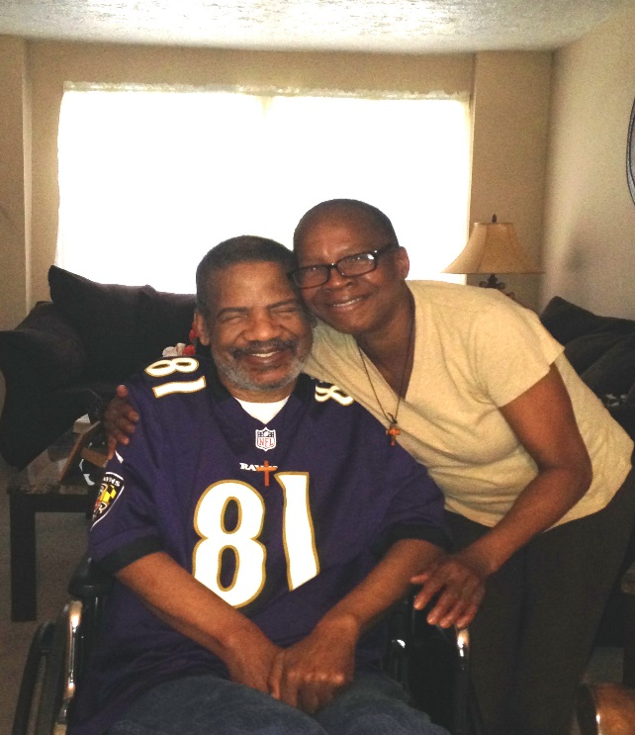
What Families are Saying
“They are somebody. They are somebody. They have the right to be cared for. He is a good man”
“[Thank you] for the practical assistance and moral support we’re receiving from Mind at Home. In a rather bleak time for our family, this program has been a ray of hope.”
“You are my angel. You lift me up….my emotions. All other programs are to help him. You help me.”
Photo: QMS with permission

Slide 12
So, what’s next for
MIND at Home ?
2 Active research studies (RCT , CMMI project)
  Enrollment closing soon for MIND clinical trial
    Call 410-550-6744 or email mindathome@jhmi.edu
Sustainability, scalability and dissemination, with well matched partners

Slide 13
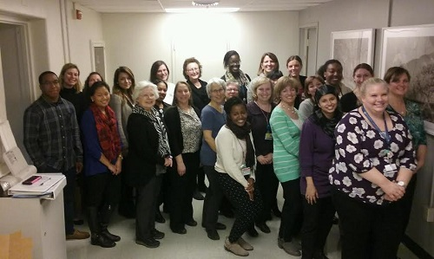
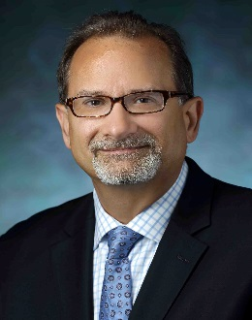

The MIND at Home Team 2016
Coordinators, nurses, doctors, OTs, evaluators, and researchers
Special thanks Co-Investigators: Deirdre Johnston, MD, Betty Black, PhD, Karen Davis, PhD, and Laura Gitlin, PhD

Slide 14
Thank you!
Quincy Samus, PhD, MS
Associate Professor
Department of Psychiatry, JHU
qmiles@jhmi.edu

