Slide 1
This research details an innovative ongoing approach to the development, implementation, and evaluation of a community intervention in rural pharmacies, designed to improve prescription drug safety (PDS) and reduce alcohol and medication interactions (AMI) among older adults in rural areas.
Four Step Process:
Obtain community insights from pharmacy staff and community members
Create PDS educational health campaign material
Implement intervention components & evaluate intervention effectiveness
Vet educational materials with population
1
2
3
4

Slide 2


Previous Evidence
3000% increase in fatal medication errors related to alcohol and illicit drug use between 1983 and 2004 in the US, more so than deaths from medication or alcohol/illicit drug use alone. (Phillips et al 2008).
124% increase in older adult comorbid alcohol and medication poisoning hospitalizations between 2001-2012
60% of 60+ year olds are taking alcohol-interactive medication and consuming alcohol

Slide 3
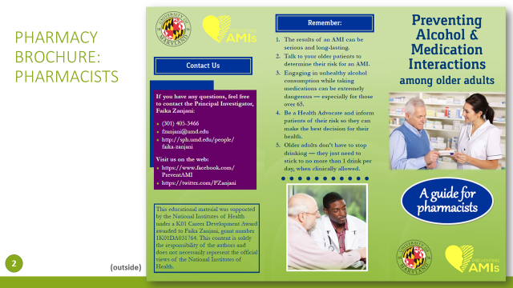
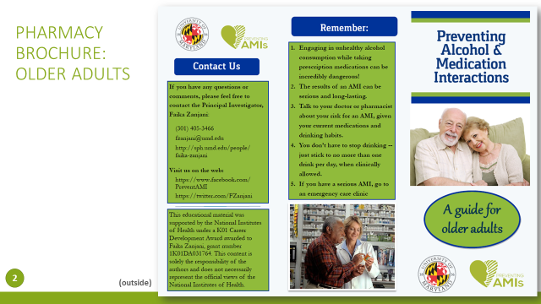

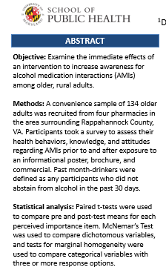

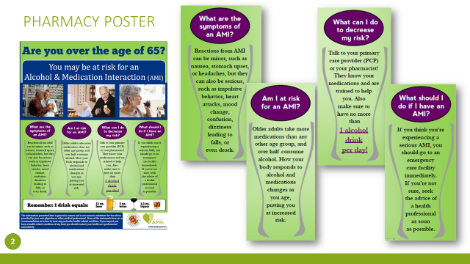

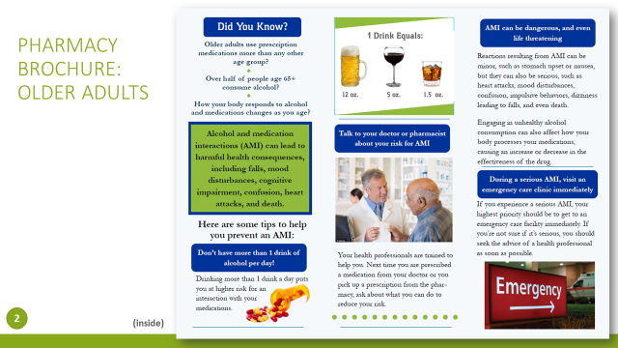
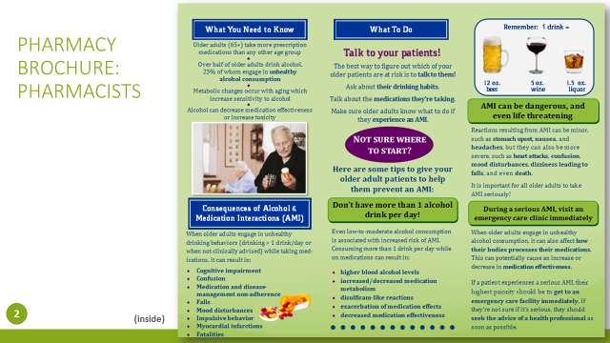
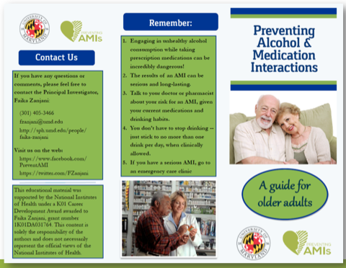
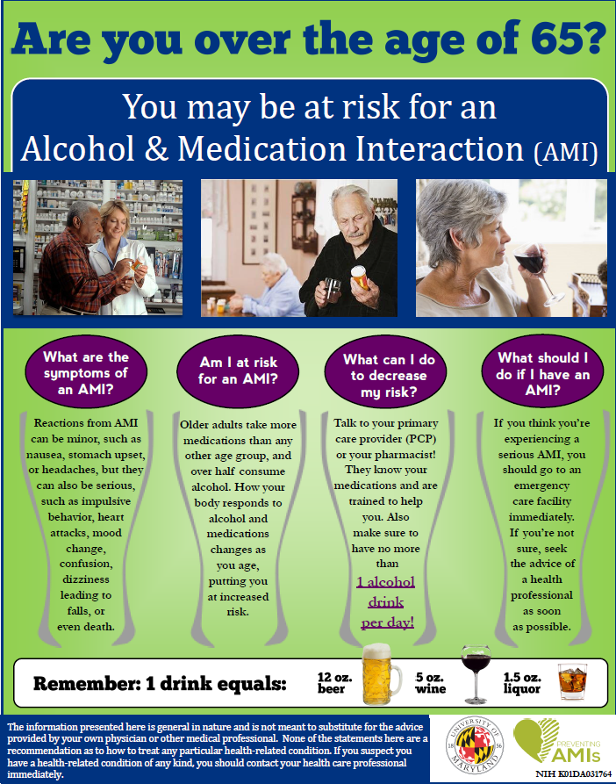
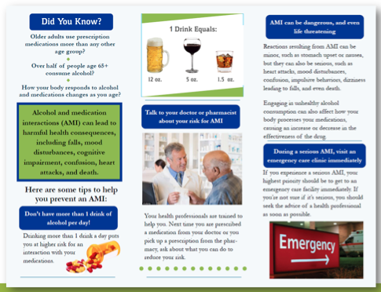
Outcomes of a Brief Alcohol and Medication Interaction (AMI) Prevention Campaign
Faika Zanjani, PhD,¹ Hannah Allen, MHS,¹ Catherine Martin, MD,² Richard Clayton, PhD,² and Nancy Schoenberg, PhD²
¹Department of Behavioral and Community Health, University of Maryland School of Public Health; ²University of Kentucky
ABSTRACT
RESULTS
Objective: Examine the immediate effects of an intervention to increase awareness for alcohol medication interactions (AMIs) among older, rural adults.
Methods: A convenience sample of 134 older adults was recruited from four pharmacies in the area surrounding Rappahannock County, VA. Participants took a survey to assess their health behaviors, knowledge, and attitudes regarding AMIs prior to and after exposure to an informational poster, brochure, and commercial. Past month-drinkers were defined as any participants who did not abstain from alcohol in the past 30 days.
Statistical analysis: Paired t-tests were used to compare pre and post-test means for each perceived importance item. McNemar’s Test was used to compare dichotomous variables, and tests for marginal homogeneity were used to compare categorical variables with three or more response options.
Table 1. Sample characteristics by past-month drinking status.
KEY FINDINGS (PRE-INTERVENTION)
About half of the sample (43%) were past-month drinkers, and all but one participant in this subset was currently taking over the counter or prescription medications.
Past-month drinkers were significantly more likely to be married, have an income greater than $50,000 a year, and be more educated than non-drinkers.
Half the sample (49%) had never spoken to their doctor or pharmacist about AMIs.
Table 3. AMI beliefs, by percentage of the sample.
 | Drinkers n = 58 | Non-Drinkers n = 76 | Total n = 134
Mean Age | 71.40 | 71.77 | 71.61
Gender (%)
Male | 41.4 | 32.9 | 36.6
Female | 58.6 | 67.1 | 63.4
Race (%)
White | 98.3 | 92.1 | 94.8
Other | 1.7 | 7.9 | 5.2
Marital Status (%)*
Single, never married | 7.9 | 1.7 | 5.2
Married | 57.9 | 48.3 | 53.7
Widowed | 27.6 | 29.3 | 28.4
Divorced | 6.6 | 20.7 | 12.7
Education*
High school or less | 56.9 | 75.0 | 67.2
Higher than high school | 43.1 | 25.0 | 32.8
Employment Status
Unemployed | 6.9 | 13.2 | 10.4
Employed | 25.9 | 21.1 | 23.1
Retired | 67.2 | 65.8 | 66.4
Income*
Less than $50,000 | 36.7 | 70.6 | 56.4
$50,000 or more | 63.3 | 29.4 | 43.6
 | Pre-Test | Post-Test
What medications do you think are potentially dangerous when consuming alcohol?
Tylenol | 32.1 | 44.8*
Advil | 28.4 | 41.0*
Aleve | 29.9 | 44.8*
Prescription Pain Medications | 87.3 | 91.0
Psychiatric Treatment Medications | 78.4 | 86.6*
How do you think alcohol can interact with prescription drug use and cause harmful effects?
Falling | 78.4 | 92.5*
Driving Impairment | 88.8 | 91.8
Memory Loss | 61.2 | 81.3*
Infection | 20.1 | 32.1*
Hospitalization | 55.2 | 70.9*
Agitation | 59.7 | 75.4*
Unable to Perform Everyday Activities | 66.4 | 80.6*
Conflicts with Friends/Family | 53.7 | 72.4*
Confusion | 59.7 | 74.6*
Vision Loss | 76.1 | 85.8*
Disease | 44.0 | 55.2*
Drowsiness | 24.6 | 44.0*
Vomiting | 84.3 | 89.6
Increased Blood Pressure/ Heart Attack | 56.7 | 70.1*
Shortness of Breath/ Difficulty Breathing | 69.4 | 79.9*
Death | 56.0 | 70.1*
KEY FINDINGS (POST-INTERVENTION)
Perceived importance of including messaging surrounding alcohol use in an AMI prevention campaign significantly increased, and this increase was more prominent among past-month drinkers.
The high majority of the sample (95%) indicated that older adults should not drink more than one alcoholic drink a day while taking prescription medications.
There was a significant increase in the number of identified AMI side effects and medications that could be potentially dangerous when mixed with alcohol.
Participants reported being significantly more likely to talk to their doctor about the potential for AMIs, and non-drinkers reported being significantly more likely to be an advocate for AMI prevention.
INTERVENTION MATERIALS
Figure 1. Informational brochure.
*Significantly different by drinking status at the p<0.05 level.
Figure 2. Informational poster.
Table 2. Perceived importance of AMI-related messages, by mean score.
Note: Values are the percentage of the sample who indicated the option as a potential dangerous medication or side effect. *Significantly different from pre-test at the p<0.05 level.
 | Pre-Test | Post-Test
AMIs can be potentially dangerous, and even life-threatening. | 1.09 | 1.08
Alcohol consumption can be dangerous at any level. | 1.72 | 1.51*
It is important to consume no more than one alcoholic drink a day. | 2.15 | 1.28*
It is important to talk to your doctor or pharmacist about possible AMIs. | 1.20 | 1.11*
AMIs can result in negative mental and/or physical health consequences. | 1.16 | 1.08
When consuming any level of alcohol, it is important to be aware of potential minor or severe side effects. | 1.21 | 1.10*
During serious AMIs, it is important to visit your local emergency care clinic immediately. | 1.19 | 1.08
CONCLUSIONS
This brief intervention had an immediate, positive effect on health knowledge and behavioral intention regarding alcohol and medication interactions.
More knowledge is needed on the effectiveness of AMI interventions for older adults who engage in high-risk drinking behaviors.
Research reported was supported by the National Institutes of Health (NIH) and NIDA awarded to Faika Zanjani, grant number 1K01DA031764. The content is solely the responsibility of the authors and does not necessarily represent the official views of the NIH.
Note: Response options ranged from 1 (very important) to 5 (not at all important). *Significantly different from pre-test at the p<0.05 level.

Slide 4
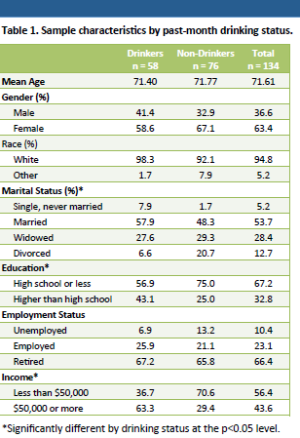
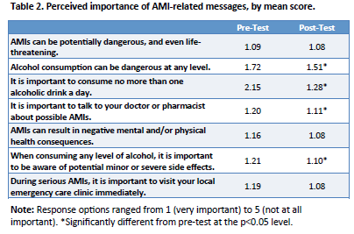
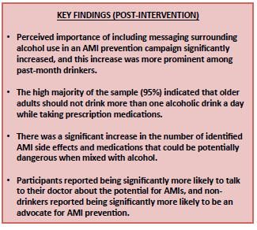
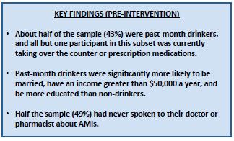
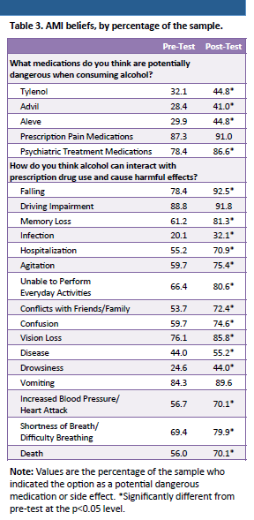
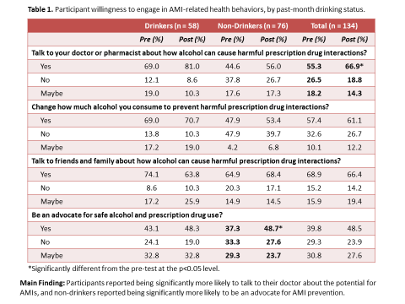

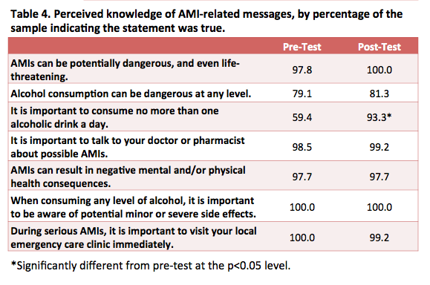
Outcomes of a Brief Alcohol and Medication Interaction (AMI) Prevention Campaign
Faika Zanjani, PhD,¹ Hannah Allen, MHS,¹ Catherine Martin, MD,² Richard Clayton, PhD,² and Nancy Schoenberg, PhD²
¹Department of Behavioral and Community Health, University of Maryland School of Public Health; ²University of Kentucky
ABSTRACT
RESULTS
Objective: Examine the immediate effects of an intervention to increase awareness for alcohol medication interactions (AMIs) among older, rural adults.
Methods: A convenience sample of 134 older adults was recruited from four pharmacies in the area surrounding Rappahannock County, VA. Participants took a survey to assess their health behaviors, knowledge, and attitudes regarding AMIs prior to and after exposure to an informational poster, brochure, and commercial. Past month-drinkers were defined as any participants who did not abstain from alcohol in the past 30 days.
Statistical analysis: Paired t-tests were used to compare pre and post-test means for each perceived importance item. McNemar’s Test was used to compare dichotomous variables, and tests for marginal homogeneity were used to compare categorical variables with three or more response options.
Table 1. Sample characteristics by past-month drinking status.
KEY FINDINGS (PRE-INTERVENTION)
About half of the sample (43%) were past-month drinkers, and all but one participant in this subset was currently taking over the counter or prescription medications.
Past-month drinkers were significantly more likely to be married, have an income greater than $50,000 a year, and be more educated than non-drinkers.
Half the sample (49%) had never spoken to their doctor or pharmacist about AMIs.
Table 3. AMI beliefs, by percentage of the sample.
 | Drinkers n = 58 | Non-Drinkers n = 76 | Total n = 134
Mean Age | 71.40 | 71.77 | 71.61
Gender (%)
Male | 41.4 | 32.9 | 36.6
Female | 58.6 | 67.1 | 63.4
Race (%)
White | 98.3 | 92.1 | 94.8
Other | 1.7 | 7.9 | 5.2
Marital Status (%)*
Single, never married | 7.9 | 1.7 | 5.2
Married | 57.9 | 48.3 | 53.7
Widowed | 27.6 | 29.3 | 28.4
Divorced | 6.6 | 20.7 | 12.7
Education*
High school or less | 56.9 | 75.0 | 67.2
Higher than high school | 43.1 | 25.0 | 32.8
Employment Status
Unemployed | 6.9 | 13.2 | 10.4
Employed | 25.9 | 21.1 | 23.1
Retired | 67.2 | 65.8 | 66.4
Income*
Less than $50,000 | 36.7 | 70.6 | 56.4
$50,000 or more | 63.3 | 29.4 | 43.6
 | Pre-Test | Post-Test
What medications do you think are potentially dangerous when consuming alcohol?
Tylenol | 32.1 | 44.8*
Advil | 28.4 | 41.0*
Aleve | 29.9 | 44.8*
Prescription Pain Medications | 87.3 | 91.0
Psychiatric Treatment Medications | 78.4 | 86.6*
How do you think alcohol can interact with prescription drug use and cause harmful effects?
Falling | 78.4 | 92.5*
Driving Impairment | 88.8 | 91.8
Memory Loss | 61.2 | 81.3*
Infection | 20.1 | 32.1*
Hospitalization | 55.2 | 70.9*
Agitation | 59.7 | 75.4*
Unable to Perform Everyday Activities | 66.4 | 80.6*
Conflicts with Friends/Family | 53.7 | 72.4*
Confusion | 59.7 | 74.6*
Vision Loss | 76.1 | 85.8*
Disease | 44.0 | 55.2*
Drowsiness | 24.6 | 44.0*
Vomiting | 84.3 | 89.6
Increased Blood Pressure/ Heart Attack | 56.7 | 70.1*
Shortness of Breath/ Difficulty Breathing | 69.4 | 79.9*
Death | 56.0 | 70.1*
KEY FINDINGS (POST-INTERVENTION)
Perceived importance of including messaging surrounding alcohol use in an AMI prevention campaign significantly increased, and this increase was more prominent among past-month drinkers.
The high majority of the sample (95%) indicated that older adults should not drink more than one alcoholic drink a day while taking prescription medications.
There was a significant increase in the number of identified AMI side effects and medications that could be potentially dangerous when mixed with alcohol.
Participants reported being significantly more likely to talk to their doctor about the potential for AMIs, and non-drinkers reported being significantly more likely to be an advocate for AMI prevention.
INTERVENTION MATERIALS
Figure 1. Informational brochure.
*Significantly different by drinking status at the p<0.05 level.
Figure 2. Informational poster.
Table 2. Perceived importance of AMI-related messages, by mean score.
Note: Values are the percentage of the sample who indicated the option as a potential dangerous medication or side effect. *Significantly different from pre-test at the p<0.05 level.
 | Pre-Test | Post-Test
AMIs can be potentially dangerous, and even life-threatening. | 1.09 | 1.08
Alcohol consumption can be dangerous at any level. | 1.72 | 1.51*
It is important to consume no more than one alcoholic drink a day. | 2.15 | 1.28*
It is important to talk to your doctor or pharmacist about possible AMIs. | 1.20 | 1.11*
AMIs can result in negative mental and/or physical health consequences. | 1.16 | 1.08
When consuming any level of alcohol, it is important to be aware of potential minor or severe side effects. | 1.21 | 1.10*
During serious AMIs, it is important to visit your local emergency care clinic immediately. | 1.19 | 1.08
CONCLUSIONS
This brief intervention had an immediate, positive effect on health knowledge and behavioral intention regarding alcohol and medication interactions.
More knowledge is needed on the effectiveness of AMI interventions for older adults who engage in high-risk drinking behaviors.
Research reported was supported by the National Institutes of Health (NIH) and NIDA awarded to Faika Zanjani, grant number 1K01DA031764. The content is solely the responsibility of the authors and does not necessarily represent the official views of the NIH.
Note: Response options ranged from 1 (very important) to 5 (not at all important). *Significantly different from pre-test at the p<0.05 level.

Slide 5
Contact Information:
Faika Zanjani, PhD
University of Maryland- College Park, MD
SPH: Behavioral and Community Health, 4200 Valley Drive 1242x Center for Health Behavior Research, Telephone: (301) 405-3466 email: fzanjani@umd.edu
Acknowledgements: This research was supported by the National Institute of Health and specifically NIDA awarded to Faika Zanjani (1K01DA031764-01A1).
This research would not have been possible without the support of participants!
Disclosure Statement: No competing financial interest exists for contributors.

