Slide 1
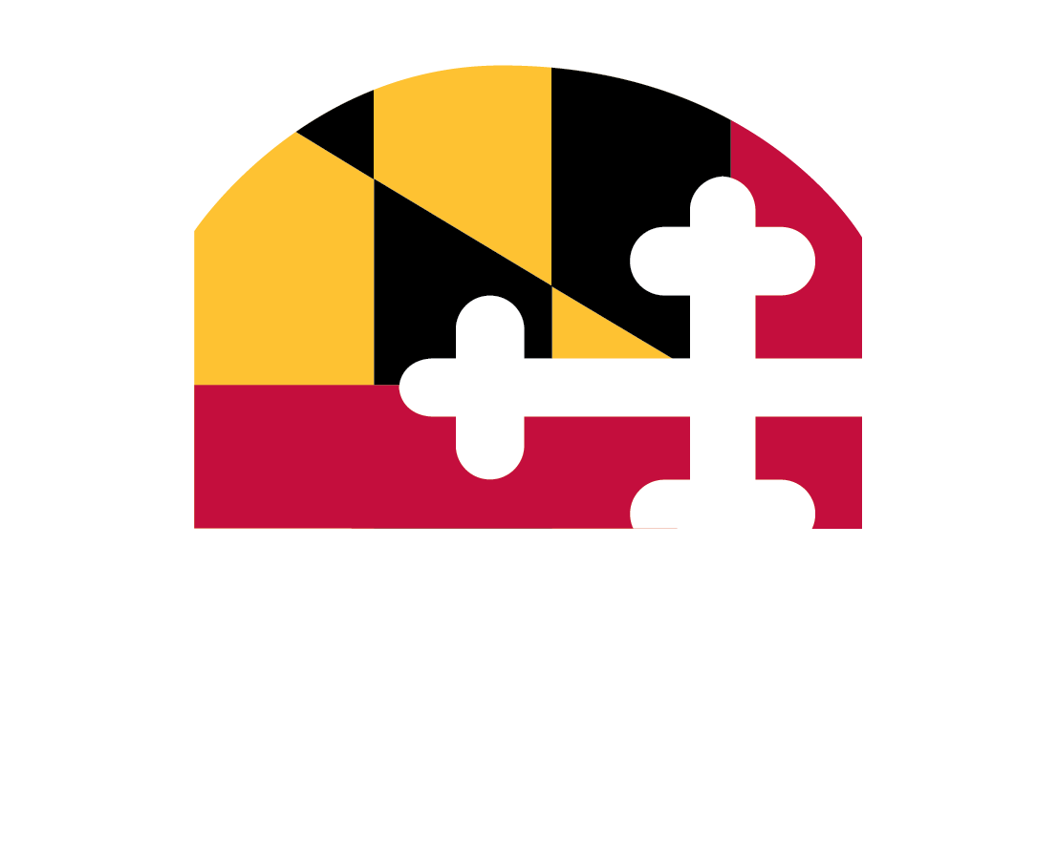
Maryland’s Multisector Plan for Aging
Public Review: March 2025
Notes:
Longevity Ready Maryland is the state’s multisector plan for aging. The goal for today is to learn about the plan and provide feedback.

Slide 2
BACKGROUND
Maryland’s Demographic Shift and a Mandate from Governor Moore
Notes:
We’re going to begin with why the governor decided to ask the Maryland Department of Aging to develop a multisector plan for aging.

Slide 3
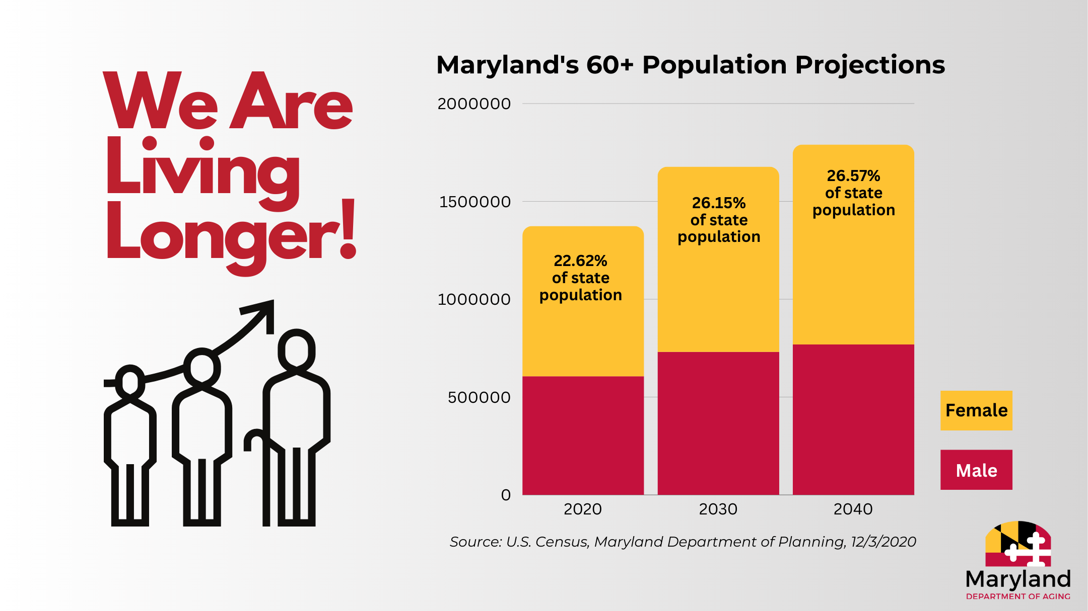
Notes:
The 100-year lifespan is upon us.
Maryland, like the rest of the country, is experiencing longer lives and falling birth rates
Older adults are the fastest growing population.
Right now, more than 1 in 5 Marylanders are over 60
By 2030, that number will grow to more than 1 in 4 Marylanders over 60. Eclipsing 19 and under youth for the first time.

Slide 4
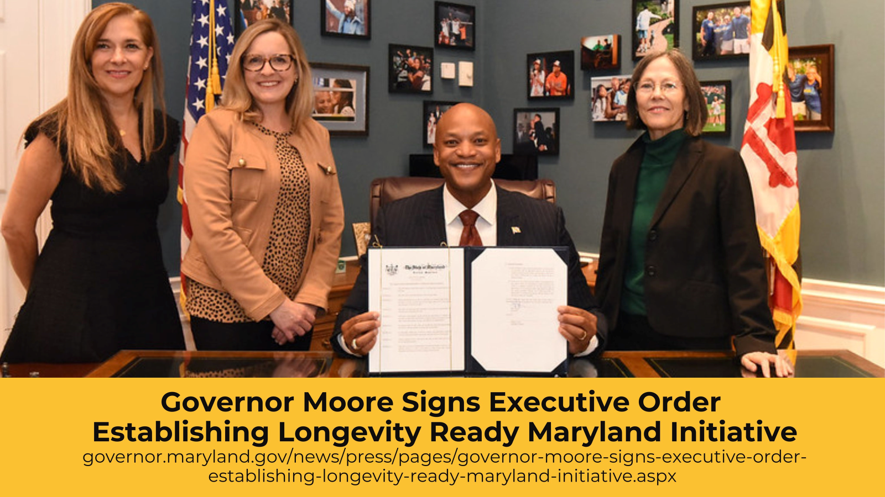
Notes:
Longevity Ready Maryland is a framework for planning ahead for the changing demographics we are experiencing.
Addresses the systematic changes we need to prepare for across all sectors.
The Longevity Ready Maryland name reflects a shift from focusing on aging services to longevity readiness.
Removes the silos in services and systems that previously separated the aging process from other stages of the life span.
Prepares for longevity-readiness throughout all stages of life
The LRM executive order mandated MDOA to:
Develop a multisector plan for aging
Assess existing services and supports
Recommend a plan of action to transform infrastructure and services
Assess data-driven progress

Slide 5
Notes:
A multisector plan for aging is a blueprint for all sectors to transform the aging experience for all Marylanders through collaboration, partnership, strategic investments, and policy changes.
It benefits all Marylanders at all stages of life.
Requires participation from all sectors, not just aging and health services, to prepare for longer lives
Housing, transporation, legal services, workforce development, etc.

Slide 6
PLAN REVIEW
Where Maryland Stands, Epic Goals, and Implementation
Notes:
We will now go over the basic landscape of the plan
Focusing on three areas of discussion from the document:
Where Maryland Stands
Epic Goals
Phases of Implementation

Slide 7
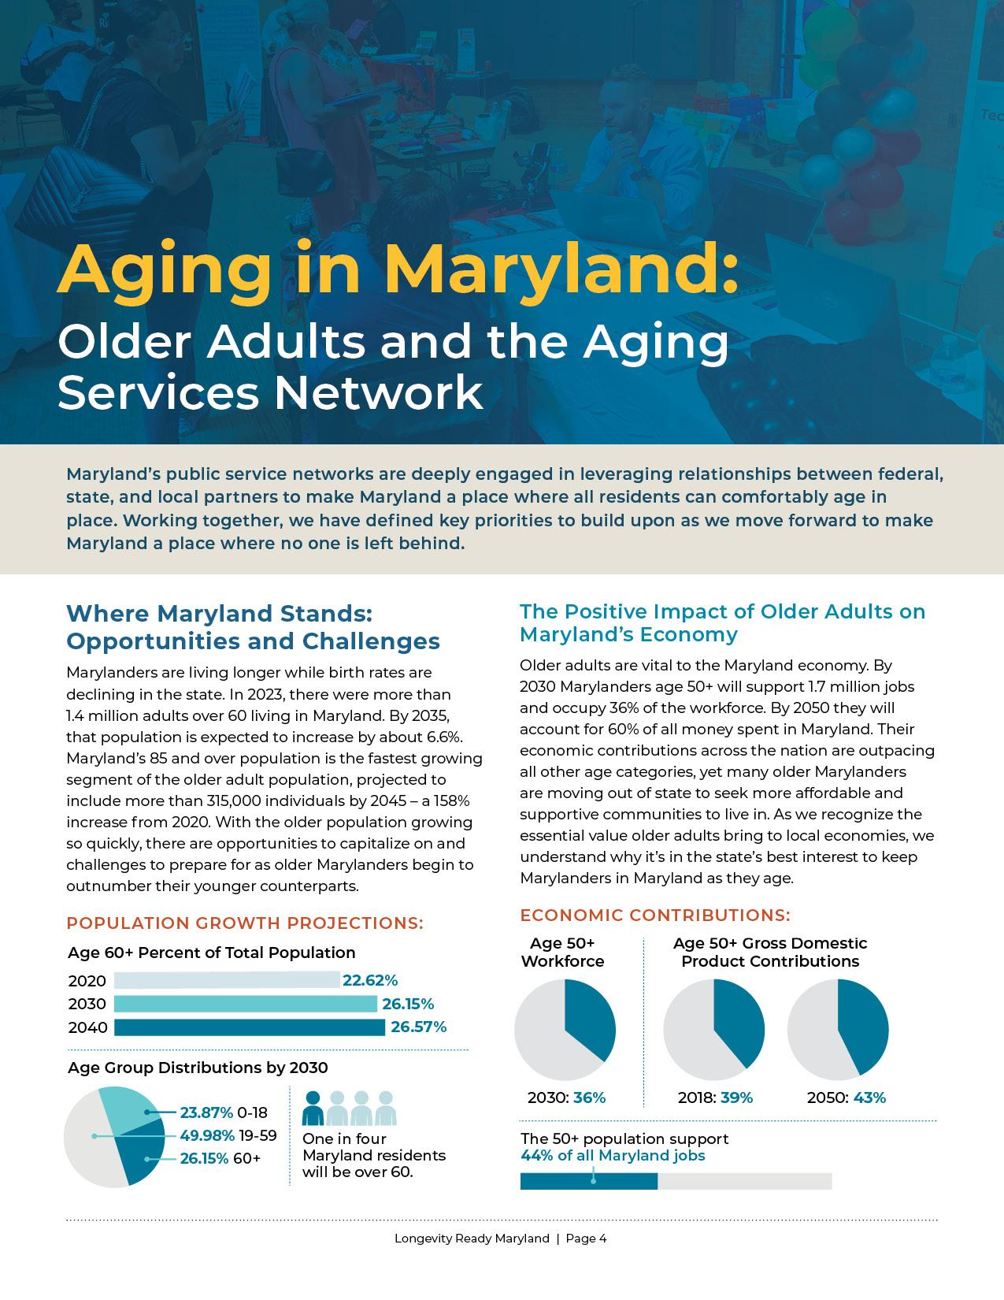
Where Maryland Stands
The older adult population is growing.
The wellbeing of the older adult population is very important to Maryland communities
Notes:
Data indicated some basic priorities, opportunities, and challenges we need to get in front of.
A large amount of research went into this, and that is detailed in the document.
Range of factors explored, including population changes, cost of living challenges, health outcomes, and social isolation
Lead us in some very clear directions.
Population growth and economic contributions data points as an example.
We have a rising number of older adults + they drive our economy in significant ways = we need to plan for ways to keep Marylanders in Maryland as we age.

Slide 8
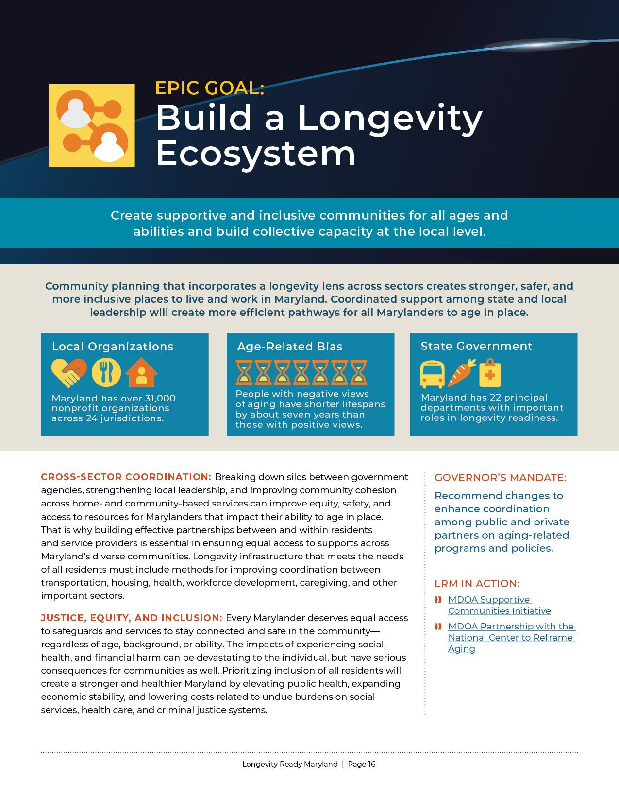
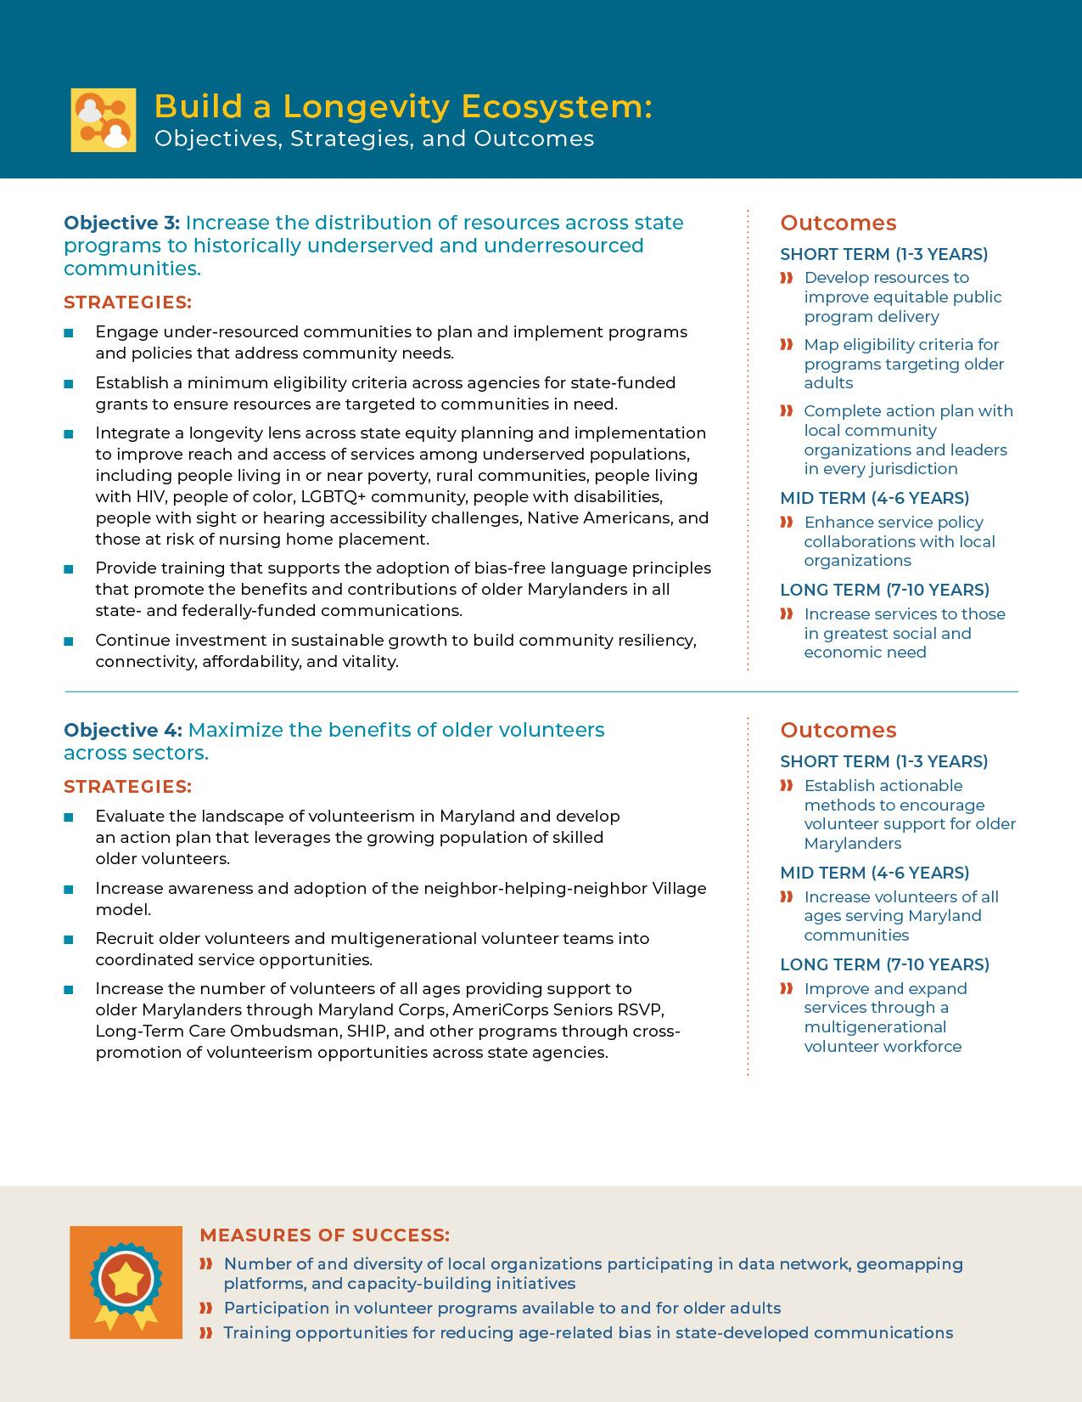
Epic
Goals
Areas of Focus: Informed by research and mandated by Governor Moore.
Objectives: Supported by specific strategies with defined outcomes and measures of success.
Notes:
Our four Epic Goals provide the primary structure of the plans call to action.
Each Epic Goal includes:
Areas of focus and how they align with the Governor’s mandate
Series of three or four objectives
Strategies for meeting those objectives
Measures of success to help evaluate those strategies when implemented
What’s not in the document:
A large amount of methodology, resource material, and details that our Work Groups put together to guide the implementation and tracking of each objective

Slide 9
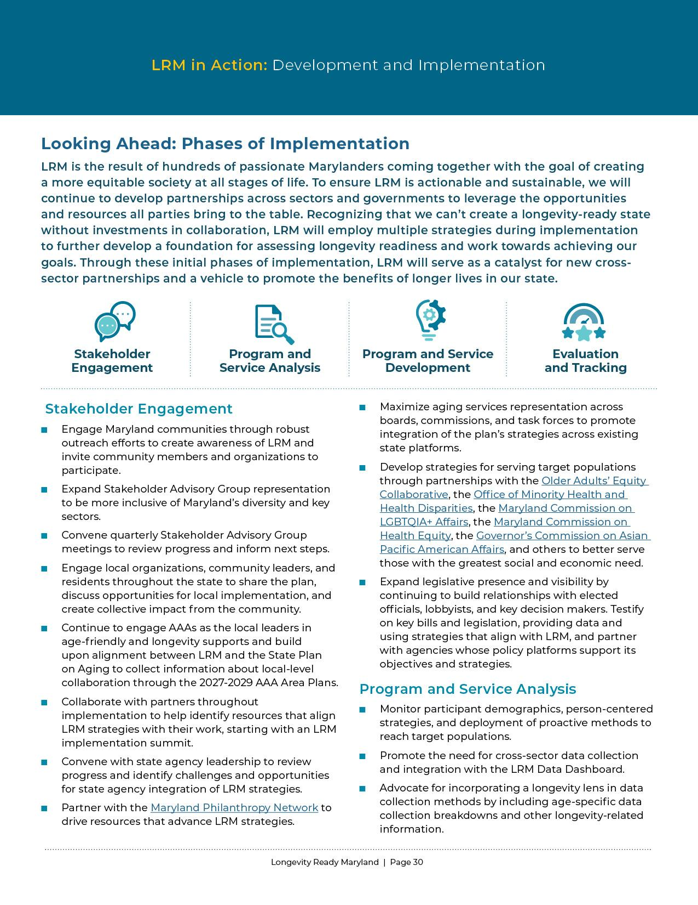
Phases of Implementation
26 methods for implementing 79 defined strategies.
Stakeholder Engagement
Program and Service Analysis
Program and Service Development
Evaluation and Tracking
Notes:
Roadmap for HOW we will implement the 79 defined strategies in the Epic Goals section
More circular than linear
Examples:
Stakeholder Engagement: Expand Stakeholder Advisory Group representation to be more inclusive of Maryland’s diversity and key sectors
Program and Service Analysis: Monitor participant demographics and deployment of proactive methods to reach target populations
Program and Service Development: Define calls to action on how the plan can be used at state and local levels to identify needs, promote opportunities, implement strategies, and build capacity.
Evaluation and Tracking: Monitor the efficacy of programs and track progress.

Slide 10
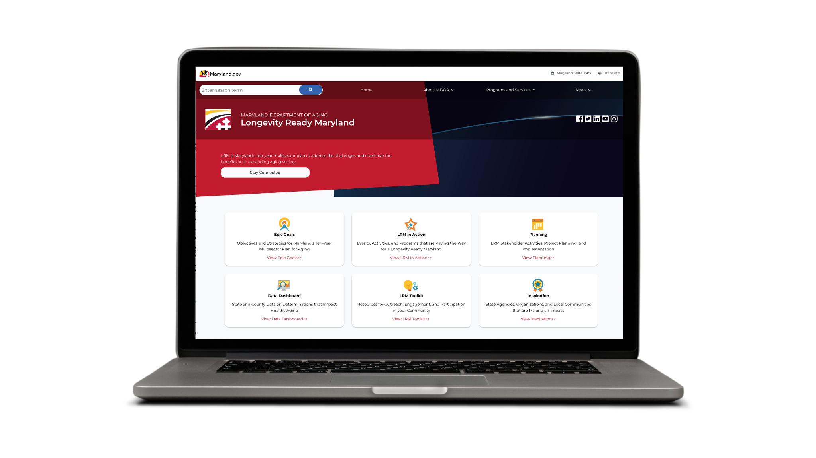
LRM.Maryland.gov
Work in Progress Planning
Program Development
Data and Public Evaluation
Resources for Participation
Notes:
What is NOT in the document
Volumes of objective-specific program and project management documentation.
Website and digital resources that will be the forward-facing representation of the implementation process:
Work in progress planning, program development, and most importantly, ways everybody can participate in the parts of this plan that are most important to them, will be shared online and through other communications channels.

Slide 11
THE ASK
Learn About LRM, Offer Input, and Get Involved
Notes:
What we want from you
Learn about the plan. Ask questions and gain an understanding of what it proposes.
Offer input. Yes let us know if you feel important objectives are not included, but what we really want to learn about is how you think we can achieve some of these strategies. We’re excited to learn from you today.
And most important, get involved in its implementation.

Slide 12
Epic Goals and Priority Areas
Build a Longevity Ecosystem:
Cross-sector coordination
Justice, equity, and inclusion
Promote Economic Opportunity:
Caregiving supports
Employment for all
Prepare Marylanders to Afford Longevity:
Affordable housing
Financial stability
Services and benefits
Optimize Health, Wellness, and Mobility
Access to equitable systems of care
Notes:
In the document, you will see the methods we used to develop our Epic Goals and define our Priority areas
These are the priorities that guide us now, but these may change over time.

Slide 13
Build a Longevity Ecosystem
Strengthen partnerships between service providers by sharing data, information, and resources that support each other’s work.
Protect older adults from abuse, neglect, and exploitation by increasing safeguards and improving systems of oversight and monitoring.
Increase equity by identifying communities in need and prioritizing program development accordingly.
Promote volunteerism by capitalizing on the opportunities of older volunteers as a resource.
Notes:
This Epic Goal is about creating supportive and inclusive communities for all ages and abilities by building collective capacity at the local level.
Priority areas:
Strengthen partnerships between service providers by sharing data, information, and resources that support each other’s work.
Strategies include:
engaging community members in mapping their resources and planning for action,
expanding the use of the age-friendly communities model for local planning efforts, and
increasing investment from the private sector, among others.
Protect older adults from abuse, neglect, and exploitation by increasing safeguards and improving systems of oversight and monitoring.
Strategies relate to long term care facilities, like nursing facilities, programs like guardianship and those that address fraud and scams.
Increase equity by identifying communities in need and prioritizing program development accordingly.
Strategies include:
planning with community members and state partners to target resources based on need, and
providing training that promotes the benefits and contributions of older adults, among others.
Promote volunteerism by capitalizing on the opportunities of older volunteers as a resource.
Strategies include:
Increasing awareness of volunteer opportunities, and
recruiting multigenerational volunteer teams into services for older adults, among others.

Slide 14
Promote Economic Opportunity
Support unpaid and family caregivers by increasing access to caregiving resources.
Support the direct care workforce through improvements in training programs, wage determinations, and workforce development.
Encourage age-inclusive employment by developing programs that promote the value of older workers and increase multigenerational workplaces.
Notes:
This Epic Goal is about supporting income and economic stability for older adults and their caregivers.
Priority areas:
Support unpaid and family caregivers by increasing access to caregiving resources.
Strategies include:
working across state agencies that are serving caregivers of different age ranges and needs to build our collective ability to support caregivers,
expanding the reach of our services through systems change and outreach, among others.
Support the direct care workforce through improvements in training programs, wage determinations, and workforce development.
Strategies include:
identifying opportunities to bring more people into the workforce and keep them there by improving wages and benefits, and
putting in place skills-based career pathways, among others.
Encourage age-inclusive employment by developing programs that promote the value of older workers and increase multigenerational workplaces.
Strategies include:
making state government an age-inclusive employer, and
creating career pathways to support workers over the age of 40, among others.

Slide 15
Prepare Marylanders to Afford Longevity
Increase access to affordable housing through improvements to wraparound referral systems for identifying housing-insecure older adults and program development to meet a diverse range of housing needs.
Encourage financial planning by increasing and promoting financial literacy programs across the lifespan and improving access to financial planning resources.
Improve access to benefits and services by modernizing screening and referral services for identifying at-risk older adults and promoting awareness of available programs.
Notes:
This Epic Goal is about increasing Marylander’s ability to save money through financial planning and access to affordable housing, health care, and support services.
Priority areas:
Increase access to affordable housing through improvements to wraparound referral systems for identifying housing-insecure older adults and program development to meet a diverse range of housing needs.
Strategies include:
supporting aging in place through home and community-based supports,
increasing access to tax credits, and
exploring shared, multigenerational living space housing options, among others.
Encourage financial planning by increasing and promoting financial literacy programs across the lifespan and improving access to financial planning resources.
Strategies include improving the ability for Marylanders to save.
Improve access to benefits and services by modernizing screening and referral services for identifying at-risk older adults and promoting awareness of available programs.
Strategies include:
creating new referral pathways between health and social service providers, and
increasing screening and support for people with dementia and their caregivers, among others.

Slide 16
Optimize Health, Wellness, and Mobility
Improve access to holistic health care through expanded programs and systems of care that are inclusive of physical, behavioral, emotional, and cognitive wellbeing.
Increase access to healthy food and physical activity by building awareness of available nutrition and fitness programs and promoting the value of community spaces.
Improve transportation infrastructure by prioritizing service options for older adults in need and improving mobility-friendly community planning.
Increase social connection through policies that identify older adults at risk of social isolation and promoting programs that support inclusion.
Notes:
This Epic Goal is about improving the health and wellbeing of older Marylanders so they can enjoy longer lives.
Priority areas:
Improve access to holistic health care through expanded programs and systems of care that are inclusive of physical, behavioral, emotional, and cognitive wellbeing.
Strategies include:
implementing new systems of care that better incorporate home and community-based services,
identifying healthcare shortage areas, and
increasing access to supportive technology and equipment and assistive technology, among others.
Increase access to healthy food and physical activity by building awareness of available nutrition and fitness programs and promoting the value of community spaces.
Strategies include:
promoting free and low-cost physical activity options,
improving screening and cross promotion for various food assistance programs, among others.
Improve transportation infrastructure by prioritizing service options for older adults in need and improving mobility-friendly community planning.
Strategies include:
aligning available transportation services focused on older adults and adults with disabilities,
Leveraging technology and community-based services to improve transportation options in rural communities, and
improving pedestrian safety infrastructure, among others.
Increase social connection through policies that identify older adults at risk of social isolation and promoting programs that support inclusion.
Strategies include:
improving the coordination between state and local service providers, and
promoting opportunities for intergenerational connections, among others.

Slide 17
DISCUSSION
Feedback on Priorities and Implementation
Notes:
Group discussion
ask questions if you have them
and offer feedback to others on your thoughts

Slide 18
Questions to Consider
Does LRM provide a strong foundation for preparing Maryland for longer lives?
Notes:
Questions to consider that are on the survey we’ll be sharing with you.
Does LRM cover the basic direction we need to go in preparing for a larger population of older Marylanders?

Slide 19
Questions to Consider
What do you like about LRM? What else should be included in it going forward?
Notes:
What parts resonate the most with you, and what, if anything, do you feel should be added?

Slide 20
Questions to Consider
What do you feel are the biggest priorities when we begin implementation?
Notes:
What needs to happen first and why?

Slide 21
THANK YOU!
Your feedback is appreciated.
Notes:
QR Code will link to a survey where you can offer more input.
You will also receive a follow-up email that will link to the survey.
https://lp.constantcontactpages.com/sv/DQsZIrz

