Slide 1


DEPARTMENT OF AGING
Rona E. Kramer, Secretary
1-800-243-3425 aging.maryland.gov

Slide 2
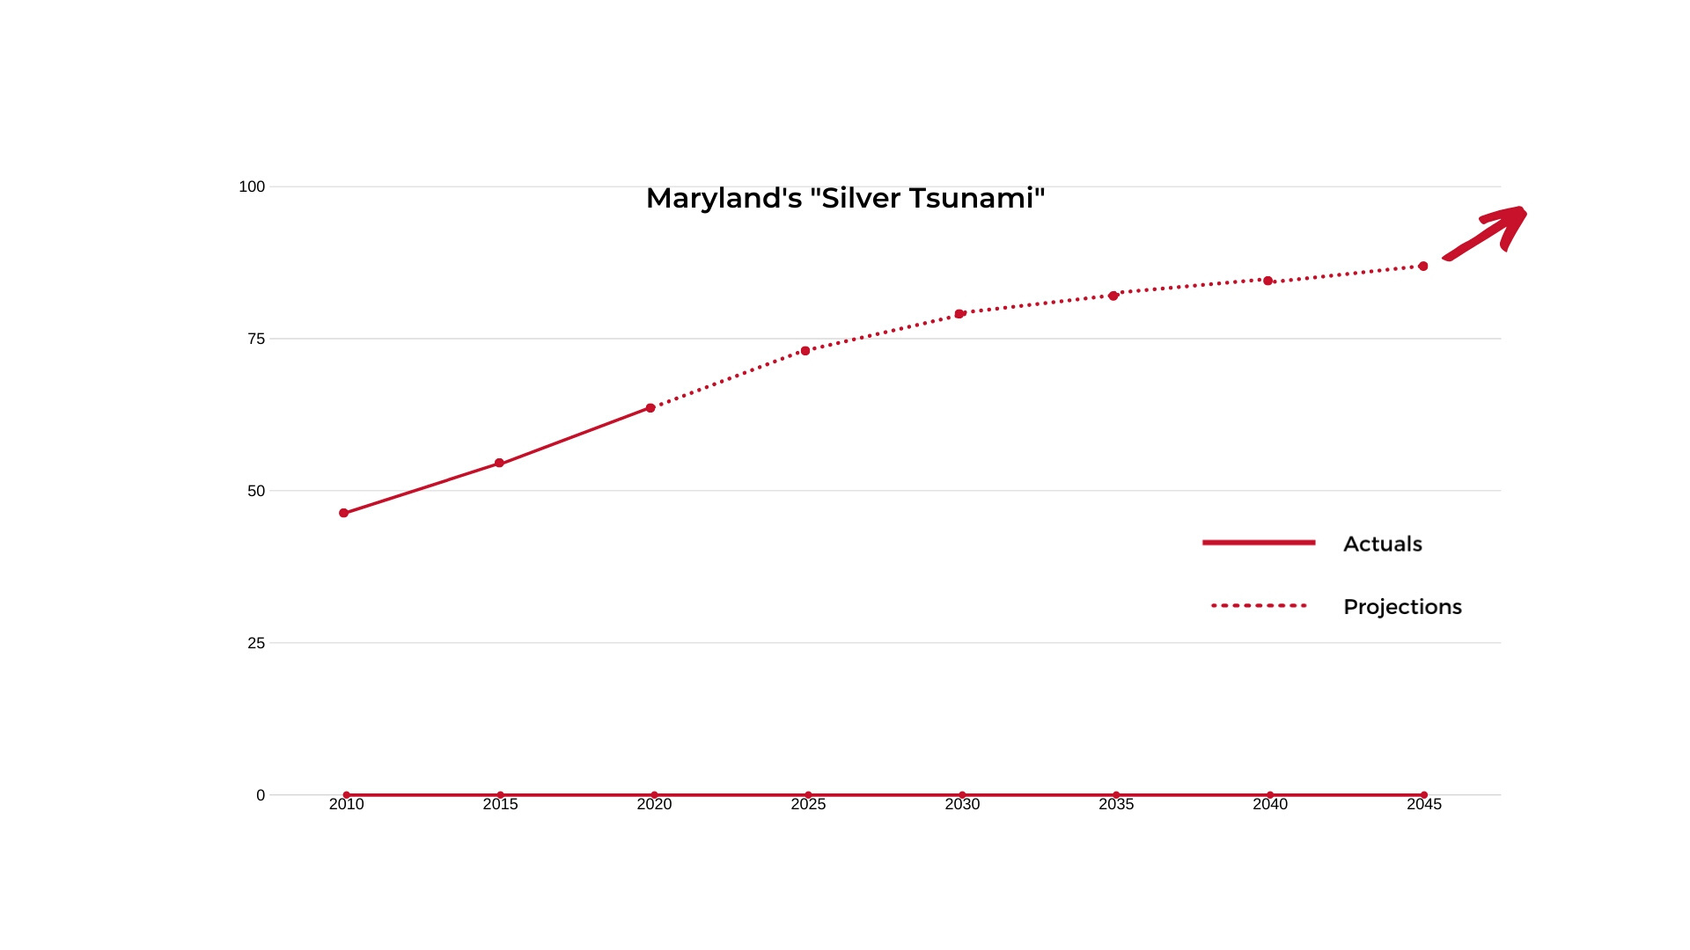
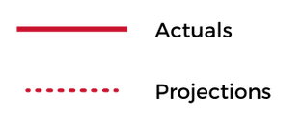

Senior Population Increase
Maryland's "Silver Tsunami"
2,000,000
1,500,000
1,000,000
500,000
0
2010
2015
2020
2025
2030
2035
2040
2045

Slide 3


Helping Maryland Residents
to Age at Home

Slide 4
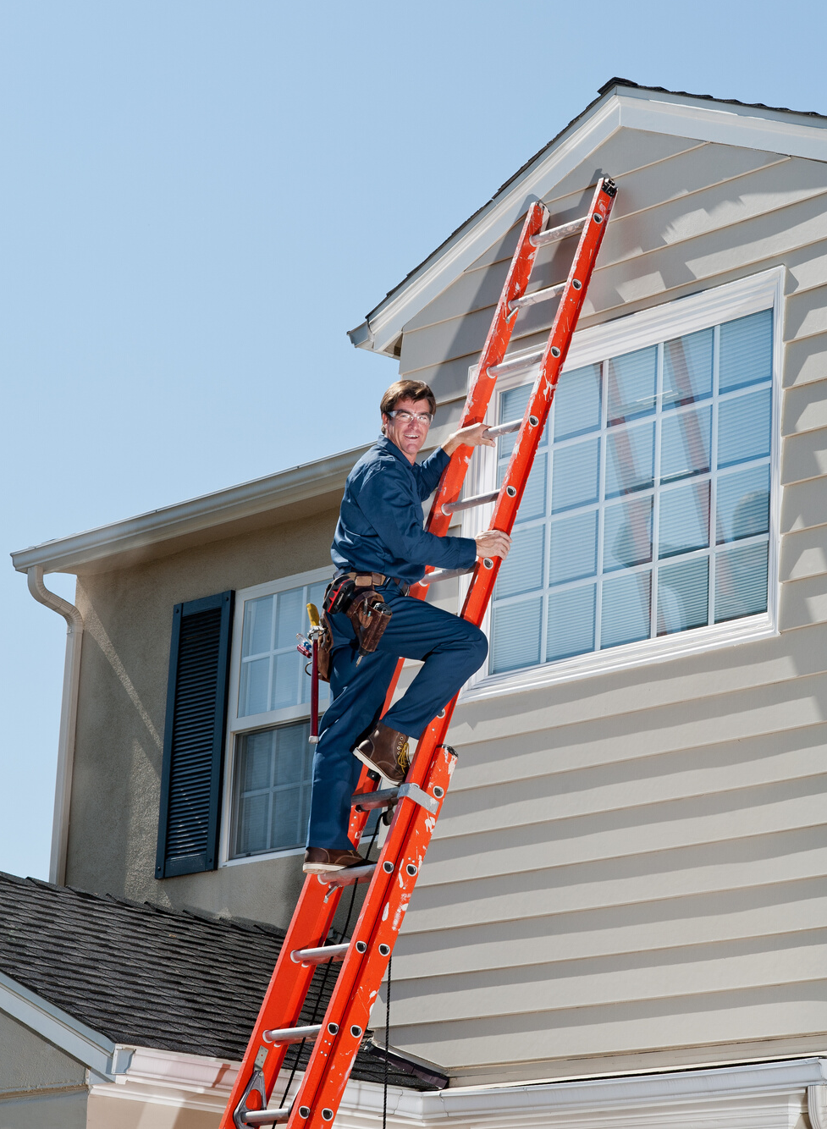
SM
Community for Life Features
  For adults age 65+
  No health or income qualification
  Offering non-medical core services and support for aging at home
  Prevents the need for costly long-term care

Slide 5
Core Services of
Community for Life
SM

Slide 6


Home Maintenance
  Initial home safety assessment
    Check for environmental hazards
    Safety assessment
        Door locks
        Windows
  Handyman services
  Vetted contractors and assistance with contract review for major repairs

Slide 7


Service Navigator
  Warm, frequent, proactive contact
  with members
  Information and assistance in obtaining all local activities and link to local resources for services in the community
  Prevent isolation and provide one-on-one personal contact
  Advice and oversight to prevent fraud

Slide 8


Transportation
  Run errands
  Get to the doctor or pharmacy visits
  Go shopping
  Visit family
  Attend social activities
  Prevent isolation

Slide 9
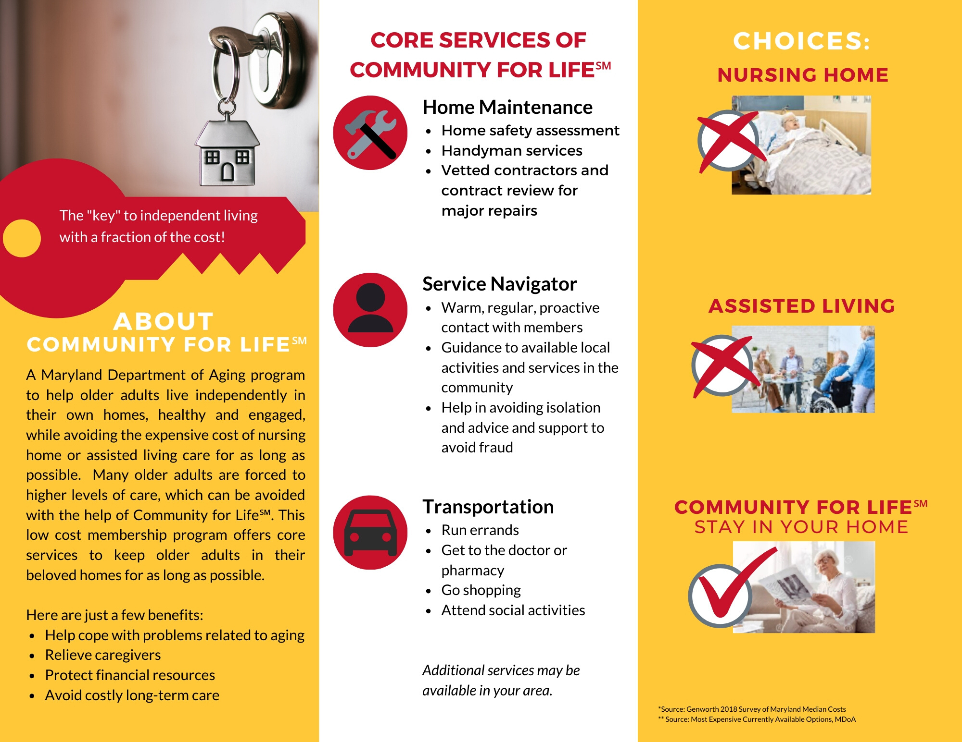
COST COMPARISON
Which would you prefer?
Your Monthly Cost*
(Semi-Private Room)
$9,231
Your Monthly Cost*
$4,673
Median Monthly Cost**
$85.00
*Source: Genworth 2018 Survey of Maryland Median Costs
**Source: Based on current available options, MDoA. Cost varies by CFL partner. (12/2019)
SM

Slide 10

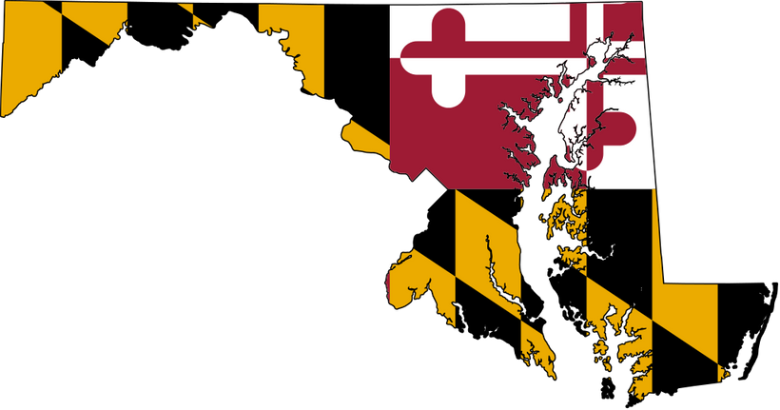
Community for LifeSM providing services in:
Allegany County
Anne Arundel County
Baltimore County
Baltimore City
Caroline County
Frederick County
Talbot County
Wicomico County
Worcester County
Washington County
Contact the Maryland Department of Aging to become a
CFLSM provider.

Slide 11

The "key" to at home independence
1-800-243-3425 aging.maryland.gov

