Slide 1



Slide 2


Slide 4
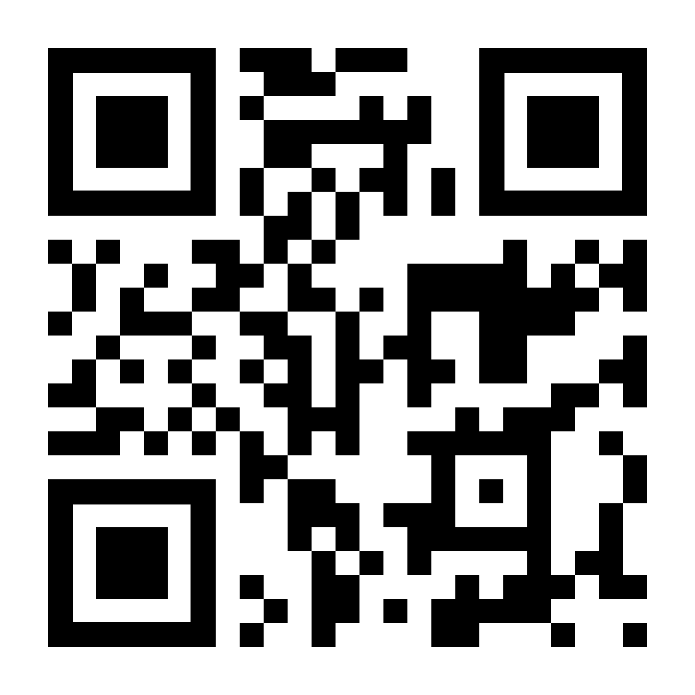

Thank you!
Name of Presenter
email address and phone number
Follow us on Social Media
facebook.com/MarylandAging
linkedin.com/company/maryland-department-of-aging
twitter.com/MarylandAging
instagram.com/marylandaging
LRM.Maryland.gov
Aging.Maryland.gov

Slide 5




Vision:
To transform institutions, systems, and norms so all older adults lead lives that are:
Healthy
Financially Secure
Socially Connected
Purposeful
For the 100-Year Lifespan

Slide 6



Longevity Ready Maryland
LRM.Maryland.gov
Maryland’s 10-year multisector plan for aging to address the challenges and maximize the benefits of an aging society.

Slide 7




Four Epic Goals
Build a longevity ecosystem
Create supportive and inclusive communities for all ages and abilities and build collective capacity at the local level.
Promote economic opportunity
Support a multi-generational workforce with opportunities for all ages and abilities while advancing Maryland’s economic competitiveness.
Prepare Marylanders to afford longevity
Improve economic security for the 100-year lifespan through affordable housing, financial literacy, and access to support services.
Optimize health, wellness, and mobility
Invest in programs that support healthier, more purposeful, and active lifestyles so Marylanders can enjoy longevity and reduce dependency.

Slide 8
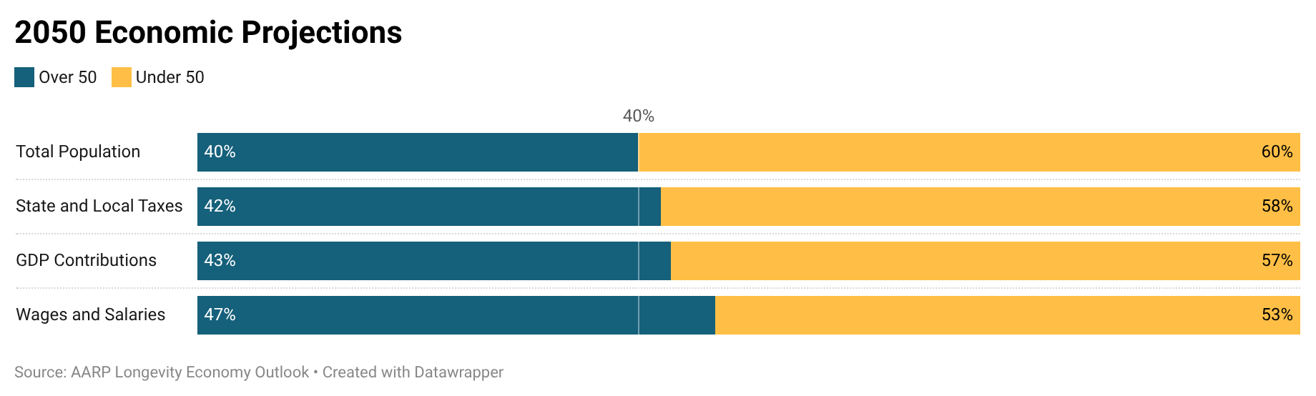
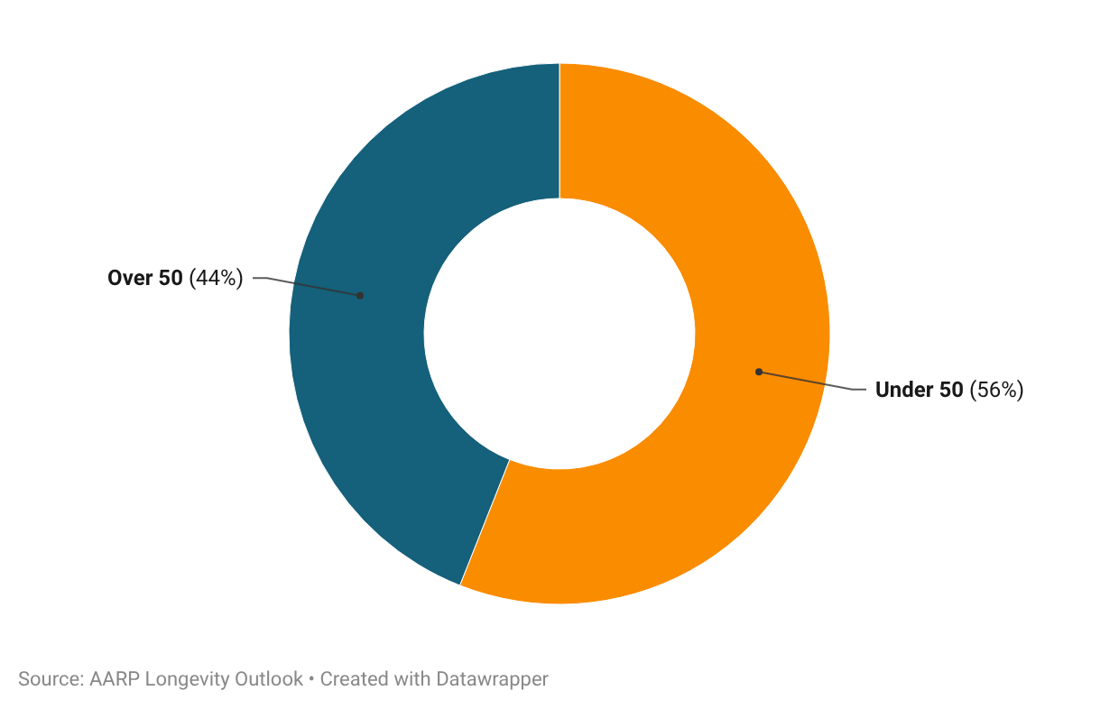
Economic Contributions
Maryland Needs Older Adults to Thrive
Jobs Supported
Notes:
. Employers can access resources and pledge their commitment through the Age Friendly Institute’s Certified Age Friendly Employer Program or the AARP Employer Alliance.

Slide 9

Older Adult Workers
A Critical Resource to a Multigenerational Workforce
Increased productivity
Stronger talent pipeline
Greater diversity
of skills and outlook
Better retention
of experience
and ability
Increased resilience
Better access
to multi-
skilled teams

Slide 11
Mission:

Slide 12

Role of MDOA
Callout in Red

Slide 13
Legislative Overview
Callout in yellow
Callout in orange
Callout in yellow
Callout in orange
Callout in yellow

Slide 14
LRM.Maryland.gov

Slide 16
Callout in Red

Slide 17
Callout in Yellow

